Slide 1


Slide 2
March 11, 2026

Slide 3
Introductions

Slide 4
Member Updates

Slide 5
Minutes

Slide 6
Treasurer’s Report

Slide 7

C.E.R.T Update

Slide 8
Euless ARC Gatherings
ERBC – Every Friday, @ 0830
Texan Kitchen 415 N Main, Euless, TX 76039
H‑E‑B Joint Radio Club Breakfast, every 3rd Saturday, Egg Haven Cafe, 760 Airport Fwy, Suite 100, Hurst, RSVP by midnight Thursday
Club Social – Monday, March 16, 1800 – 1900
Spring Creek BBQ – 1509 Airport Fwy, Bedford, 76021
Weekly Tue Club net – 7pm

Slide 9
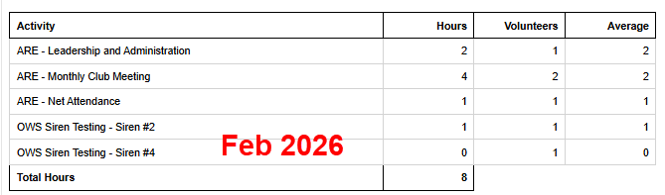
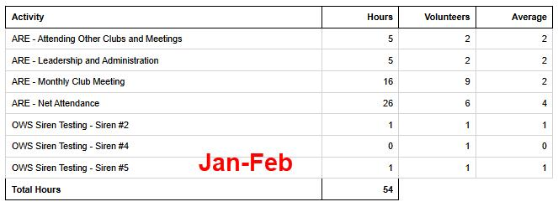
2025 Hours

Slide 10
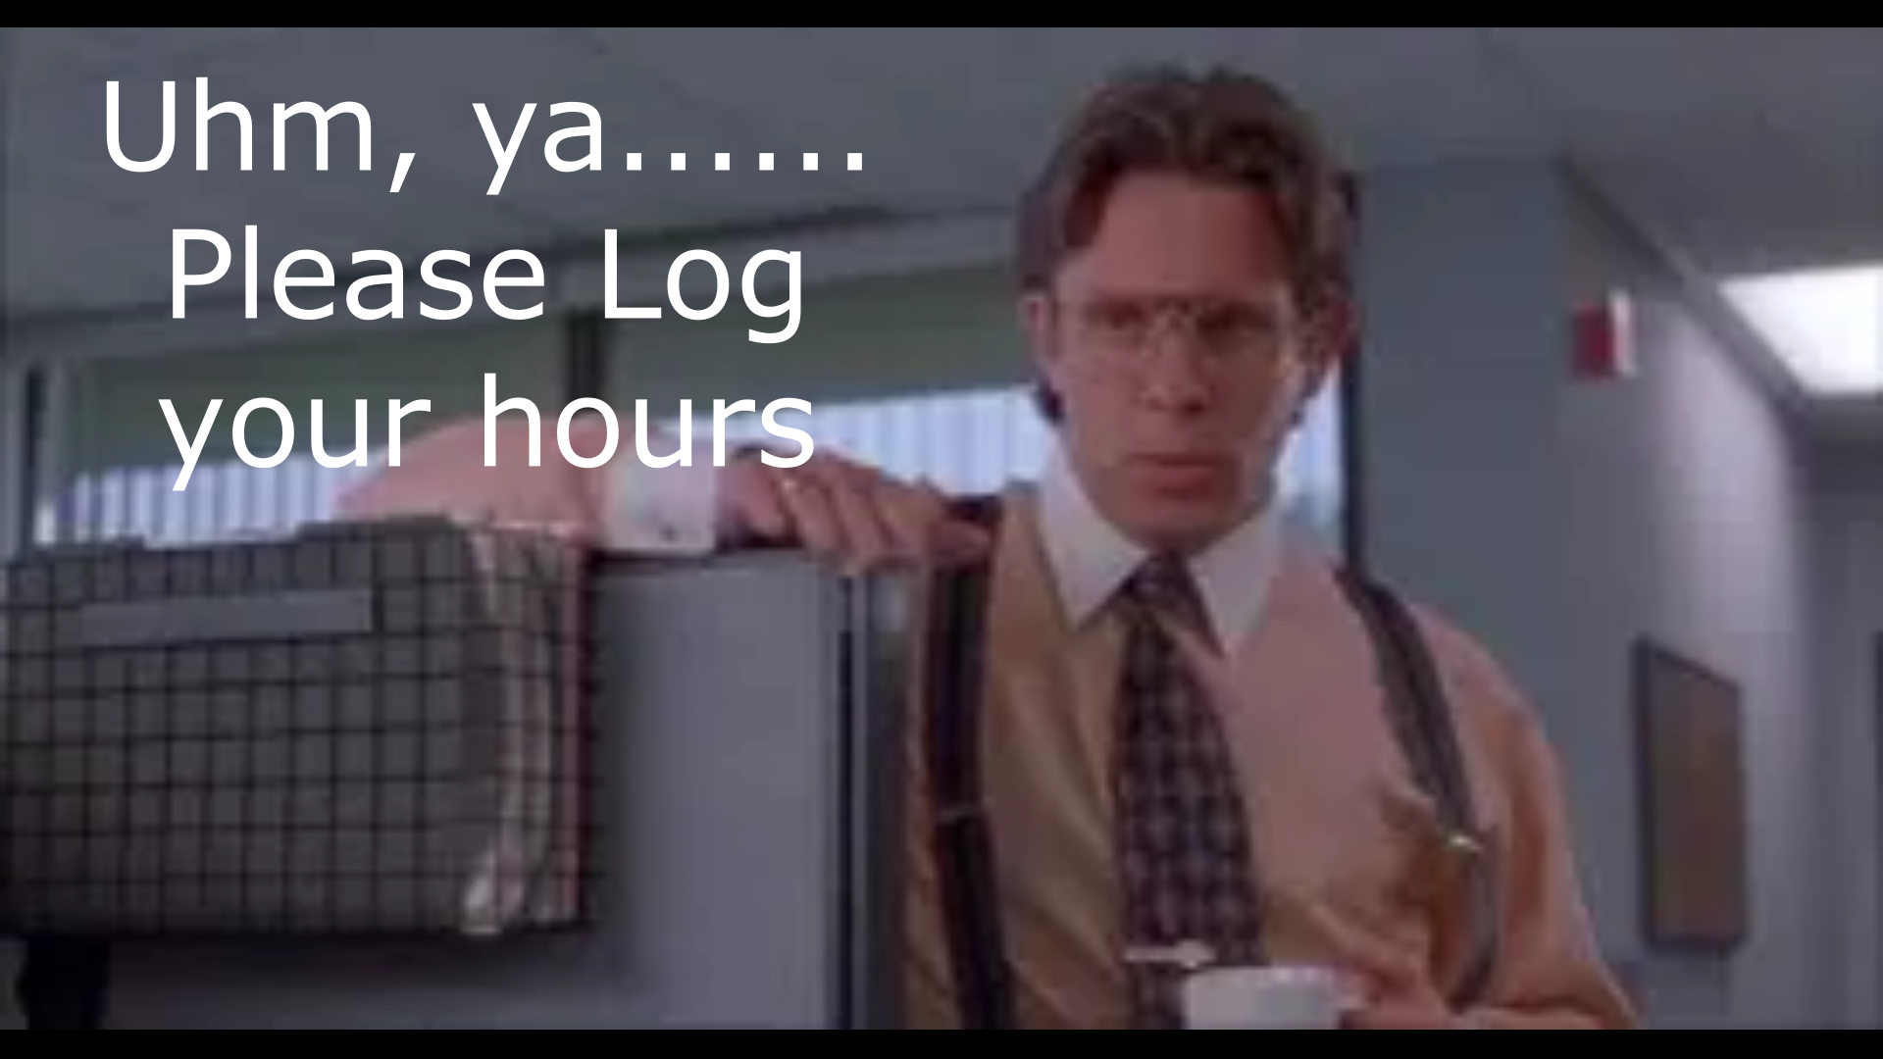
Please log your hours.

Slide 11

Planning
Dates – Times?

Slide 12
Up Coming Events/Notes
Sky Warn Class – In Person
Wednesday, March 4 , 6pm
Colleyville Center***Reschedule???
Monthly Club Simplex Net – as Needed
North Central TX Simplex Net – Fri 2000 146.580
Ham Fest Irving
Saturday, March 7 Report???

Slide 13
-Upcoming Events cont’d
Euless Police Banquet
Friday, February 20, 6pm
Texas Star
Texans on Mission – Wild Camp
March 13 -15, Latham Springs
POTA – Fort Richardson St Park
April 16 -19
TX Emergency Management Conference
May 26-29
Volunteer Signups Emailed today

Slide 14

Radio Club Communications plan
W5eul.com/sitemap-Anyone look?
What are you up to and what’s your goals?
Data HF / Dual Report
James – GMRS – Repeaters? Radios program
David Burkholder
“You have power over your mind & actions-not outside events.
Realize this and you will find strength”
Marcus Aurelius

Slide 15
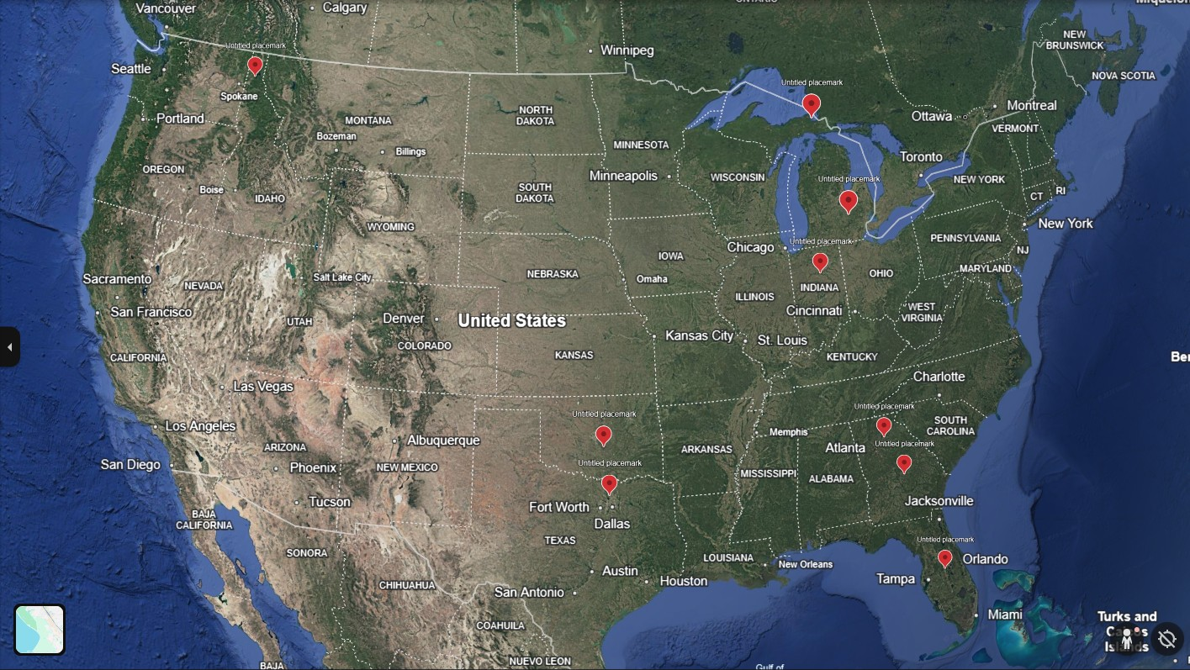
National Bulletin Distribution Net

Slide 16
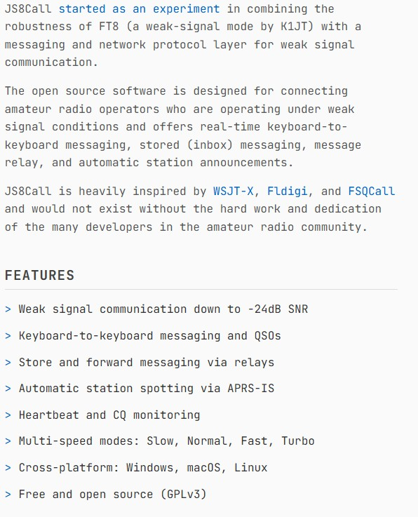

Slide 17
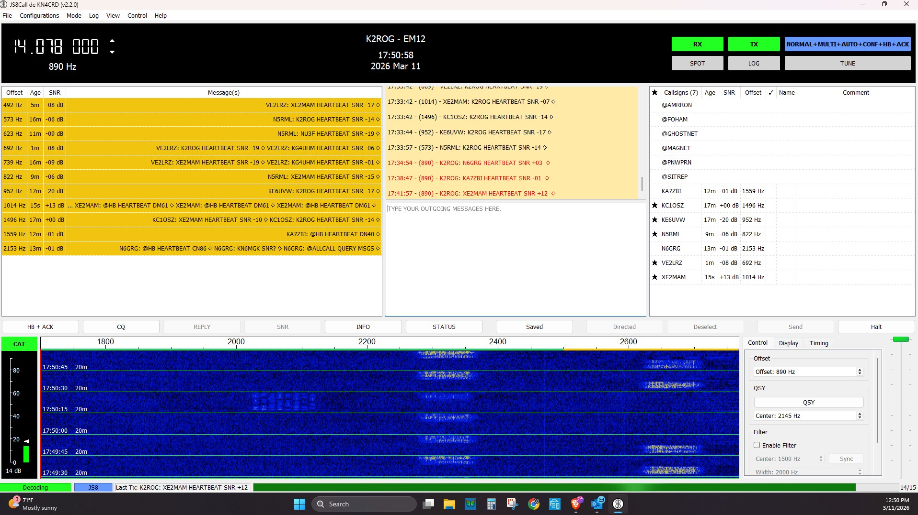

Slide 18
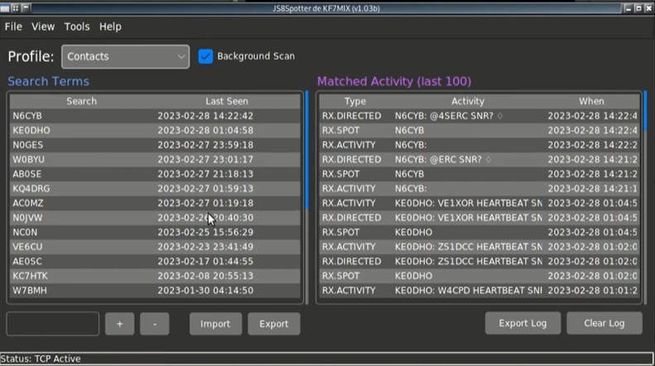

Slide 19
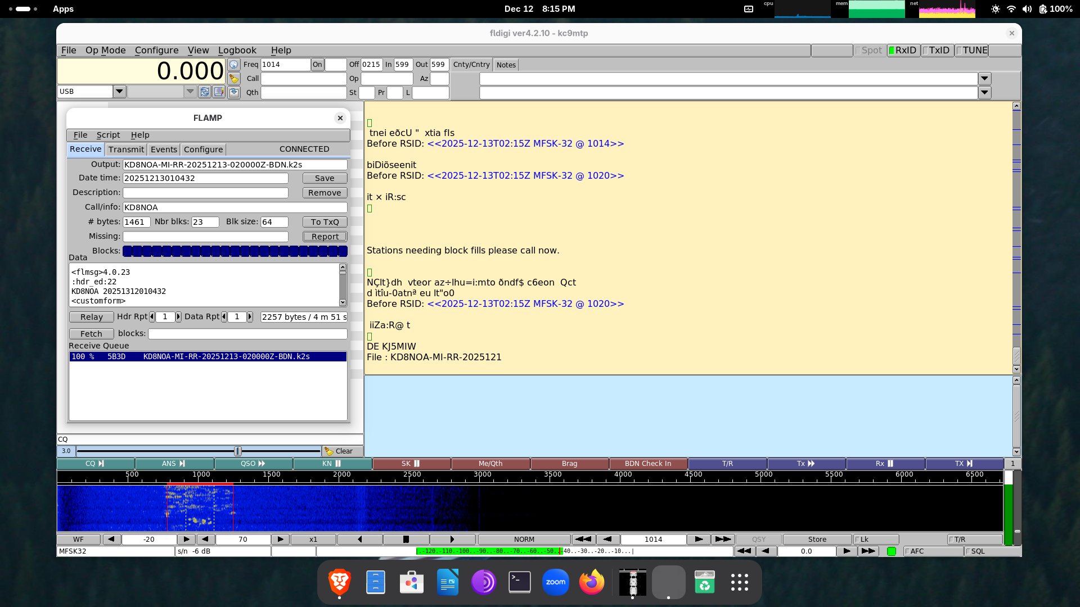

Slide 20
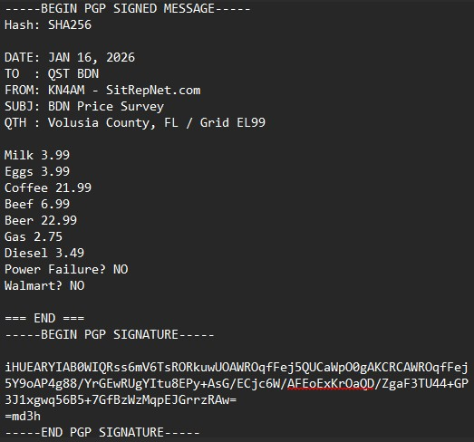
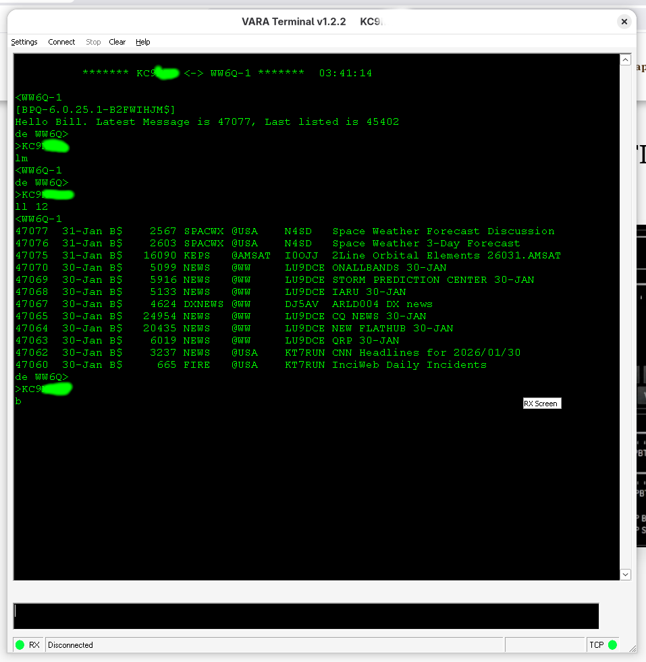
JS8Spotter Forms
Moving into VARA BBS

Slide 21
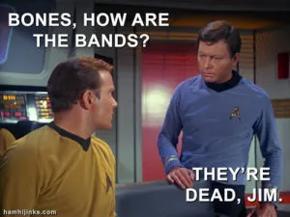

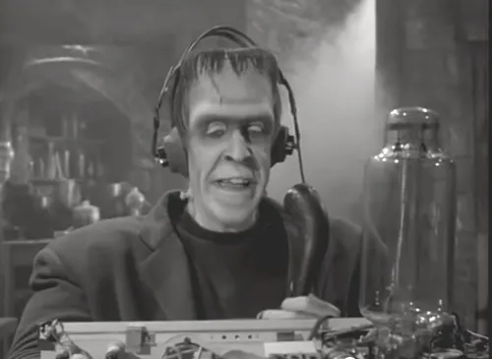
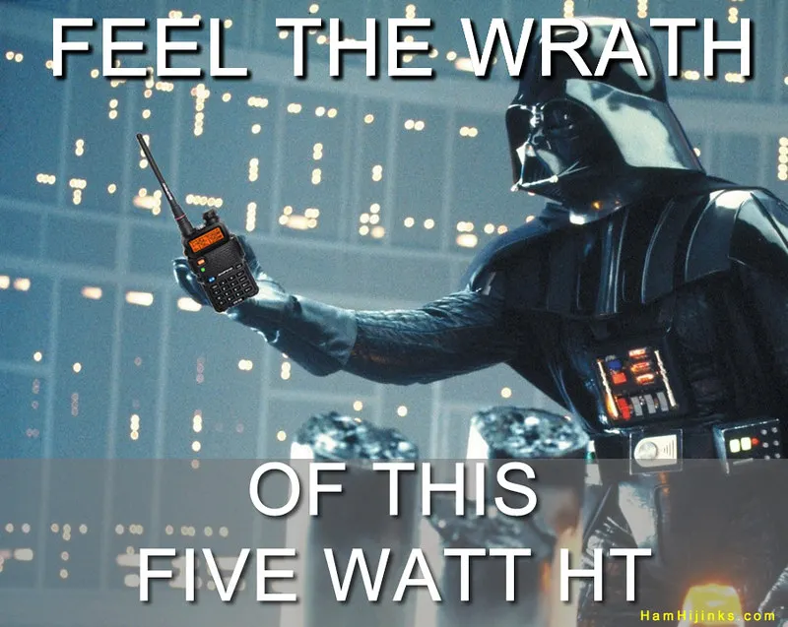
Greg
Kevin
Chris
Members

