Slide 1


Slide 2
June 10, 2026

Slide 3
Introductions

Slide 4
Member Updates

Slide 5
Minutes

Slide 6
Treasurer’s Report

Slide 7

C.E.R.T Update

Slide 8
Euless ARC Gatherings
ERBC – Every Friday, @ 0830
Texan Kitchen 415 N Main, Euless, TX 76039
H‑E‑B Joint Radio Club Breakfast, every 3rd Saturday, Egg Haven Cafe, 760 Airport Fwy, Suite 100, Hurst, RSVP by midnight Thursday
Club Social – Monday,June 15, 1800 – 1900
Outback Steak – 2601 State Hwy 121, Euless 76039
Weekly Tue Club net – 7pm

Slide 9
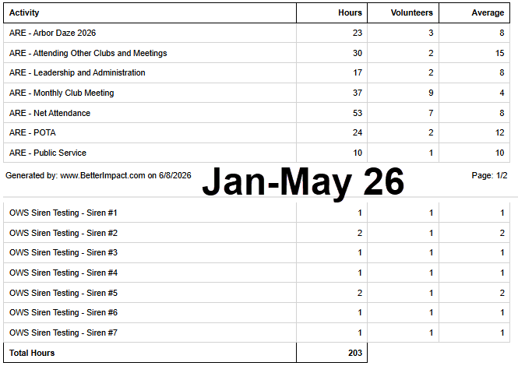
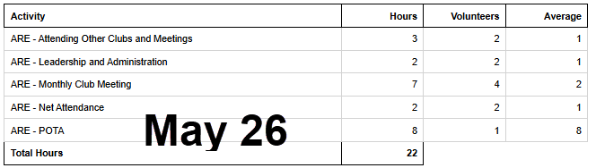
2026 Hours

Slide 10
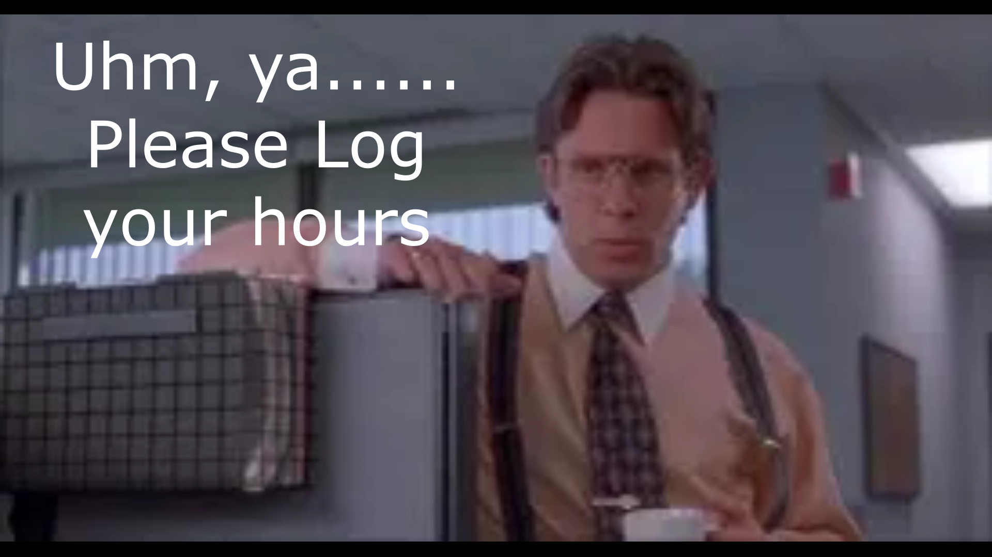
Please log your hours.

Slide 11

Planning
Dates – Times

Slide 12
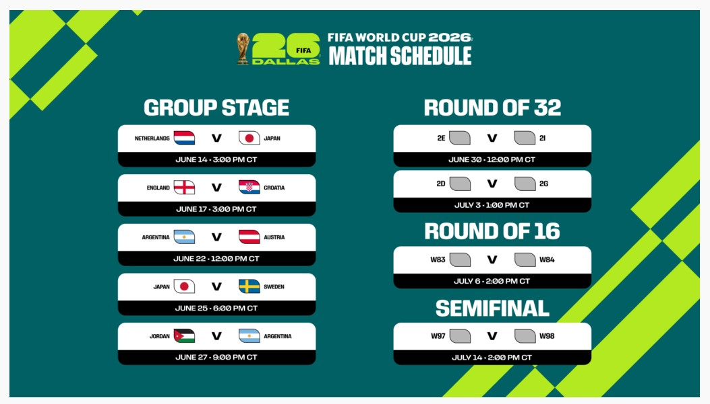
https://www.wc2026ses.org/
Special Events Stations

Slide 13
Up Coming Events/Notes
Weekly Club Net Tue 7pm– New NC
North Central TX Sx Net – Fri 8pm 146.580
White Rock Lake ARC Wed SxNet 7pm 147.520
EWFO National BDN – Fri 8pm FLDIGI-FLAMP 7.121(1000)
DFW Ham Expo (DARC+LARC) Jun 12-13 NTX Arena, Vista Mall
Former Mayor Linda Martin Fire Admin Bldg Dedication, Sat Jun 27, 10am
AARL Field Day, Saturday Jun 27
12 noon CST Jun 27 – 3pm CST Jun 28
Planning

Slide 14

Radio Club Communications plan
W5eul.com/sitemap-Anyone look?
David Burkholder K4JLM
Grants Update
Dewey Walker KI5UWK
BridgeCOM –DMR/Analog Repeater Quote
“You have power over your mind & actions-not outside events.
Realize this and you will find strength”
Marcus Aurelius

Slide 15
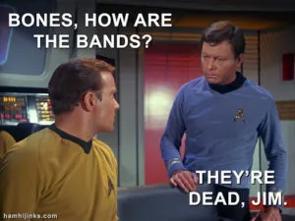

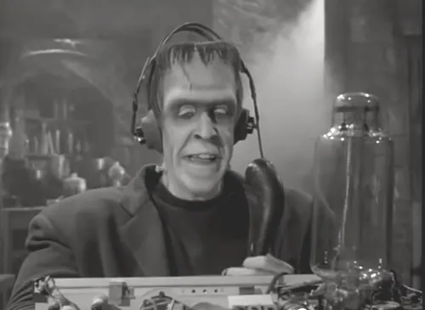
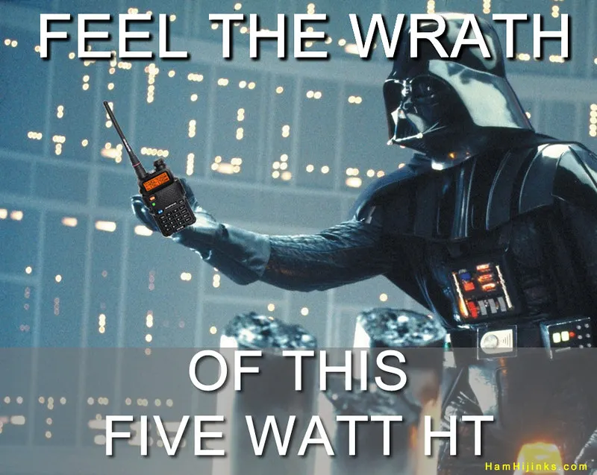
Greg
Kevin
Chris
Members

