Slide 1


Slide 2
January 14, 2026

Slide 3
Introductions

Slide 4
Member Updates

Slide 5
Minutes

Slide 6
Treasurer’s Report
Audit Committee
-Volunteers for Feb, 11 630pm before meeting

Slide 7

C.E.R.T Update

Slide 8
Euless ARC Gatherings
ERBC – Every Friday, @ 0830
Texan Kitchen 415 N Main, Euless, TX 76039
H‑E‑B Joint Radio Club Breakfast, every 3rd Saturday, Egg Haven Cafe, 760 Airport Fwy, Suite 100, Hurst, RSVP by midnight Thursday
Club Social – Monday, January 19, 1800 – 1900
    54th St, 2201 State Hwy 121, Euless, TX 76039

Slide 9
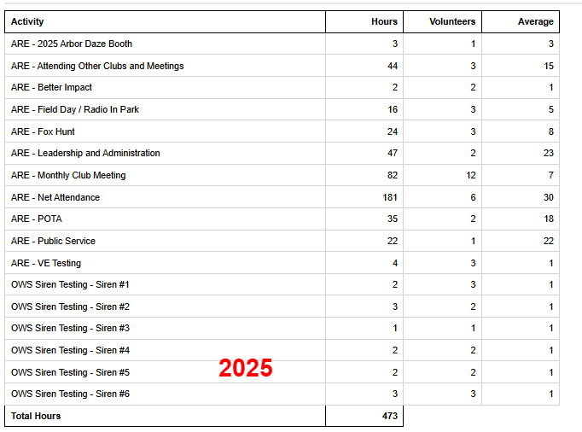
2025 Hours

Slide 10
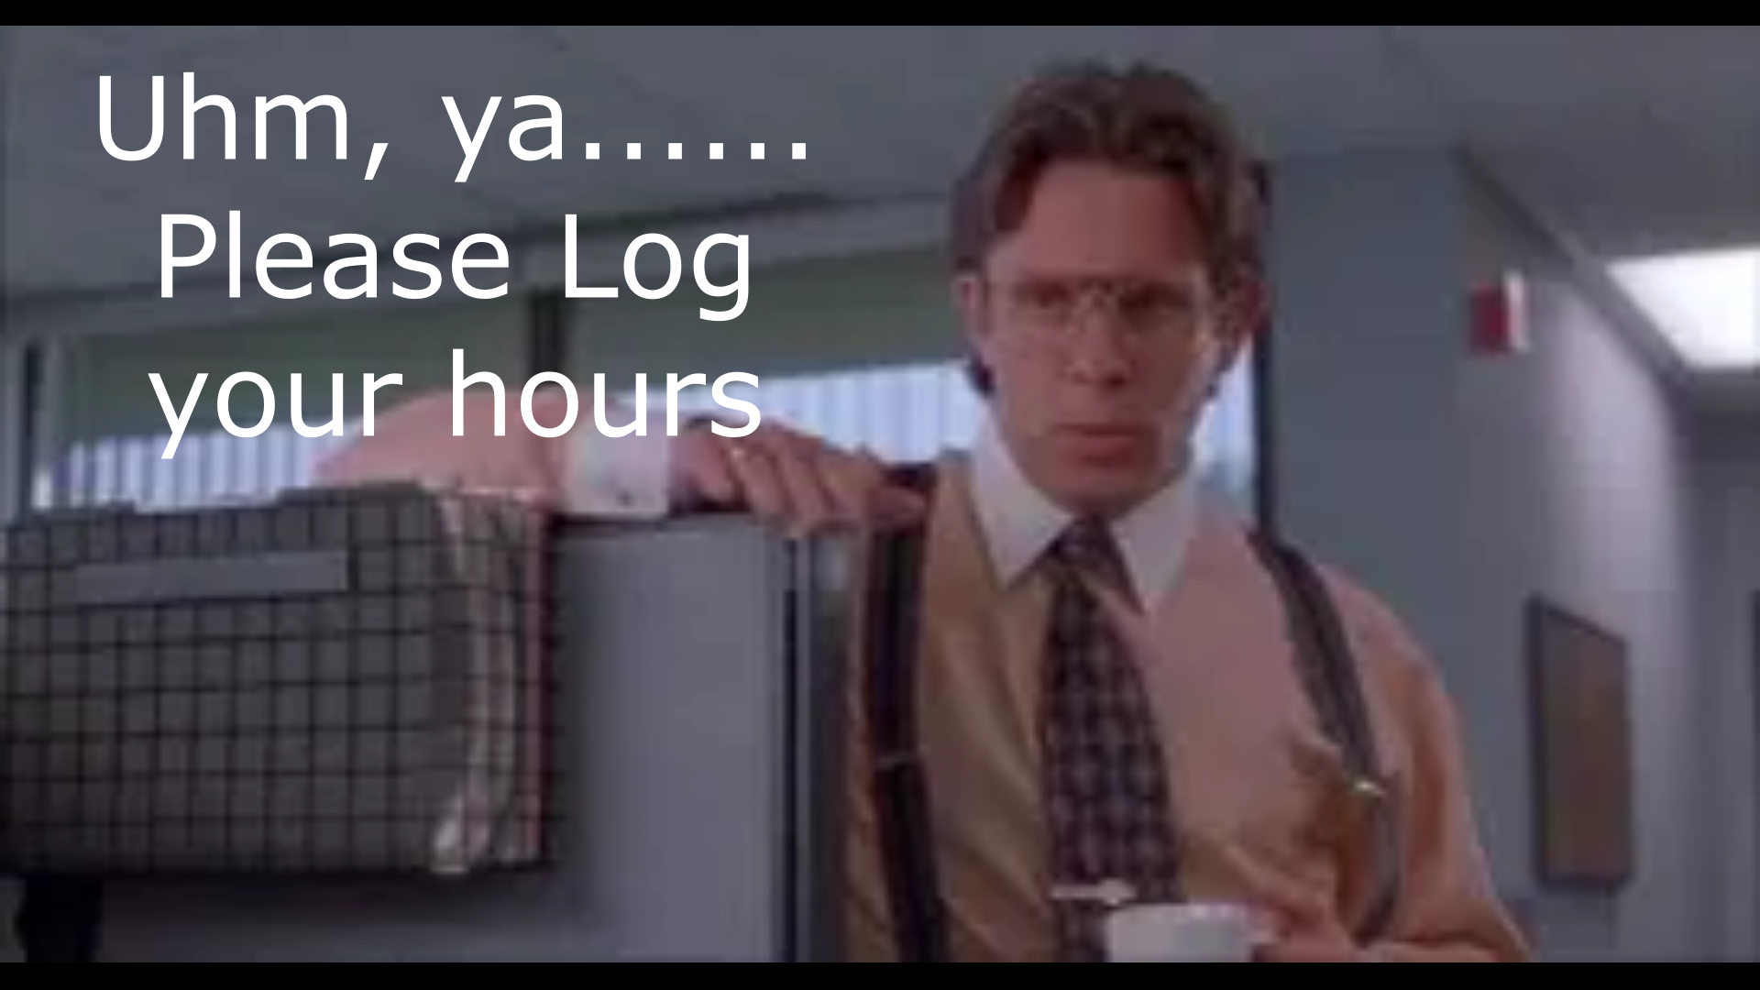
Please log your hours.

Slide 11

Planning
Or Any other Ideas for Us?

Slide 12
Up Coming Events/Notes
Sky Warn Class – In Person
Sat, Jan 31. 9am
Forrest Hill Convention Center
Tue Night Club Net moved to 7pm
Month Club Simplex Net - Suggestions
North Central TX Simplex Net – Fri 2000 146.580

Slide 13
-Ham Happenings?
Ideas for Upcoming year?
Presentation
KI5UWK & K2ROG
Data, FT8, JS8call

Slide 14
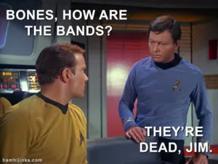
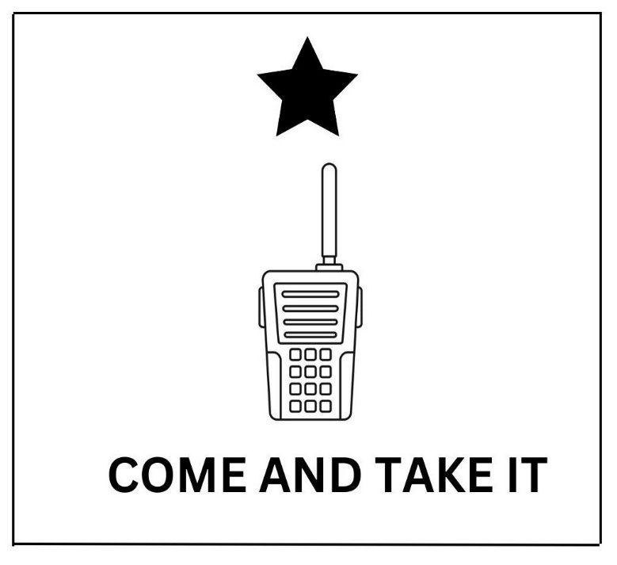
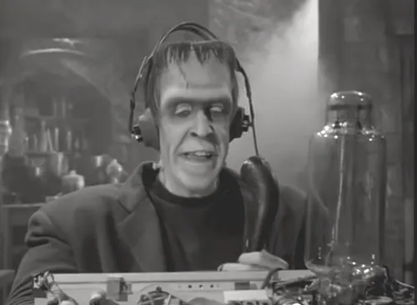
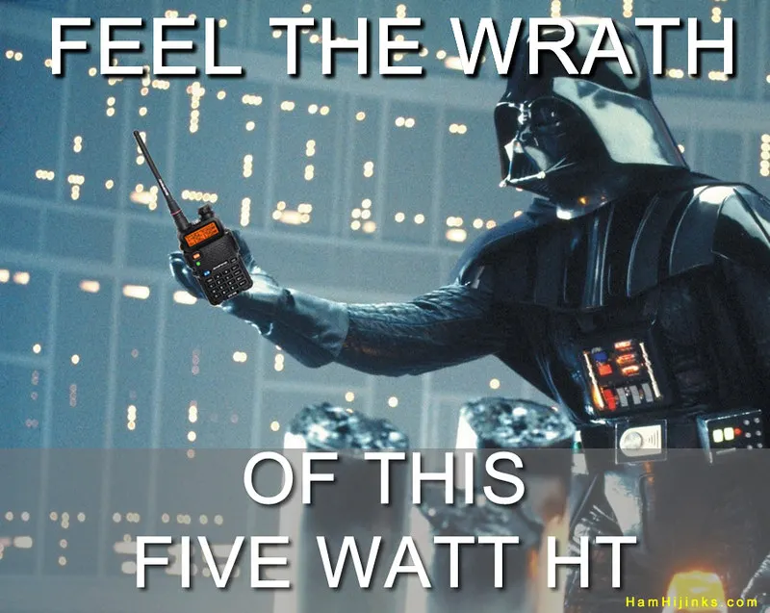
Greg
Kevin
Chris
Members

