Slide 1


Slide 2
February 11, 2026

Slide 3
Introductions

Slide 4
Member Updates

Slide 5
Minutes

Slide 6
Treasurer’s Report
Audit Committee
-Volunteers for Feb, 11 630pm before meeting

Slide 7

C.E.R.T Update

Slide 8
Euless ARC Gatherings
ERBC – Every Friday, @ 0830
Texan Kitchen 415 N Main, Euless, TX 76039
H‑E‑B Joint Radio Club Breakfast, every 3rd Saturday, Egg Haven Cafe, 760 Airport Fwy, Suite 100, Hurst, RSVP by midnight Thursday
Club Social – Monday, Feb 16, 1800 – 1900
2910 Rio Grande Blvd
Weekly Tue Club net – 7pm

Slide 9
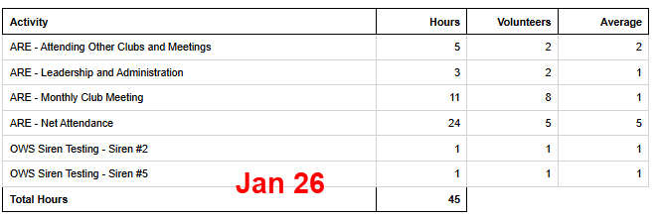
2025 Hours

Slide 10

Winter Weather Welfare Net
Jan 23 –Jan 27
*25 Independent Check-ins!
Winter Field Day
Jan 25-Jan 26
FT8- 7
JS8- 3
40M - 3
20M - 10
15M - 7
10M - 3

Slide 11
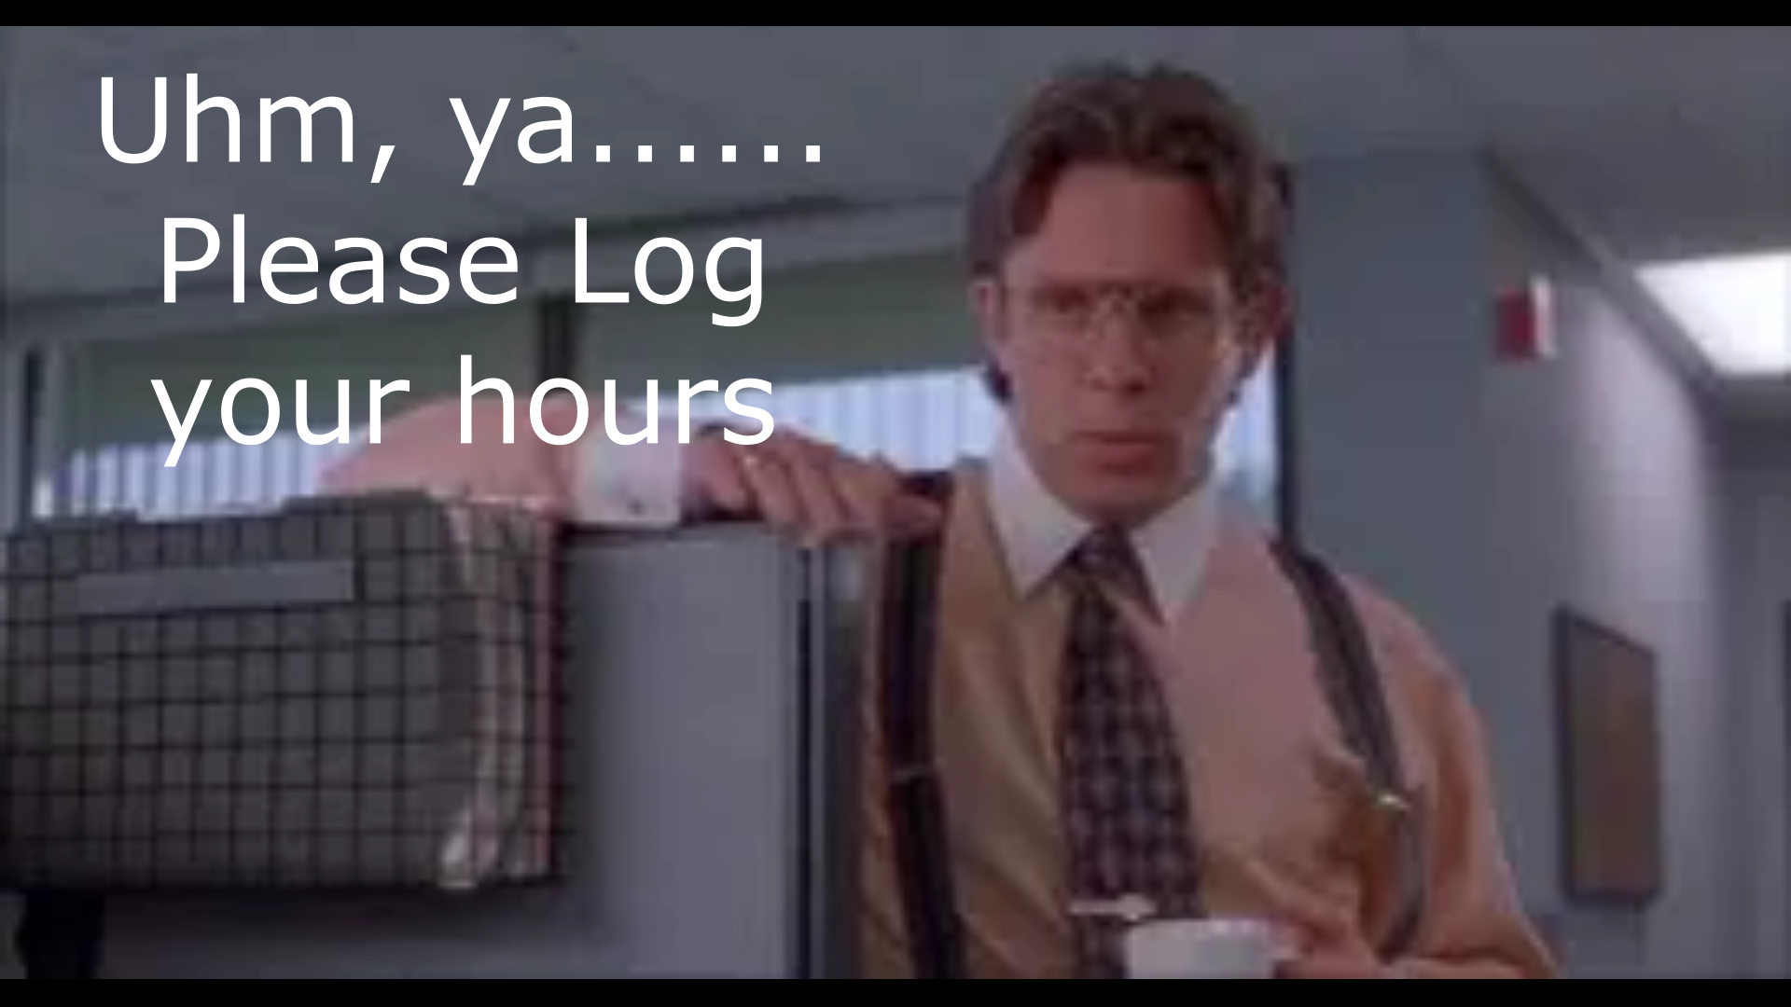
Please log your hours.

Slide 12

Planning
Dates – Times?

Slide 13
Up Coming Events/Notes
Sky Warn Class – In Person
Wednesday, March 4 , 6pm
Colleyville Center
Monthly Club Simplex Net – as Needed
North Central TX Simplex Net – Fri 2000 146.580
Ham Fest Irving
Saturday, March 7

Slide 14
-Upcoming Events cont’d
Euless Police Banquet
Friday, February 20, 6pm
Texas Star
Texans on Mission – Wild Camp
March 13 -15, Latham Springs
POTA – Fort Richardson St Park
April 16 -19
TX Emergency Management Conference
May 26-29
Volunteer Signups starting soon

Slide 15
Radio Club Communications plan
W5eul.com/sitemap
Special Recognition of Club Members
“Changing the propagation on their own”
“You have power over your mind-not outside events.
Realize this and you will find strength”
Marcus Aurelius

Slide 16
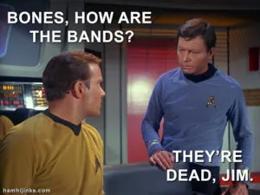

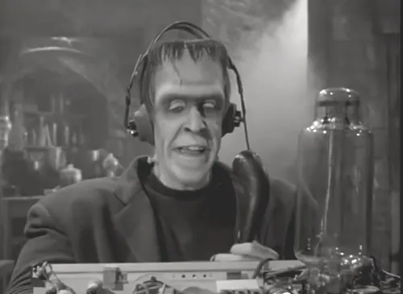
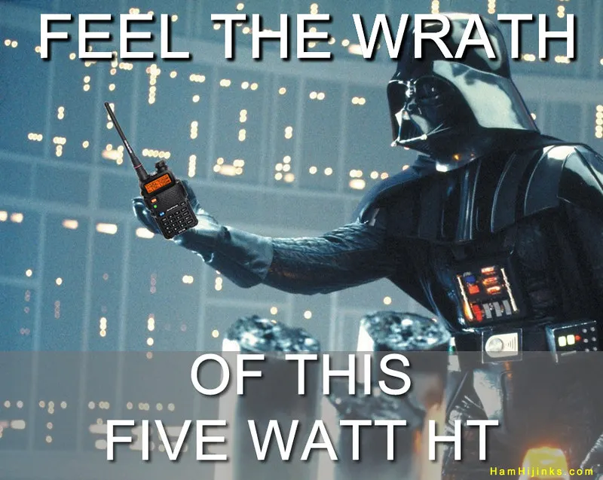
Greg
Kevin
Chris
Members

