Slide 1


Slide 2
April 8, 2026

Slide 3
Introductions

Slide 4
Member Updates

Slide 5
Minutes

Slide 6
Treasurer’s Report

Slide 7

C.E.R.T Update

Slide 8
Euless ARC Gatherings
ERBC – Every Friday, @ 0830
Texan Kitchen 415 N Main, Euless, TX 76039
H‑E‑B Joint Radio Club Breakfast, every 3rd Saturday, Egg Haven Cafe, 760 Airport Fwy, Suite 100, Hurst, RSVP by midnight Thursday
Club Social – Monday, April 20, 1800 – 1900
Panera Bread– 2911 State Hwy 121, Euless 76039
Weekly Tue Club net – 7pm

Slide 9
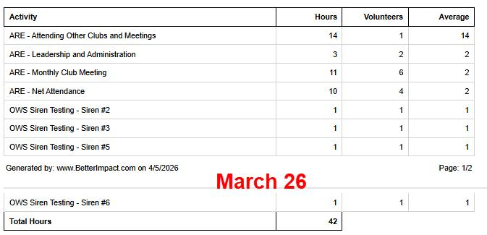
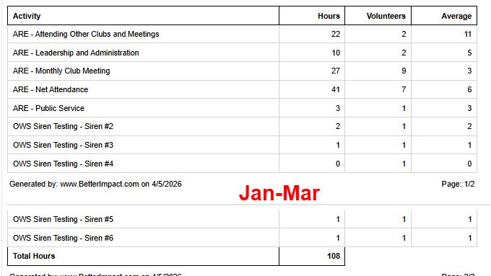
2025 Hours

Slide 10
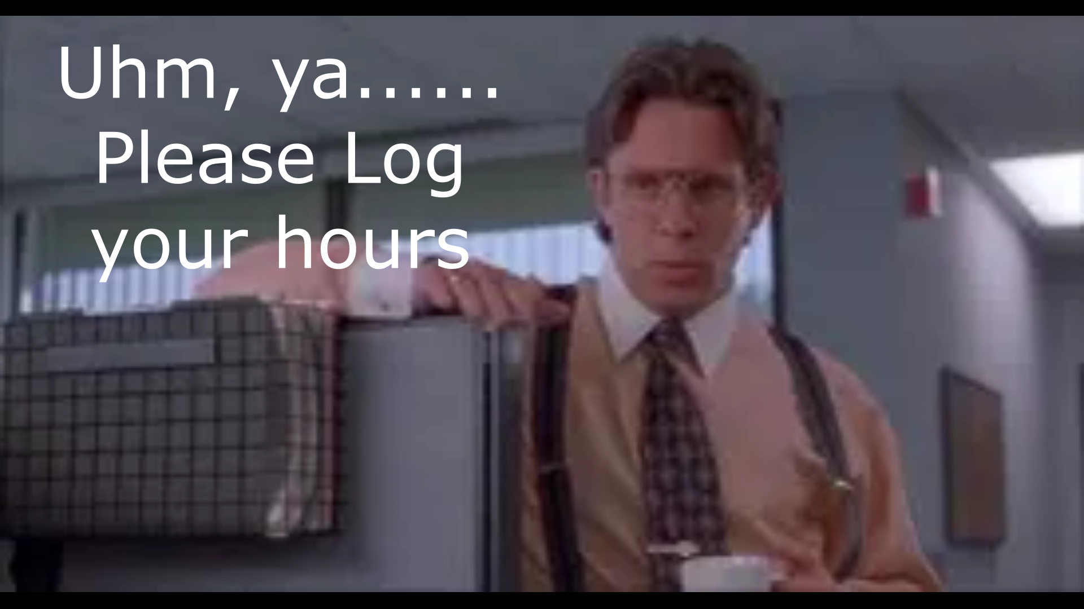
Please log your hours.

Slide 11

Planning
Dates – Times?

Slide 12
Up Coming Events/Notes
Sky Warn Class – In Person
Wednesday, March 4 , 6pm
Colleyville Center***Reschedule???
Weekly Club Net – 11 Checkins last Tue
No Central TX Sx Net – Fri 2000 146.580- 85 Checkins
World Cup Special Event Station W5C-Joe Wigner

Slide 13
-Upcoming Events cont’d
Texans on Mission – Wild Camp Recap
POTA – Fort Richardson St Park -April 16 -19
Arbor Days- April 25
DoD/MARS Armed Forces Day Event- May 9
TX Emergency Management Conference-May 26-29

Slide 14

Radio Club Communications plan
W5eul.com/sitemap-Anyone look?
David Burkholder K4JLM
Dewey Walker KI5UWK - HAMCLOCK
“You have power over your mind & actions-not outside events.
Realize this and you will find strength”
Marcus Aurelius

Slide 15
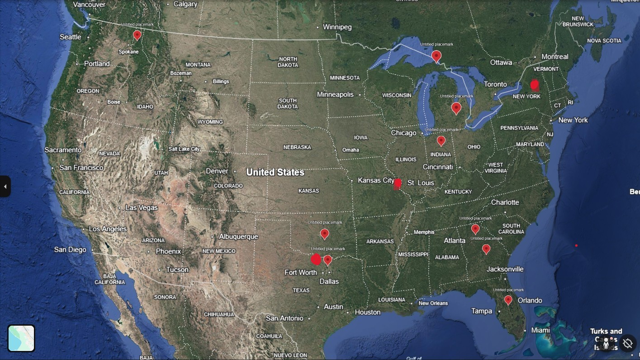
National Bulletin Distribution Net

Slide 16
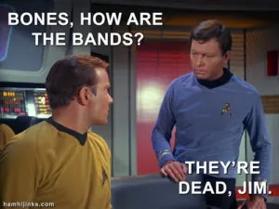

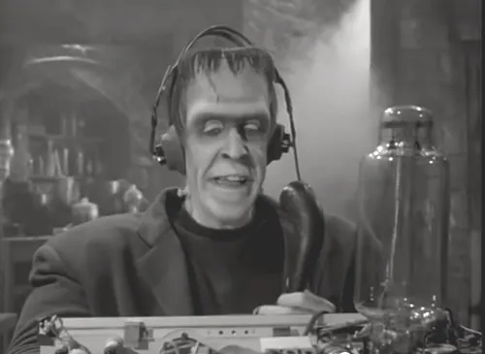
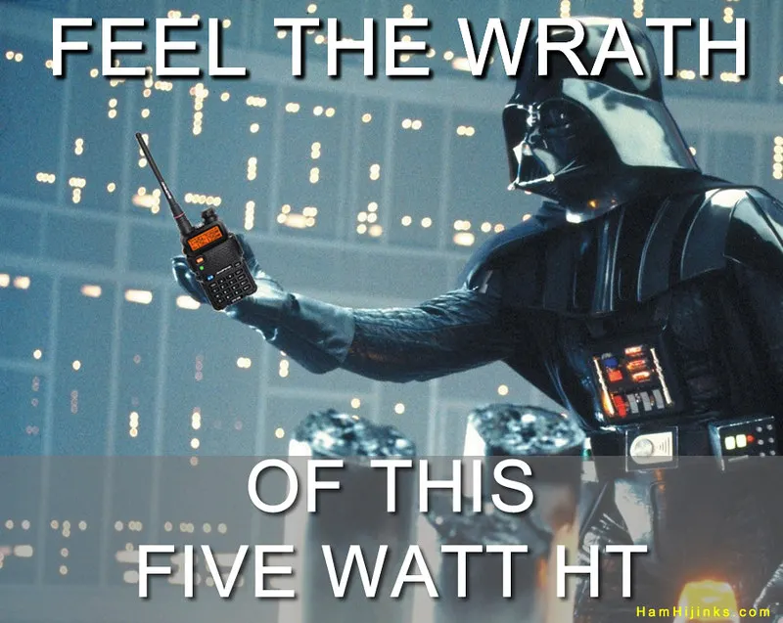
Greg
Kevin
Chris
Members

