Slide 1


Slide 2
September 10, 2025

Slide 3
Introductions

Slide 4
Member Updates

Slide 5
Minutes

Slide 6
Treasurer’s Report

Slide 7

C.E.R.T Update

Slide 8
-Ham Happenings
TriCounty ARC needs Volunteers Sept 20 for Trek 100 Bike Ride
-Speakers Upcoming
October – Satelite Comms
November – WinkLink &
TX Vanguard Sabers

Slide 9
Euless ARC Gatherings
ERBC – Every Friday, @ 0830
Texan Kitchen 415 N Main, Euless, TX 76039
H‑E‑B Joint Radio Club Breakfast, every 3rd Saturday, Egg Haven Cafe, 760 Airport Fwy, Suite 100, Hurst, RSVP by midnight Thursday
Club Social – Monday,Septe,ber 15, 1800 – 1900
    Lazy Dog
    2521 St Hwy Euless, Euless 76039

Slide 10
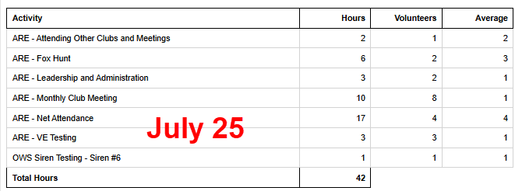
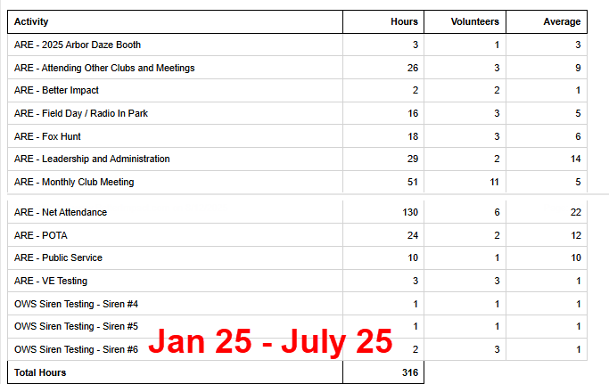
2025 Hours

Slide 11
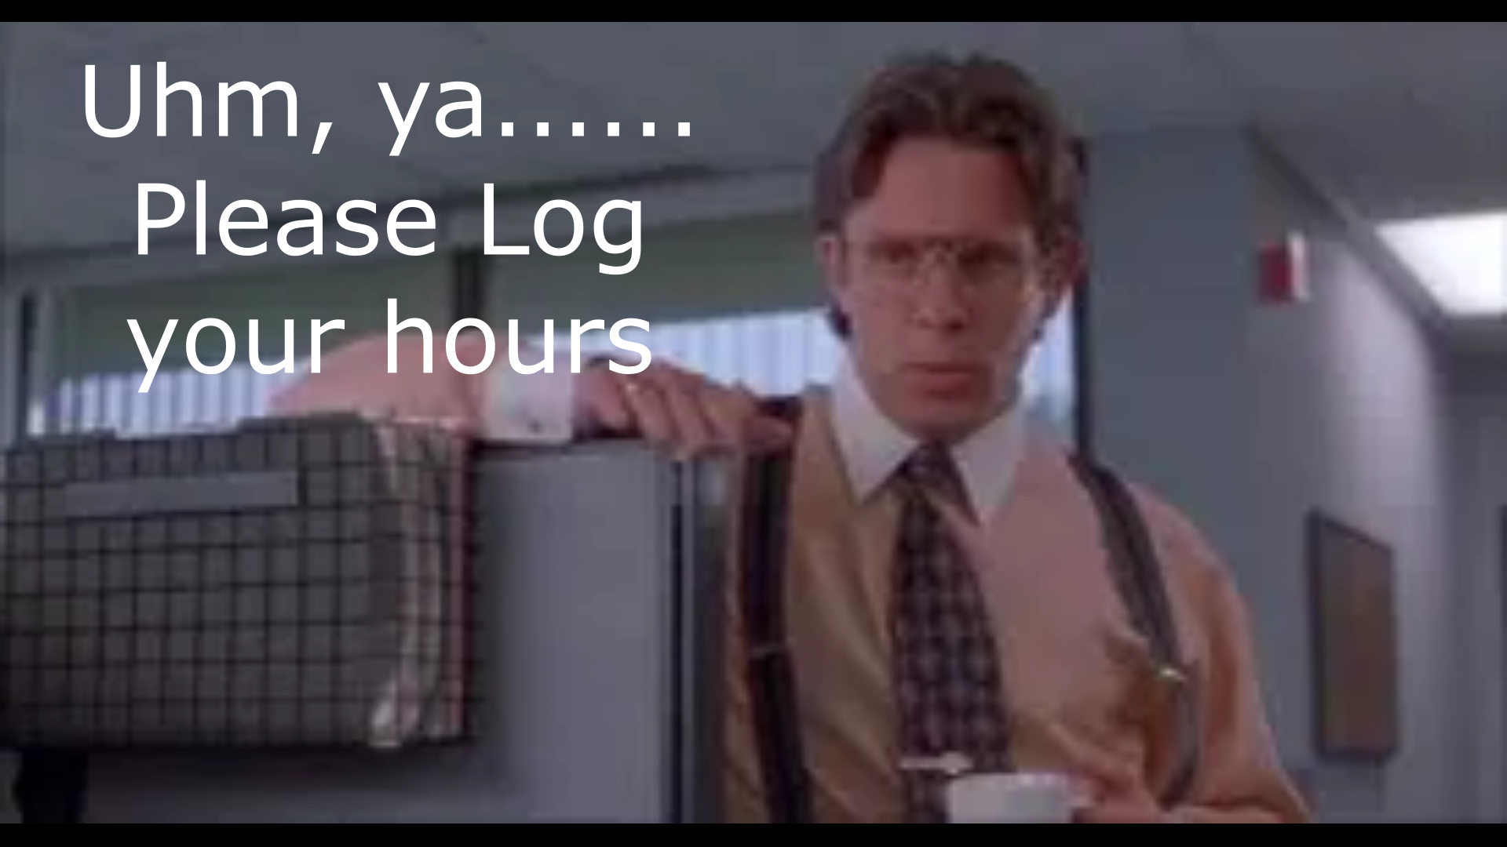
Please log your hours.

Slide 12

Planning

Slide 13
Up Coming Events
Oct 4 City Open House-Booth
Oct 23-26 POTA –Eisenhower State Park

Slide 14

Greg
Kevin
Chris
Members

Slide 15
Presentation
programming your
Baofeng
Bob Ballard KG5SQJ

