Slide 1


Slide 2
November 12, 2025

Slide 3
Introductions

Slide 4
Member Updates

Slide 5
Minutes

Slide 6
Treasurer’s Report

Slide 7

C.E.R.T Update

Slide 8
Euless ARC Gatherings
ERBC – Every Friday, @ 0830
Texan Kitchen 415 N Main, Euless, TX 76039
H‑E‑B Joint Radio Club Breakfast, every 3rd Saturday, Egg Haven Cafe, 760 Airport Fwy, Suite 100, Hurst, RSVP by midnight Thursday
Club Social – Monday, October 17, 1800 – 1900
    IHOP – 2309 W Aiport Fwy, Euless, 76040

Slide 9
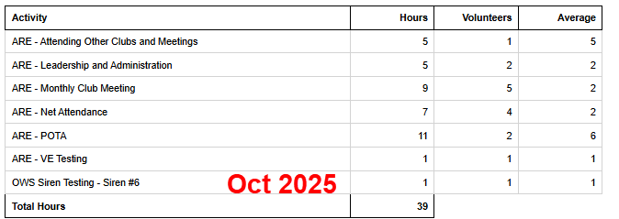
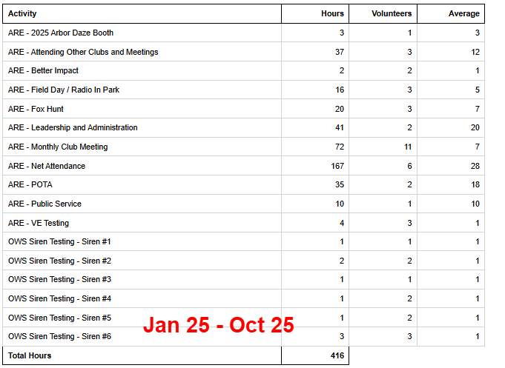
2025 Hours

Slide 10
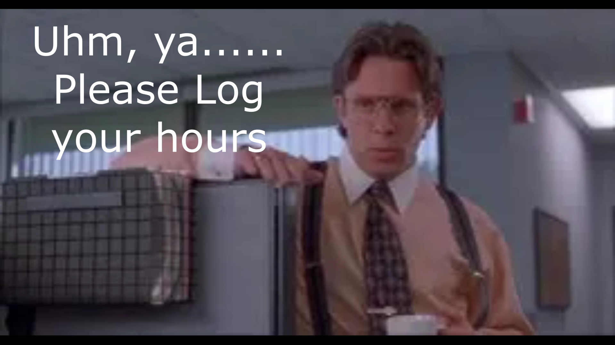
Please log your hours.

Slide 11

Planning
November 2, 8am

Slide 12
Up Coming Events
Dec 6 – Euless Parade of Lights
EARC Christmas Party – Dec 10, 2025

Slide 13
-Ham Happenings
Year in Review
Ideas – Tue Net – Simplex Net
-Upcoming year
Elections!!!!

Slide 14

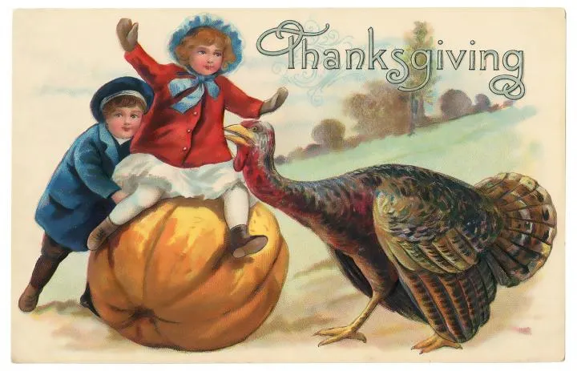

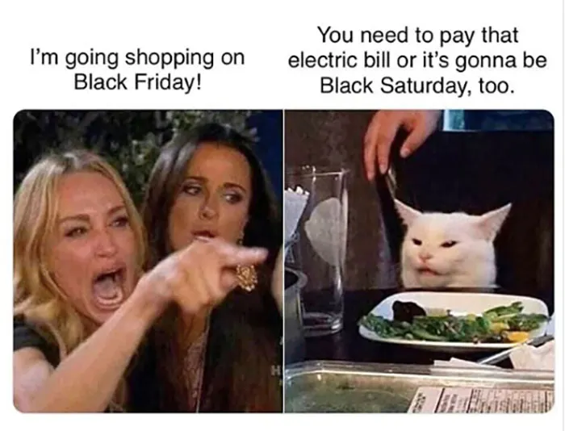
Greg
Kevin
Chris
Members

