Slide 1


Slide 2
May 14, 2025

Slide 3
Introductions

Slide 4
Member Updates

Slide 5
Minutes

Slide 6
Treasurer’s Report

Slide 7

C.E.R.T Update

Slide 8
Ham Happenings
????

Slide 9
Euless ARC Gatherings
ERBC – Every Friday, @ 0830
Texan Kitchen 415 N Main, Euless, TX 76039
H‑E‑B Joint Radio Club Breakfast, every 3rd Saturday, Egg Haven Cafe, 760 Airport Fwy, Suite 100, Hurst, RSVP by midnight Thursday
Club Social – Monday, May 19, 1800 – 1900
    The Reserve
    1310 Chisholm Trail #100, Euless, TX

Slide 10
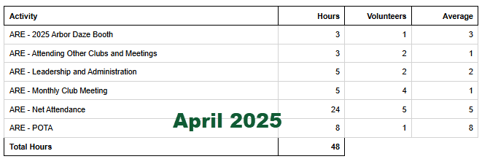
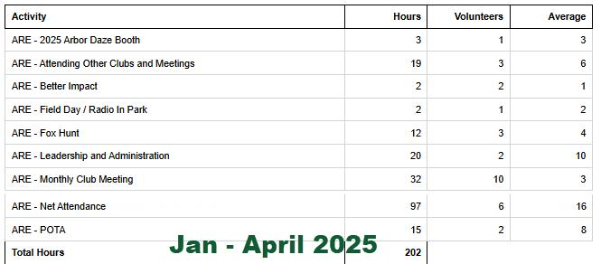
2025 Hours

Slide 11
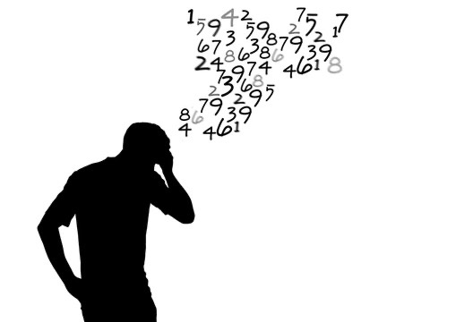
Please log your hours.

Slide 12

Planning

Slide 13
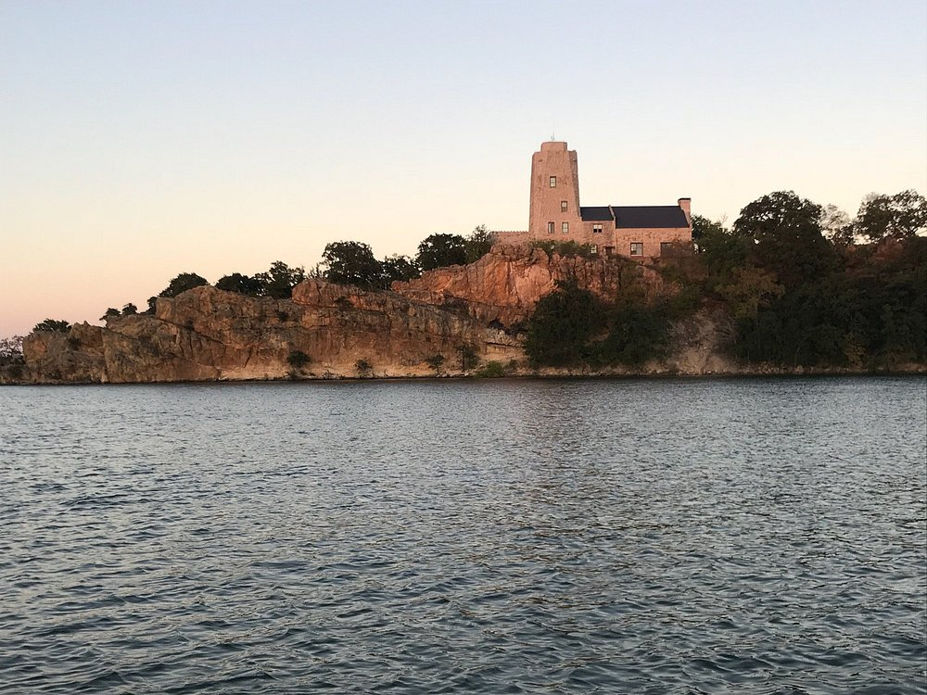
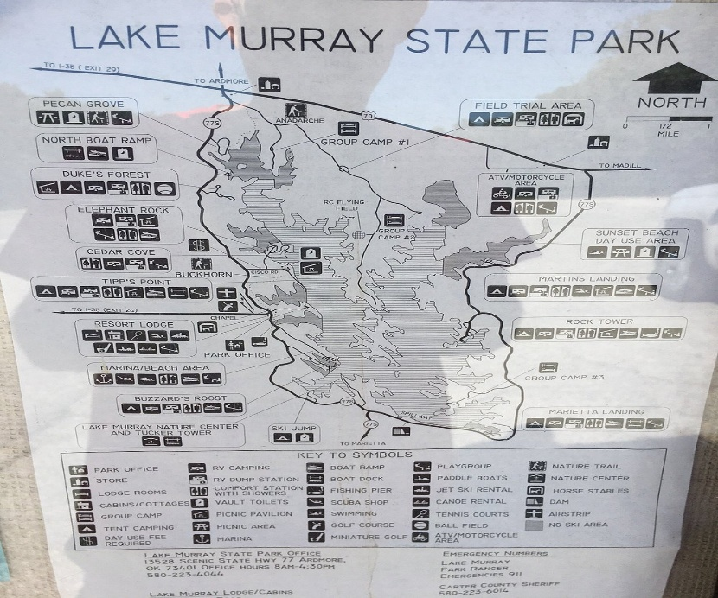
Lake Murray State Park
Ardmore, OK
May 31, June, 7,8,9 or 29??

Slide 14

Field Day
June 28-29

Slide 15

Audit Committee for 2025

Slide 16

Greg
Kevin
Chris
Members

