Slide 1


Slide 2
June 11, 2025

Slide 3
Introductions

Slide 4
Member Updates

Slide 5
Minutes

Slide 6
Treasurer’s Report

Slide 7

C.E.R.T Update

Slide 8
Ham Happenings
????

Slide 9
Euless ARC Gatherings
ERBC – Every Friday, @ 0830
Texan Kitchen 415 N Main, Euless, TX 76039
H‑E‑B Joint Radio Club Breakfast, every 3rd Saturday, Egg Haven Cafe, 760 Airport Fwy, Suite 100, Hurst, RSVP by midnight Thursday
Club Social – Monday, June 16, 1800 – 1900
    OutBack
    2601 State Hwy 121 , Euless, TX

Slide 10
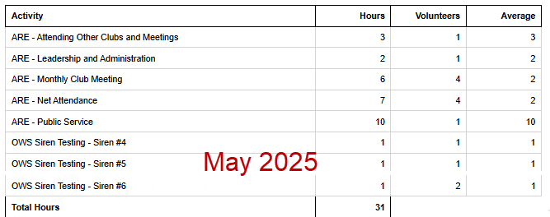
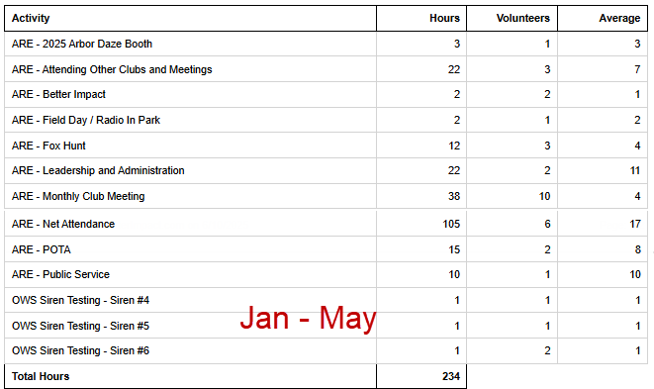
2025 Hours

Slide 11
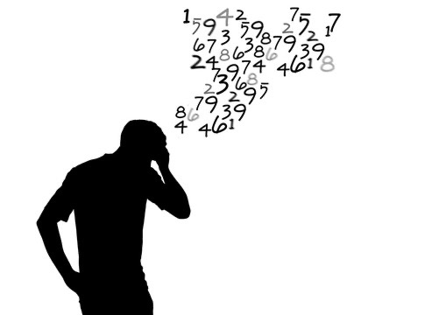
Please log your hours.

Slide 12

Planning

Slide 13
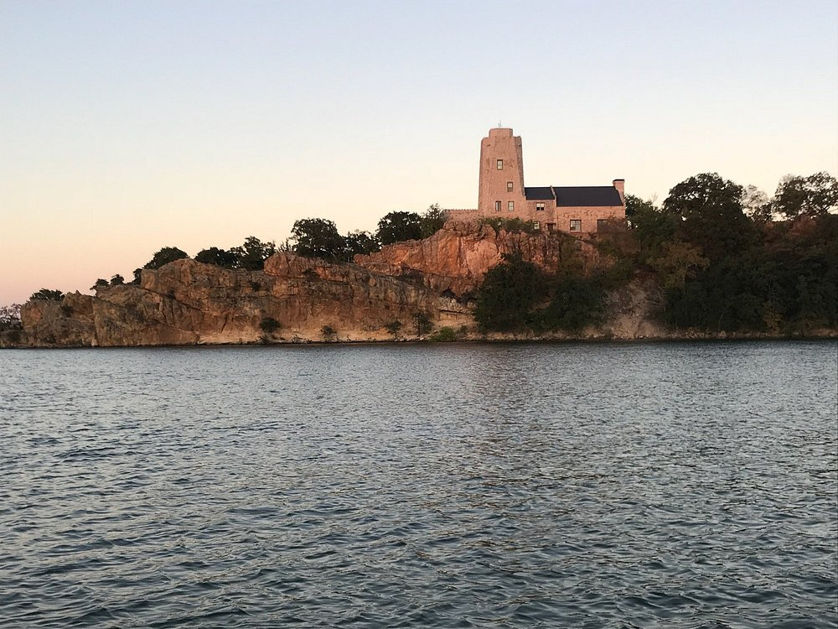
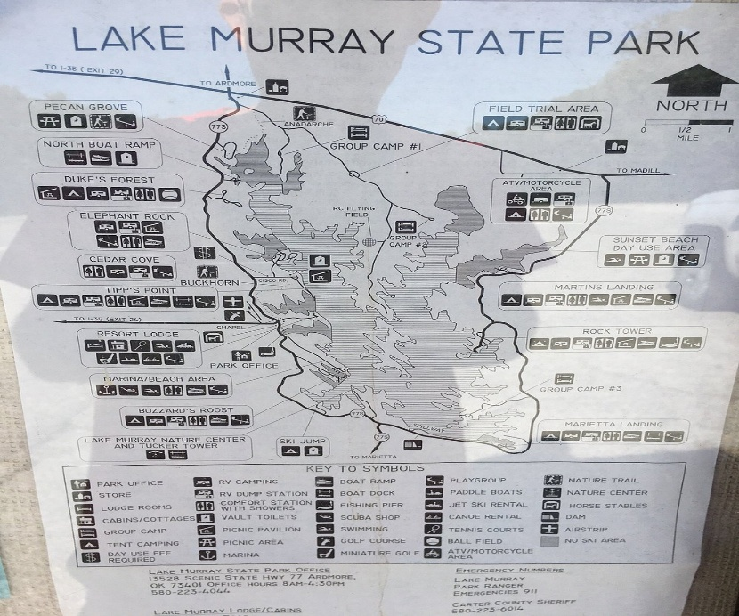
Lake Murray State Park
Ardmore, OK
Next Trip?????

Slide 14

Field Day
June 28-29

Slide 15

Greg
Kevin
Chris
Members

