Slide 1


Slide 2
July 9, 2025

Slide 3
Introductions

Slide 4
Member Updates

Slide 5
Minutes

Slide 6
Treasurer’s Report

Slide 7

C.E.R.T Update

Slide 8
-Ham Happenings
????
-Challenge Coins?
Order 50
-Speakers
Qty | Unit Price | 30%Discount | Mold Fees | Extra fees | Final Cost | 30% Discount for unit price
#1 | 50 | US$10.98 | US$7.69 | US$280.00 | US$0.00 |  | US$664.50
#2 | 50 | US$10.53 | US$7.37 | US$146.00 | US$0.00 |  | US$514.50

Slide 9
Euless ARC Gatherings
ERBC – Every Friday, @ 0830
Texan Kitchen 415 N Main, Euless, TX 76039
H‑E‑B Joint Radio Club Breakfast, every 3rd Saturday, Egg Haven Cafe, 760 Airport Fwy, Suite 100, Hurst, RSVP by midnight Thursday
Club Social – Monday, July 21, 1800 – 1900
    Jasons Deli
    2200 Airport Fwy, FWY 76022

Slide 10
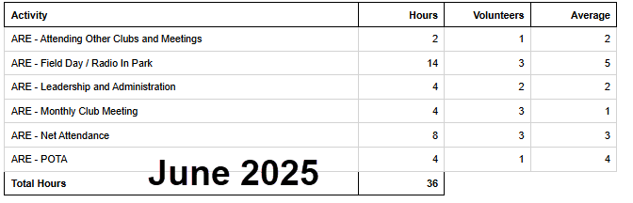
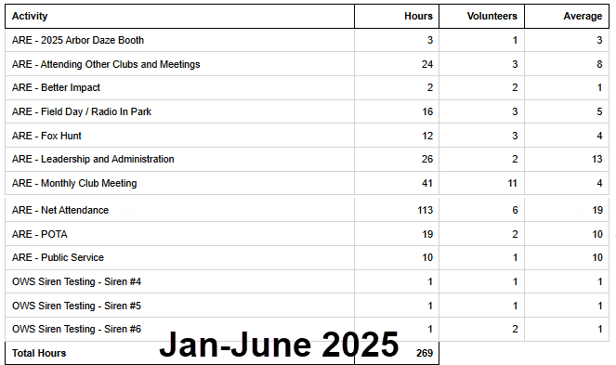
2025 Hours

Slide 11
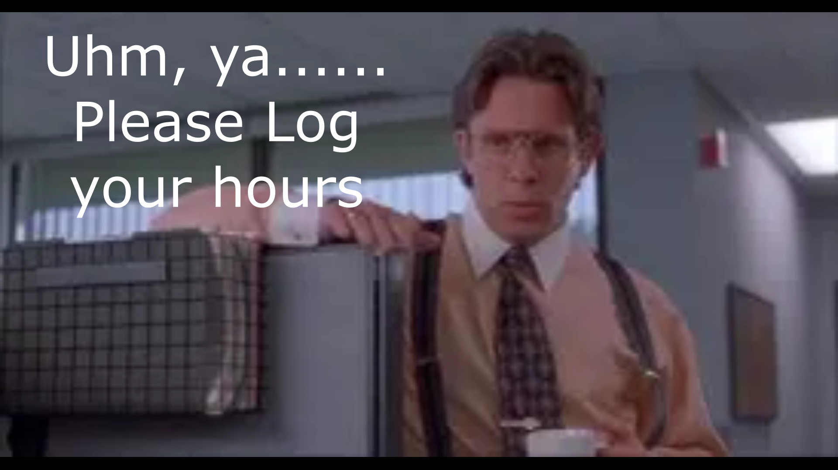
Please log your hours.

Slide 12

Planning

Slide 13

Field Day
June 28-29
Recap (Hot Wash)
-Awesome Time!
-Club Radio not work
-Ideas Suggestions

Slide 14
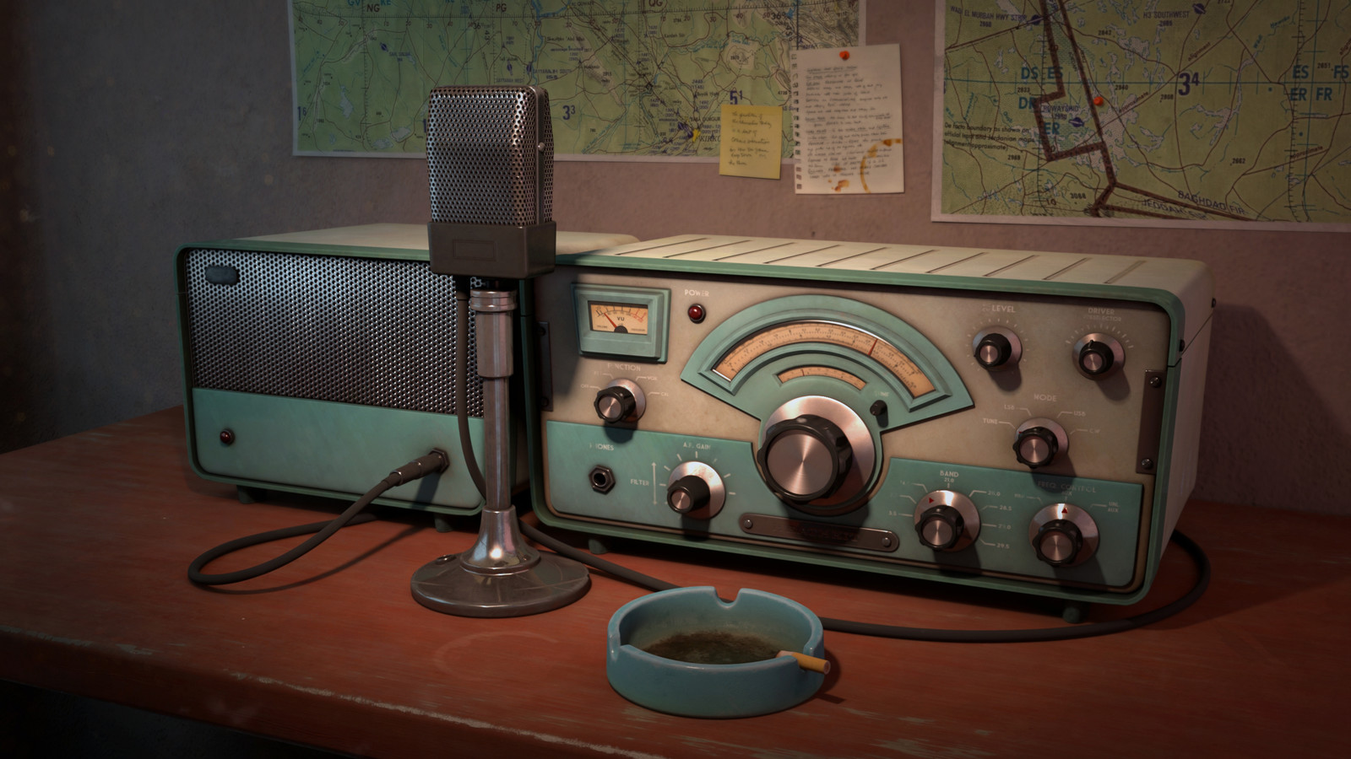
Greg
Kevin
Chris
Members

