Slide 1


Slide 2
January 8 2025

Slide 3
Introductions

Slide 4
Member Updates

Slide 5
Minutes

Slide 6
Treasurer’s Report

Slide 7

C.E.R.T Update

Slide 8
Local Happenings
-Cowtown Hamfest
January 17 & 18
-Welfare Net Thur. & Fri.
W5EUL Repeater

Slide 9
Euless ARC Gatherings
ERBC – Every Friday, @ 0830
Texan Kitchen 415 N Main, Euless, TX 76039
H‑E‑B Joint Radio Club Breakfast, every 3rd Saturday, Egg Haven Cafe, 760 Airport Fwy, Suite 100, Hurst, RSVP by midnight Thursday
Club Social – Monday, January 20, 1800 – 1900 Locations for year?????
Fox Hunts?????
AARL Winter Field Day January 25???
Welfare Net this Thursday and Friday W5EUL Repeater

Slide 10
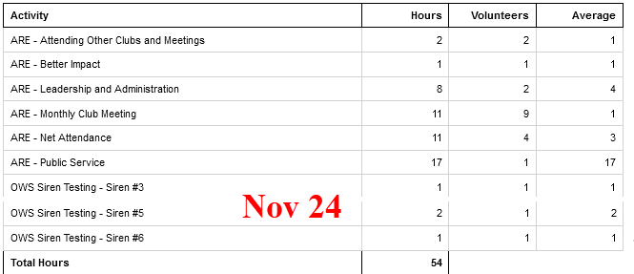
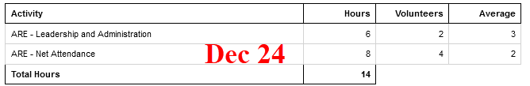
Previous Month Hours

Slide 11
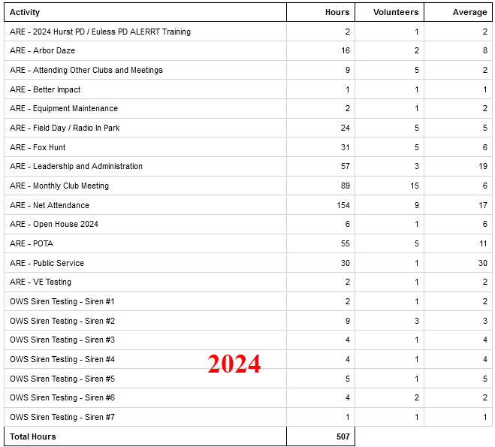
2024 Hours

Slide 12

Please log your hours.

Slide 13

Planning

Slide 14
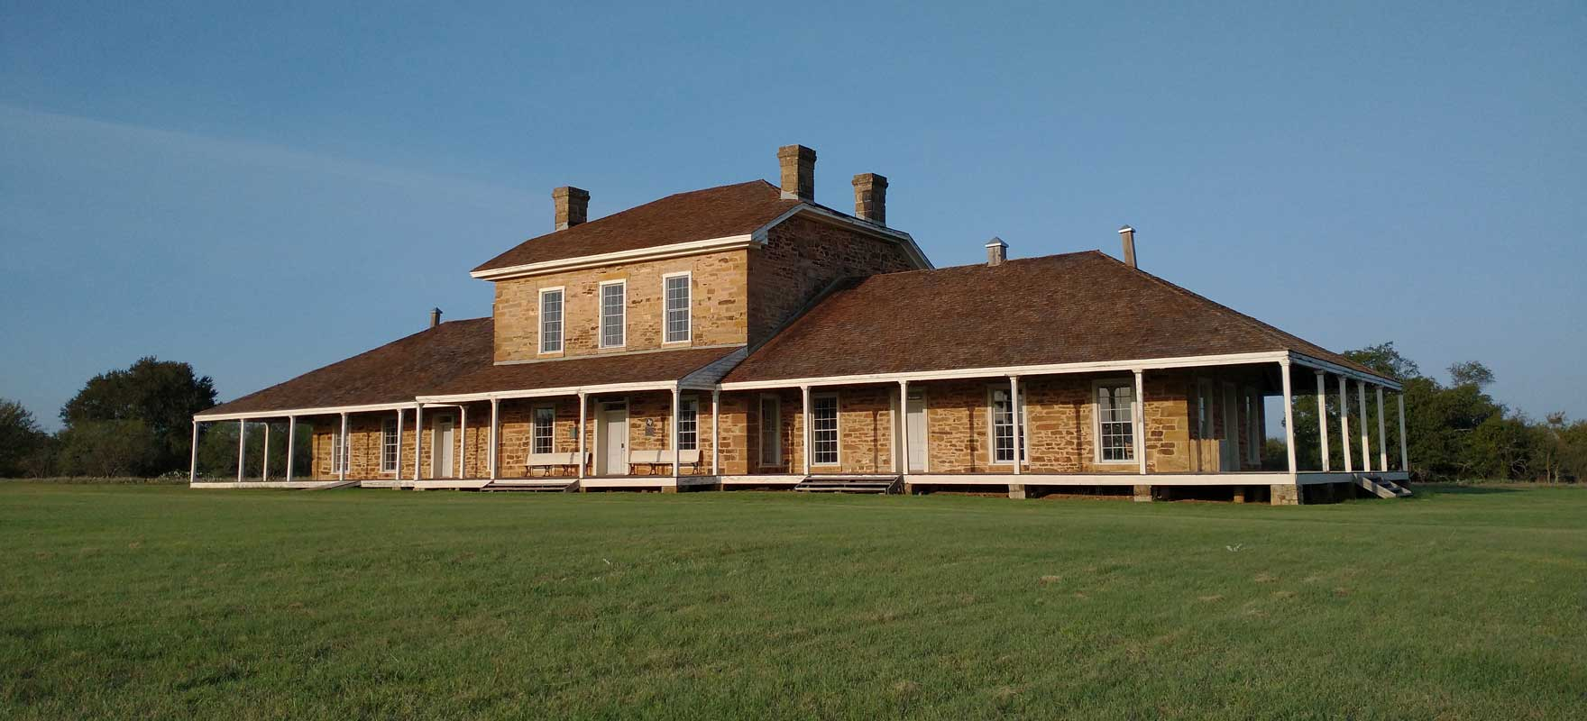

Texas State Parks On The Air
April 12-13, 2025

Slide 15

Winter Field Day
January 25 & 26

Slide 16

Audit Committee for 2025
Arbor Days April 26, Going to do?

Slide 17

Greg
Kevin
Chris
Members

