Slide 1


Slide 2
February 12, 2025

Slide 3
Introductions

Slide 4
Member Updates

Slide 5
Minutes

Slide 6
Treasurer’s Report

Slide 7

C.E.R.T Update

Slide 8
Local Happenings
-Irving Hamfest
March 1, 2025

Slide 9
Euless ARC Gatherings
ERBC – Every Friday, @ 0830
Texan Kitchen 415 N Main, Euless, TX 76039
H‑E‑B Joint Radio Club Breakfast, every 3rd Saturday, Egg Haven Cafe, 760 Airport Fwy, Suite 100, Hurst, RSVP by midnight Thursday
Club Social – Monday, Feb 17, 1800 – 1900
    Piada Italian Street Food, Glad Parks
Fox Hunt – Sunday Feb 16 9am

Slide 10
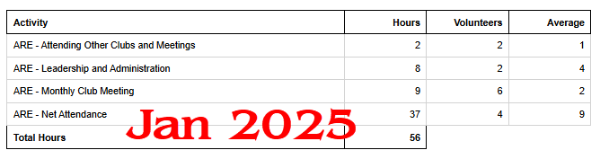
2025 Hours

Slide 11
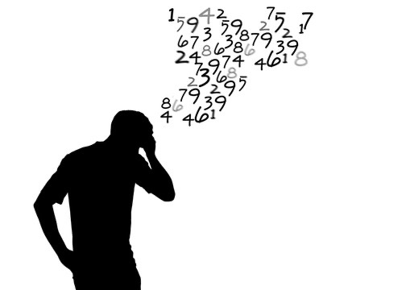
Please log your hours.

Slide 12
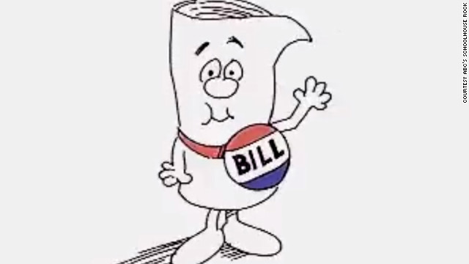
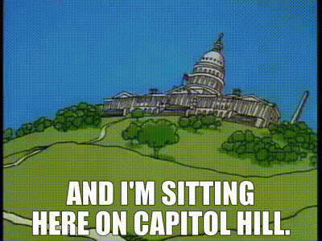
H.R. 1094
Private Land Use Bill
Send out Bulletin?

Slide 13

Planning

Slide 14
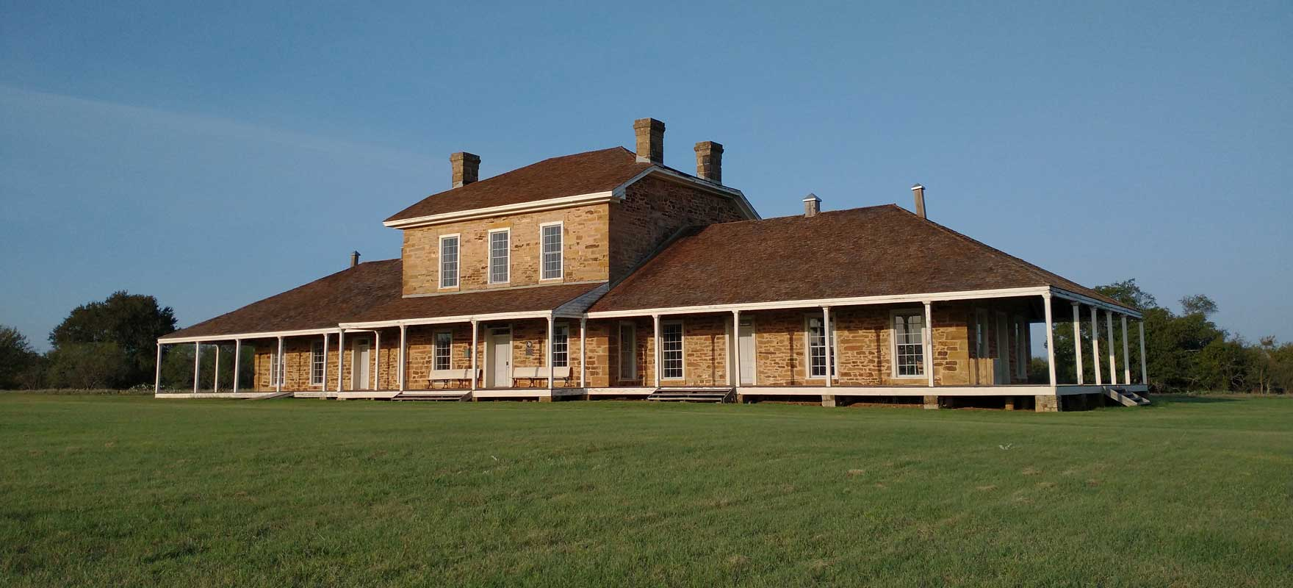

Texas State Parks On The Air
April 12-13, 2025

Slide 15

Field Day
June 28-29

Slide 16

Audit Committee for 2025
Arbor Days April 26, Going to do?

Slide 17
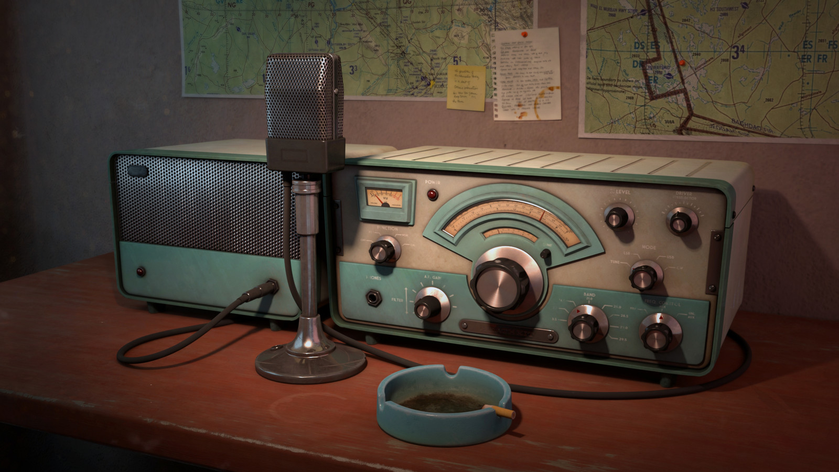
Greg
Kevin
Chris
Members

