Slide 1


Slide 2
September 11, 2024

Slide 3
Introductions

Slide 4
Member Updates

Slide 5
Minutes

Slide 6
Treasurer’s Report

Slide 7

C.E.R.T Update

Slide 8
Local Happenings

Slide 9
Euless ARC Gatherings
ERBC – Every Friday, @ 0830
Texan Kitchen 415 N Main, Euless, TX 76039
H‑E‑B Joint Radio Club Breakfast, every 3rd Saturday, Egg Haven Cafe, 760 Airport Fwy, Suite 100, Hurst, RSVP by midnight Thursday
Club Social – Monday, September 16, 1800 – 1900 Lazy Dog 2521 Star Highway 121 Euless, TX 76039

Slide 10
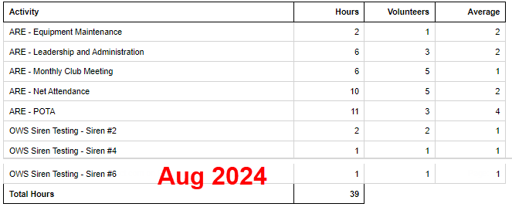
Previous Month Hours

Slide 11
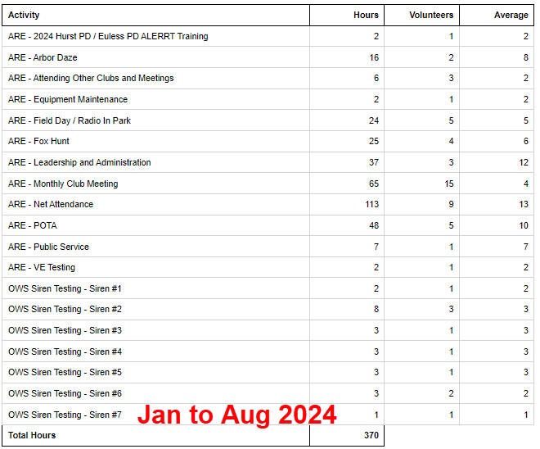
Year To Date Hours

Slide 12

Please log your hours.

Slide 13

Planning

Slide 14
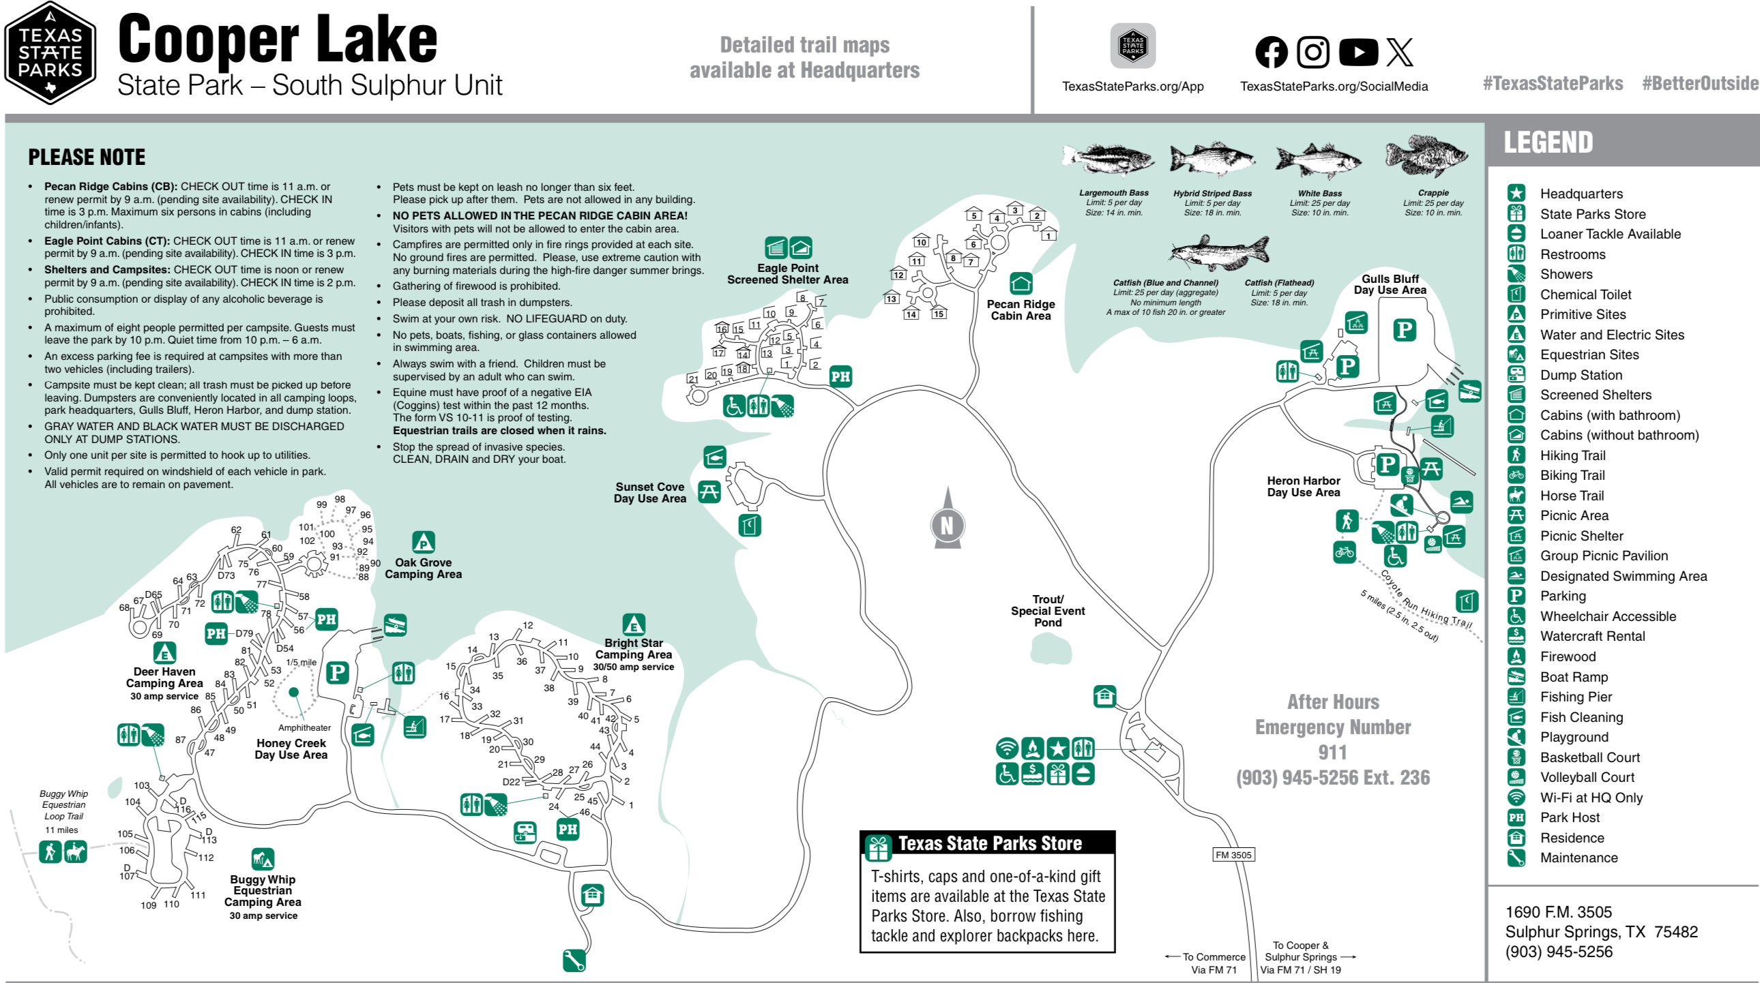
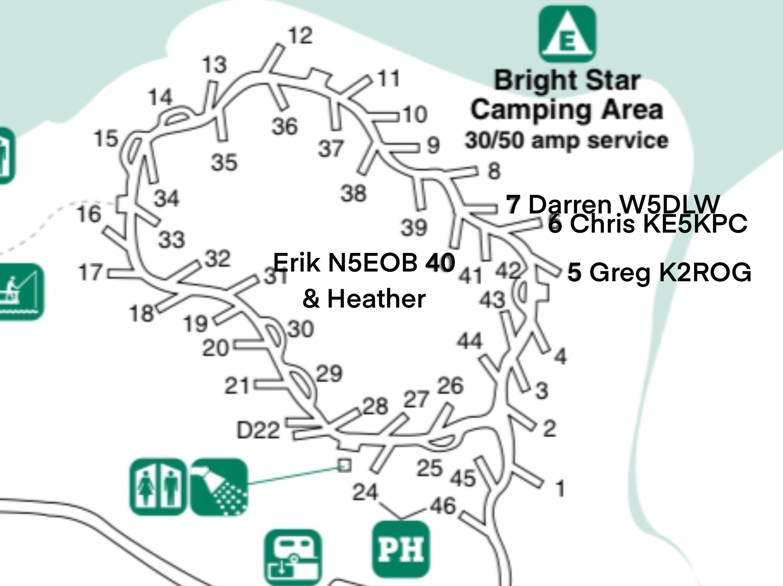

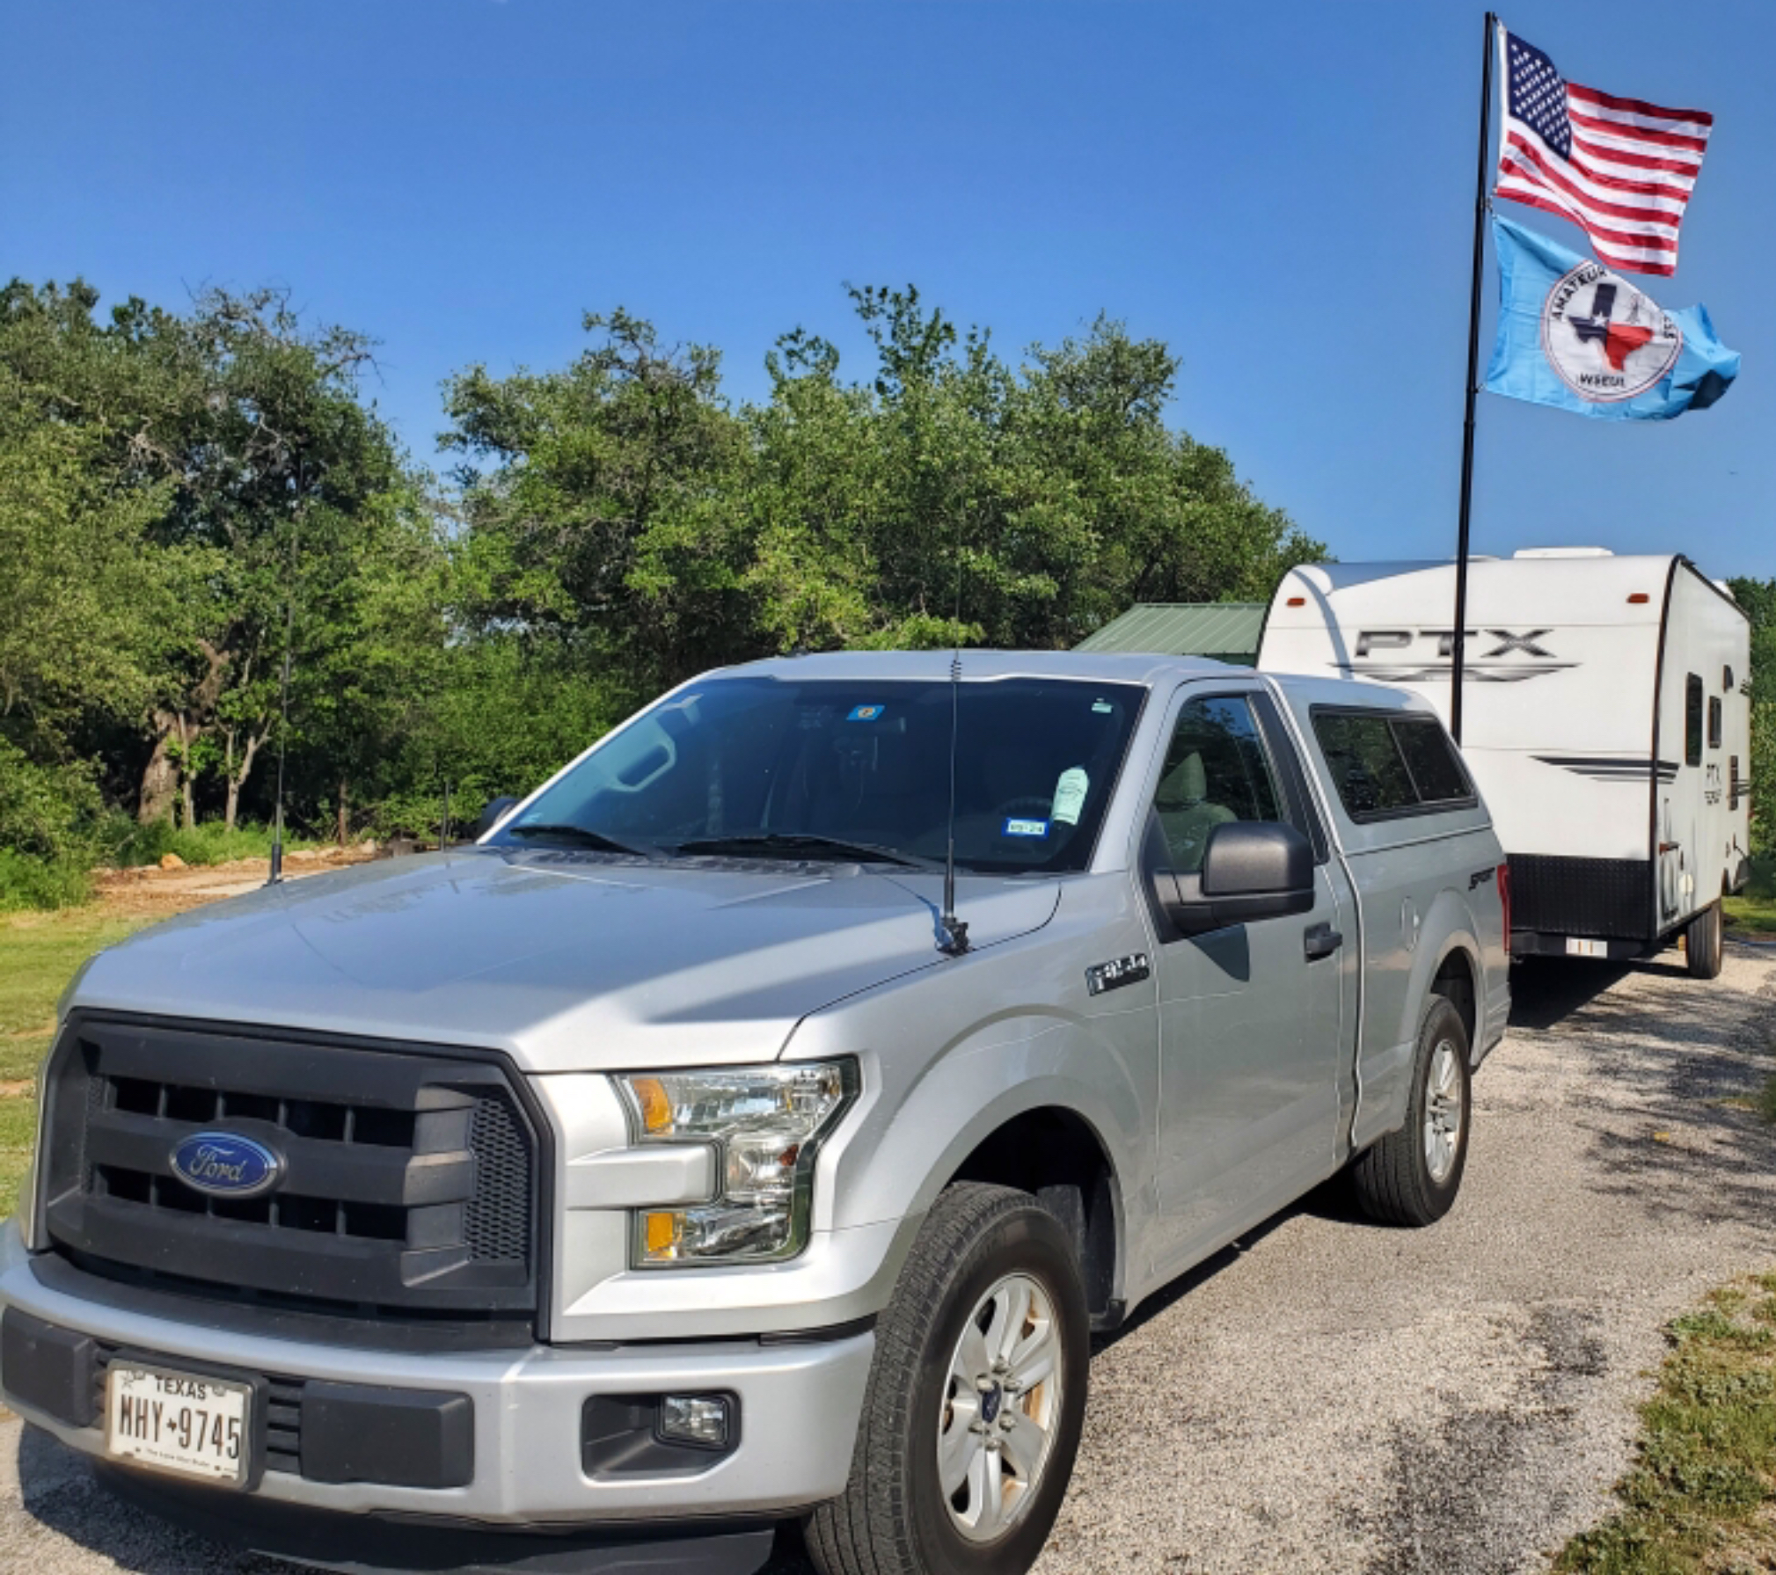
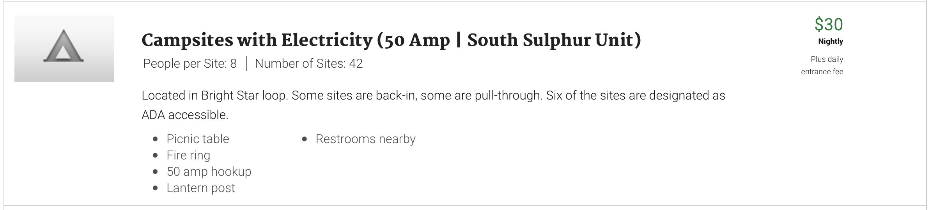
Cooper Lake State Park
South Sulphur Unit 10/12-13/2024
Parks On The Air

Slide 15
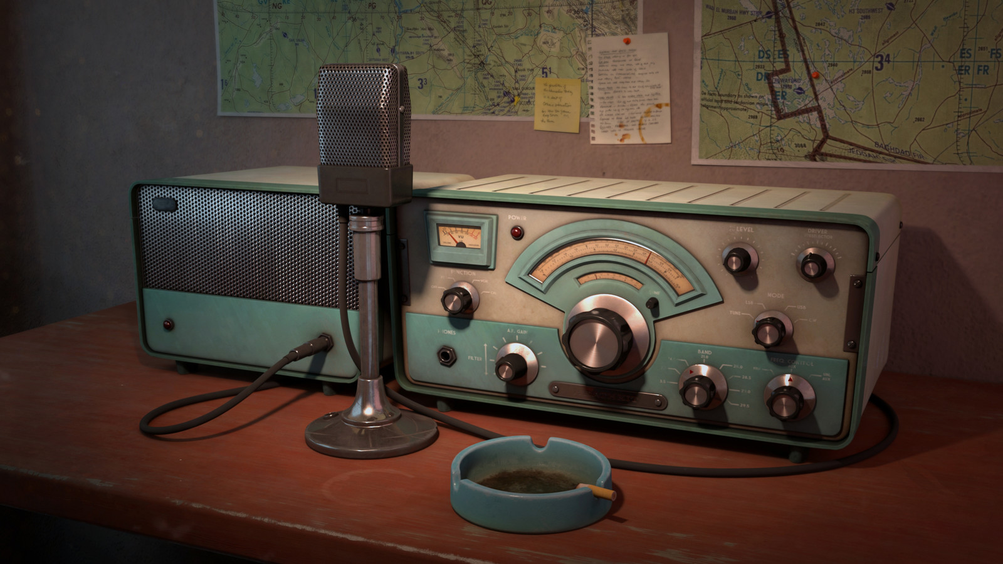
Erik
Greg
Chris
Members

