Slide 1


Slide 2
November 13, 2024

Slide 3
Introductions

Slide 4
Member Updates

Slide 5
Minutes

Slide 6
Treasurer’s Report

Slide 7

C.E.R.T Update

Slide 8
Local Happenings

Slide 9
Euless ARC Gatherings
ERBC – Every Friday, @ 0830
Texan Kitchen 415 N Main, Euless, TX 76039
H‑E‑B Joint Radio Club Breakfast, every 3rd Saturday, Egg Haven Cafe, 760 Airport Fwy, Suite 100, Hurst, RSVP by midnight Thursday
Club Social – Monday, November 18, 1800 – 1900 IHOP 2309 W. Airport Fwy, Euless, TX 76040
Fox Hunt - Sunday, November 17, 0900

Slide 10
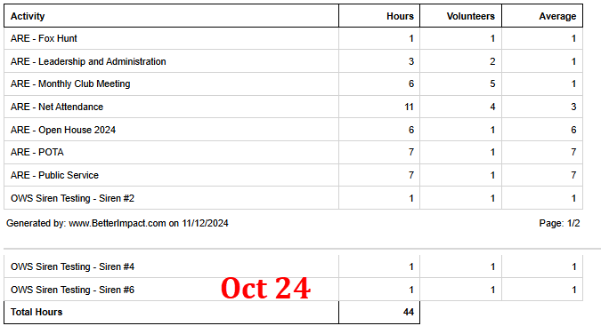
Previous Month Hours

Slide 11
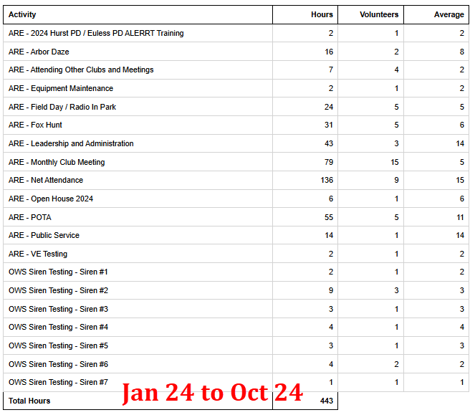
Year To Date Hours

Slide 12

Please log your hours.

Slide 13

Planning

Slide 14
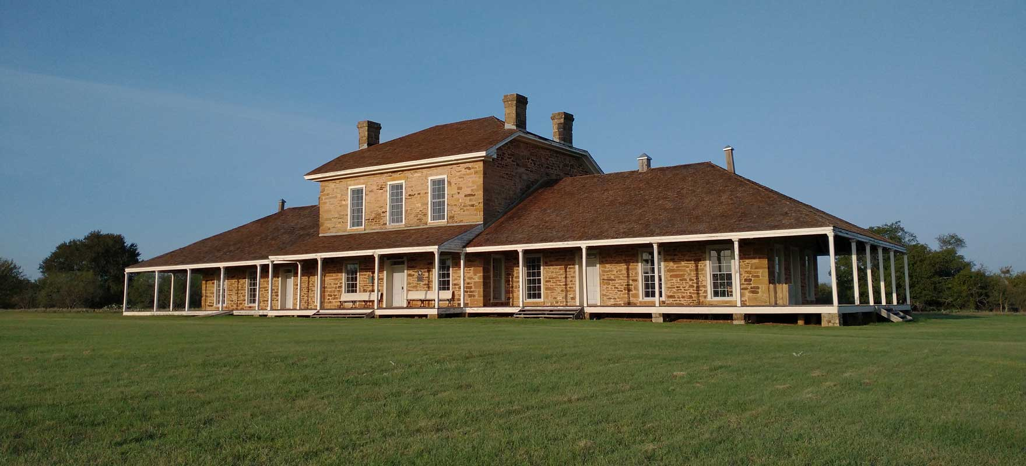

Texas State Parks On The Air
April 12-13, 2025

Slide 15

November Sweepstakes
November 16th
Bedford Radio Club
Darren and Kelly
Bedford Boys Ranch (Generation Park) 1 pm

Slide 16

Club Leadership Elections

Slide 17

Erik
Greg
Chris
Members

