Slide 1


Slide 2
May 8, 2024

Slide 3
Introductions

Slide 4
Member Updates

Slide 5
Minutes

Slide 6
Treasurer’s Report

Slide 7

C.E.R.T Update

Slide 8
Local Happenings

Slide 9
Euless ARC Gatherings
ERBC – Every Friday, @ 0830
Texan Kitchen 415 N Main, Euless, TX 76039
H‑E‑B Joint Radio Club Breakfast, every 3rd Saturday, Egg Haven Cafe, 760 Airport Fwy, Suite 100, Hurst, RSVP by midnight Thursday
Club Social – Monday, May 20, 1800 – 1900 Mod Pizza 2321 SH-121, Unit 100 Euless, TX 76021

Slide 10
Upcoming Events
May
Fox Hunt: Sunday, May 19

Slide 11
Upcoming Events
June
Field Day: Saturday, June 22-23
Fox Hunt: Saturday, June 29

Slide 12
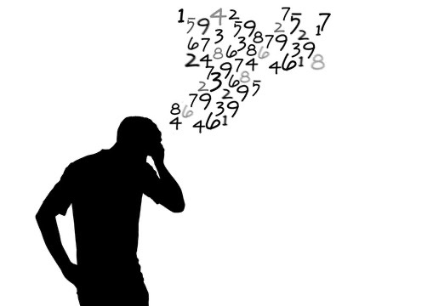
Please log your hours.

Slide 13
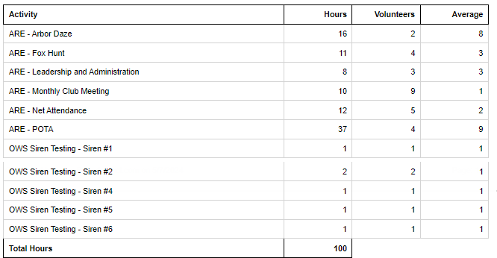
Previous Month Hours

Slide 14
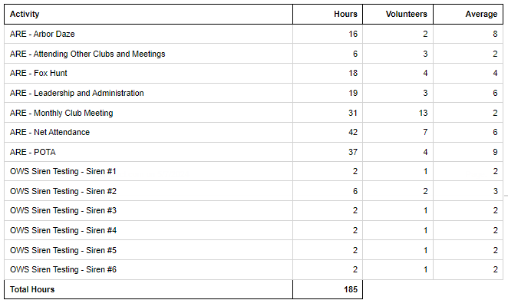
Year To Date Hours

Slide 15

July?

Slide 16
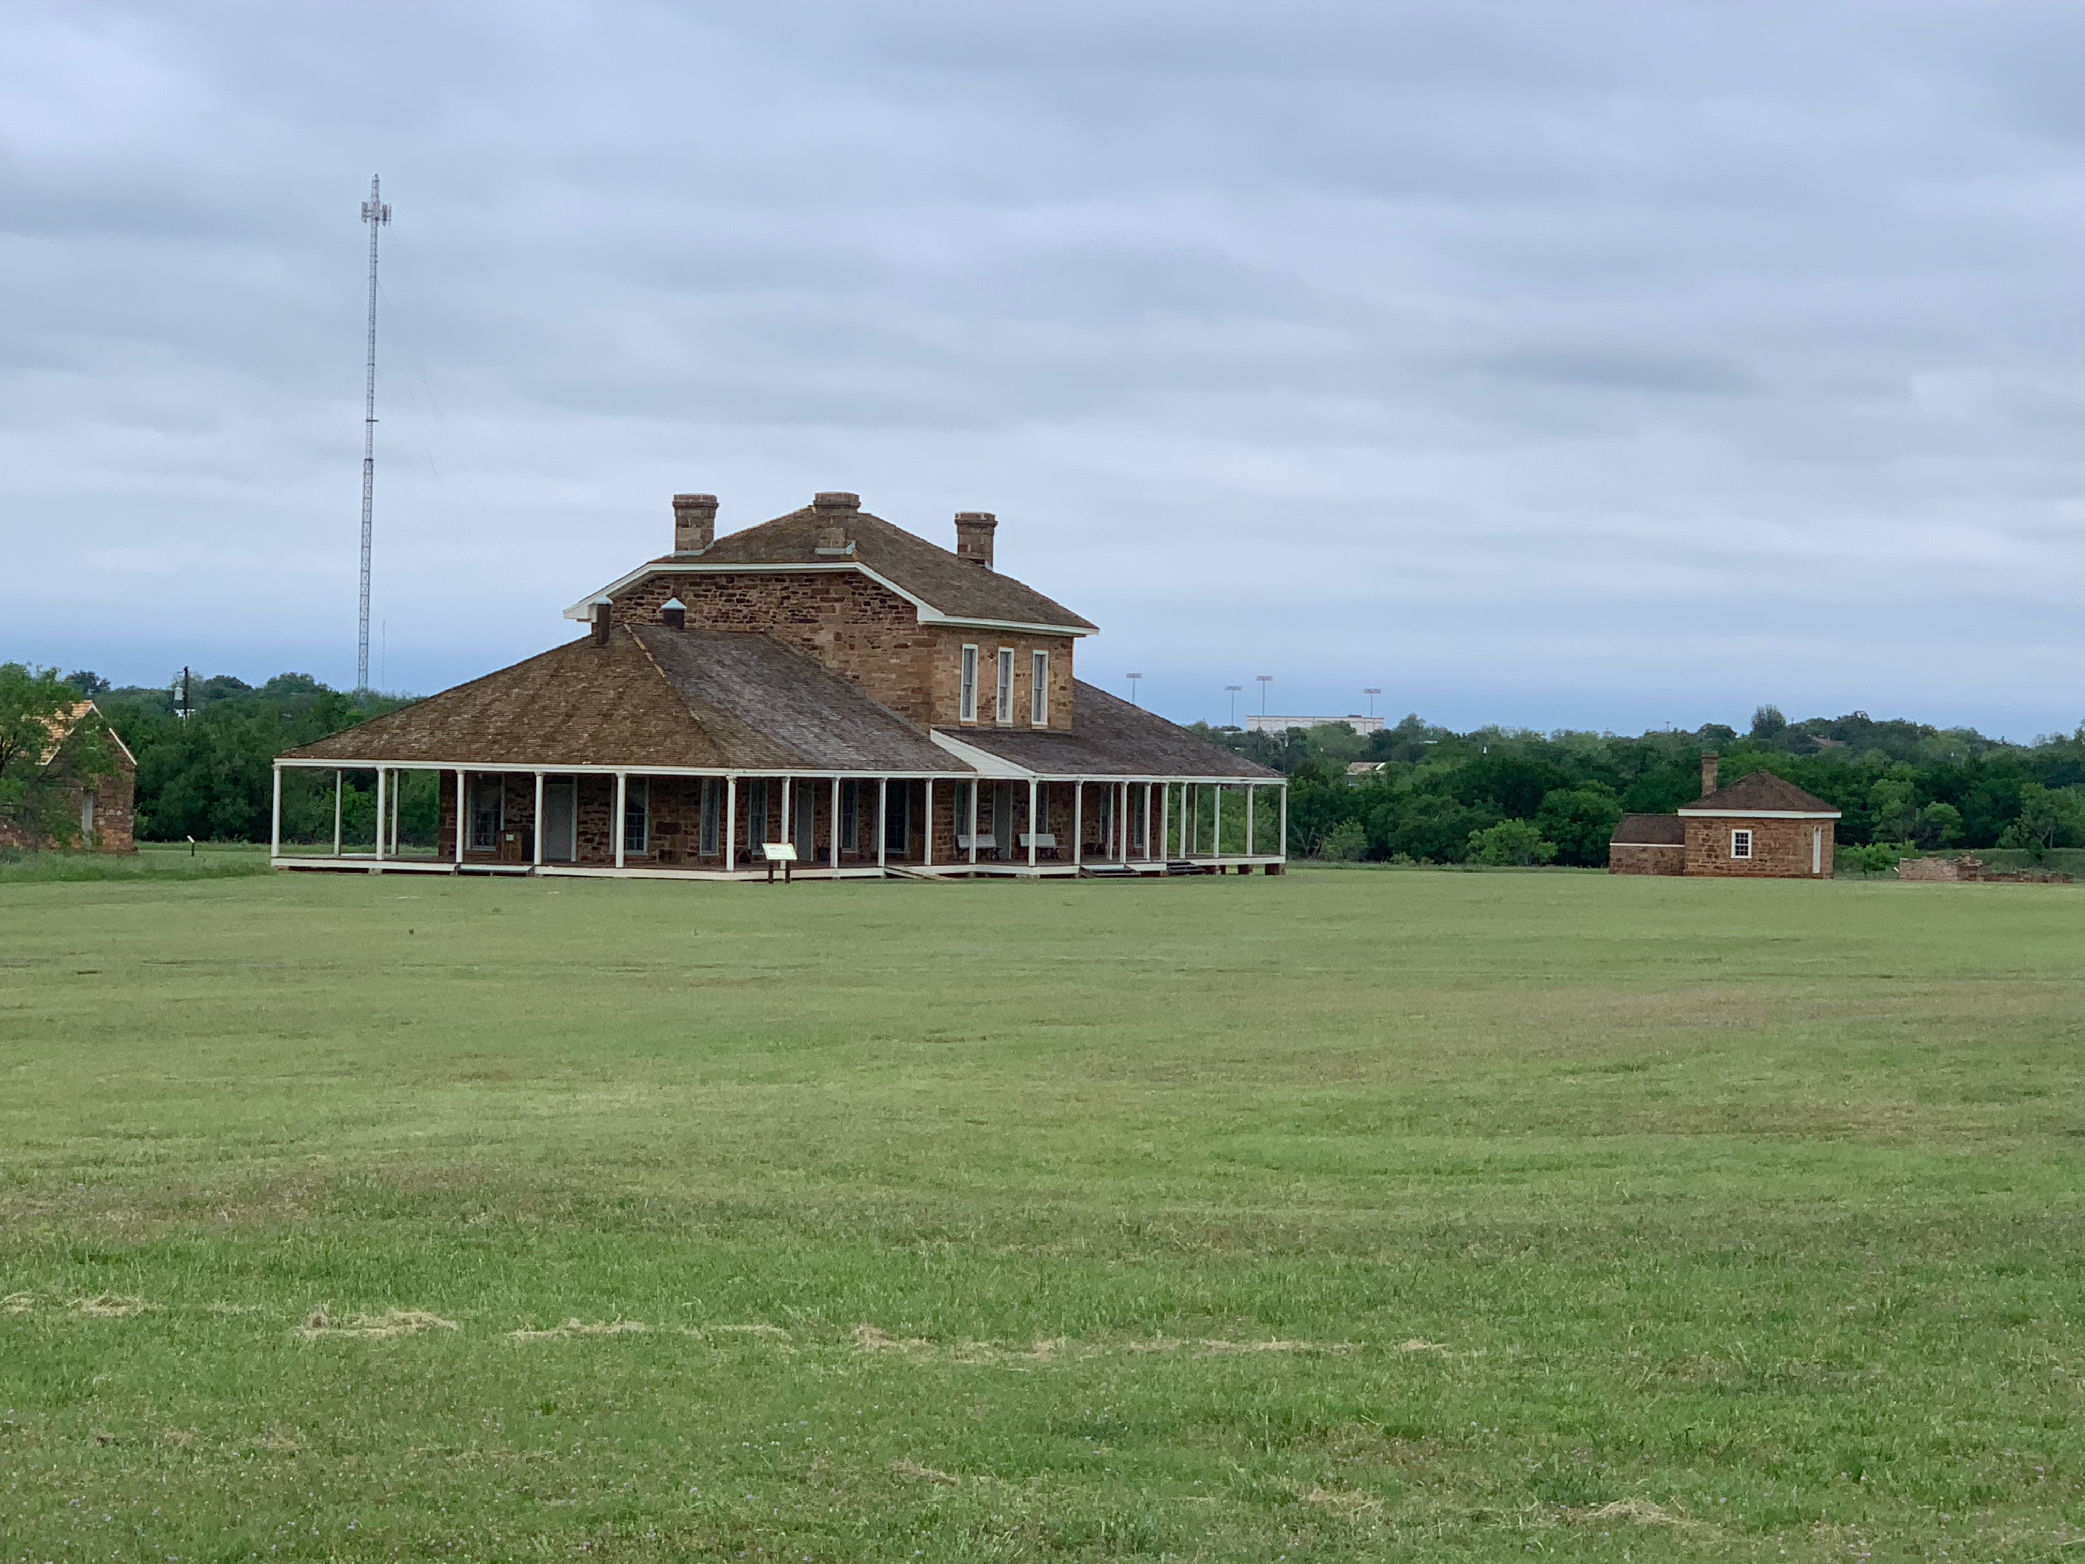
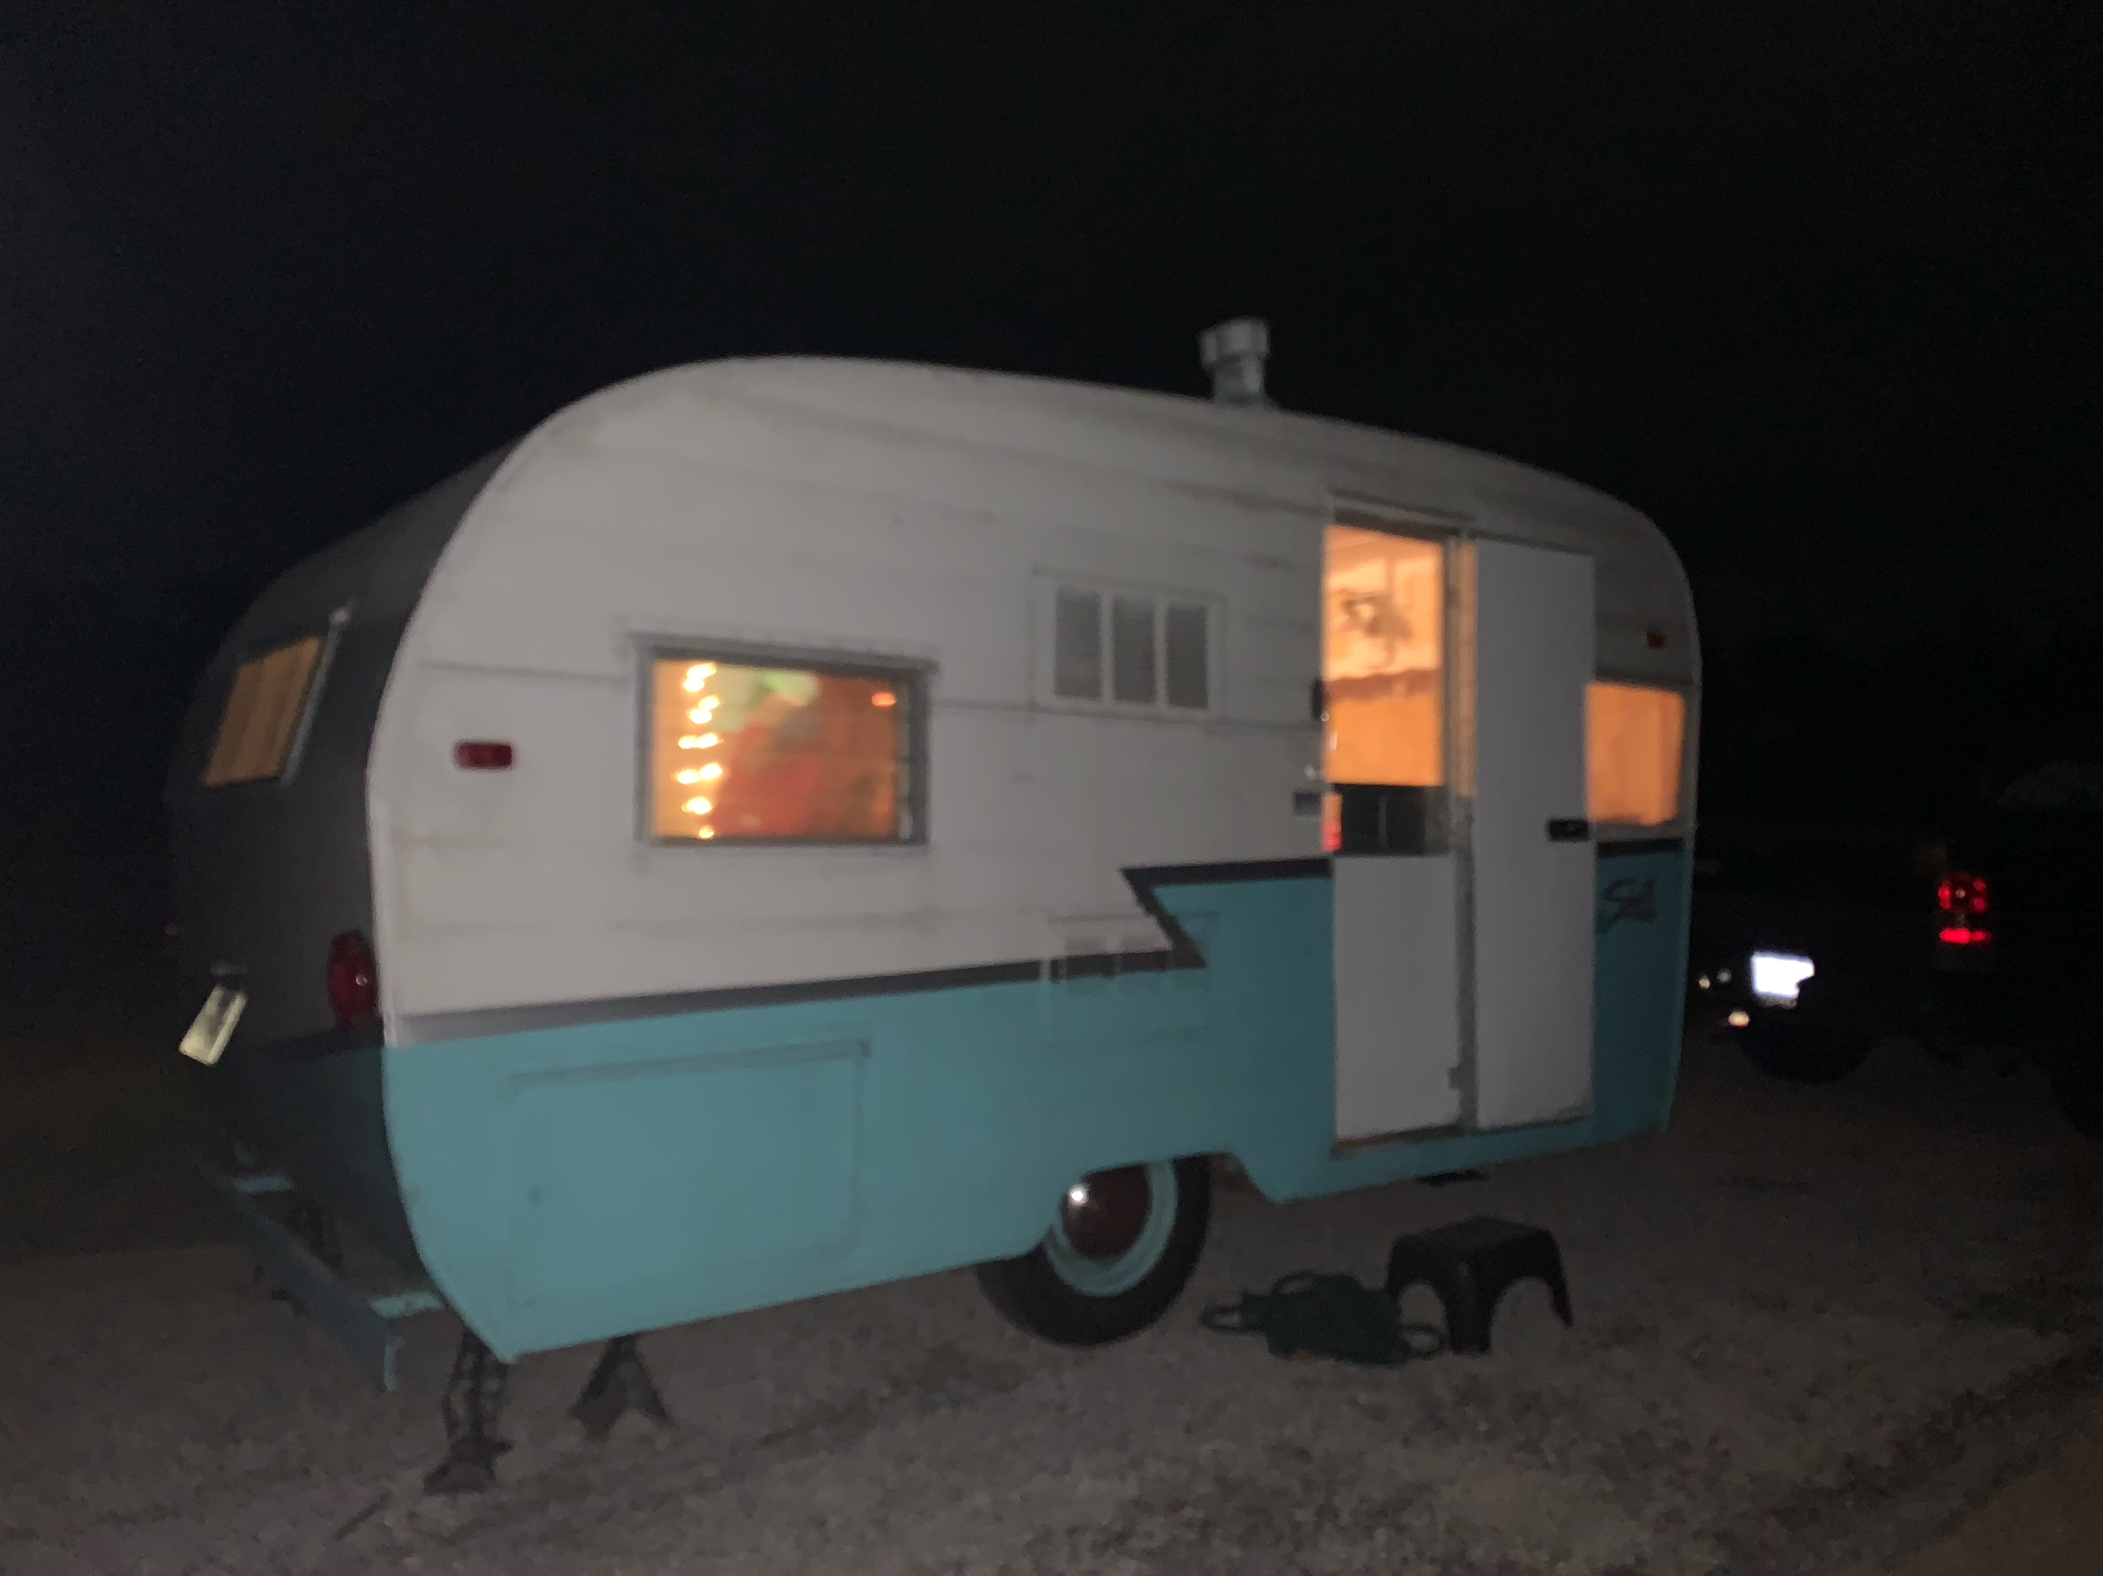
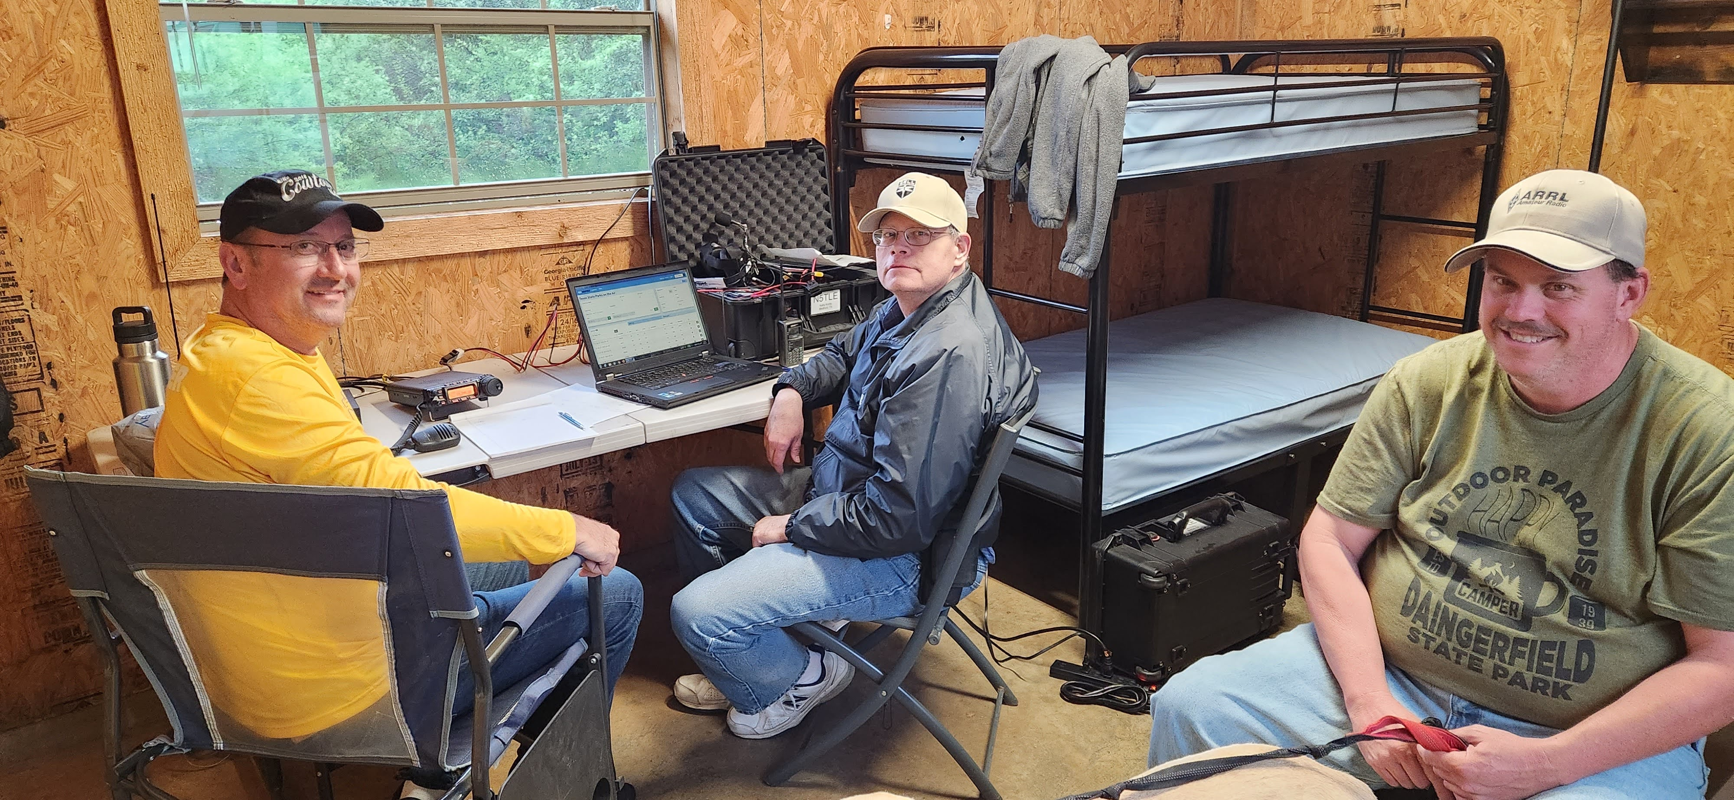
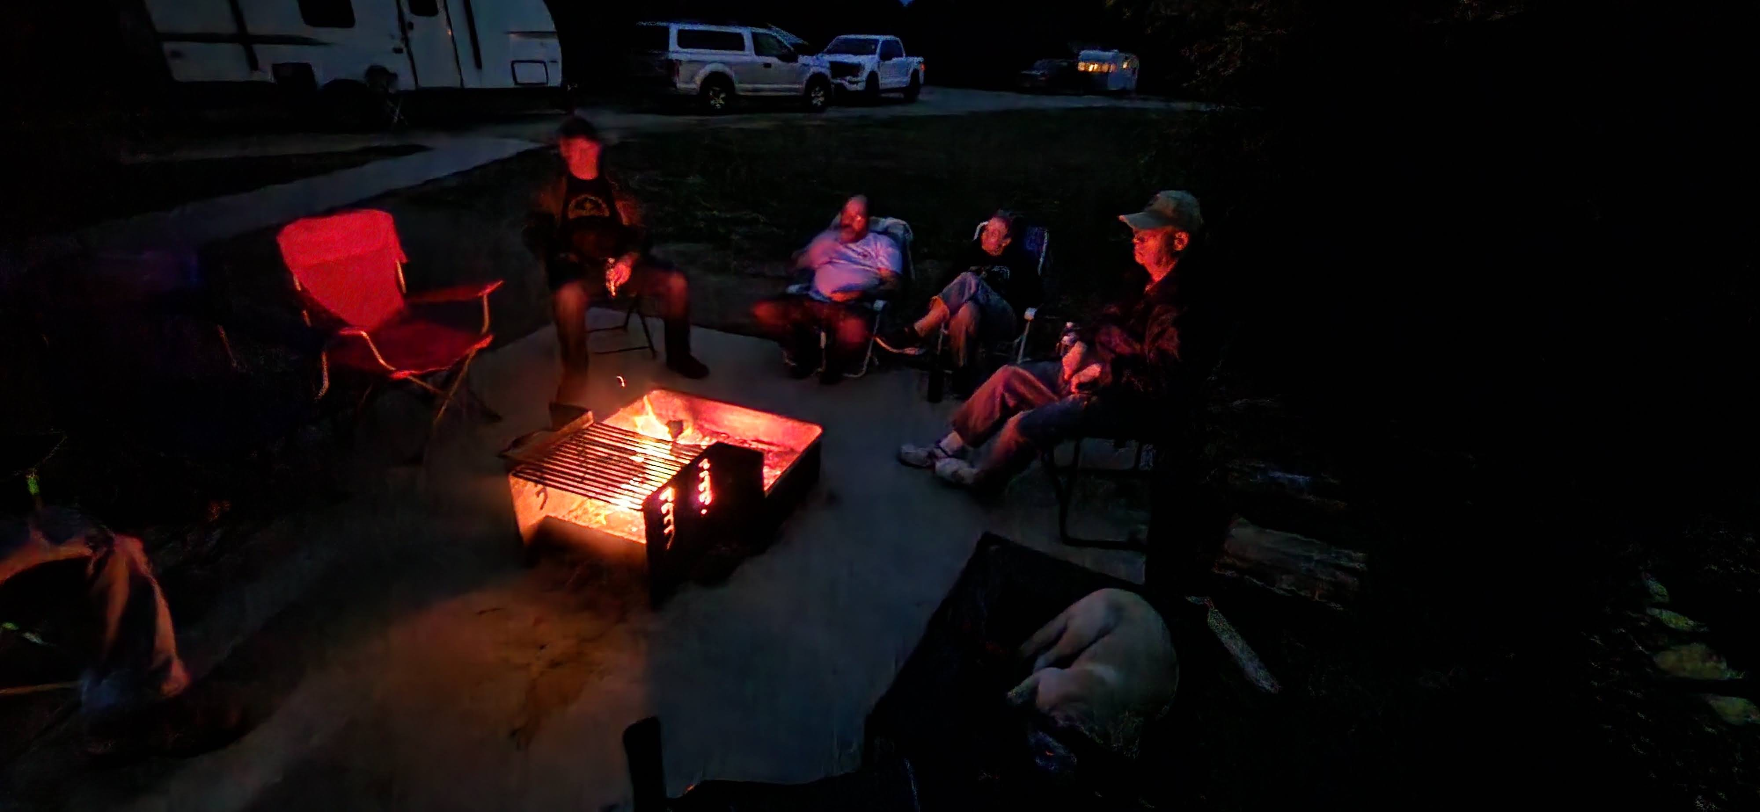
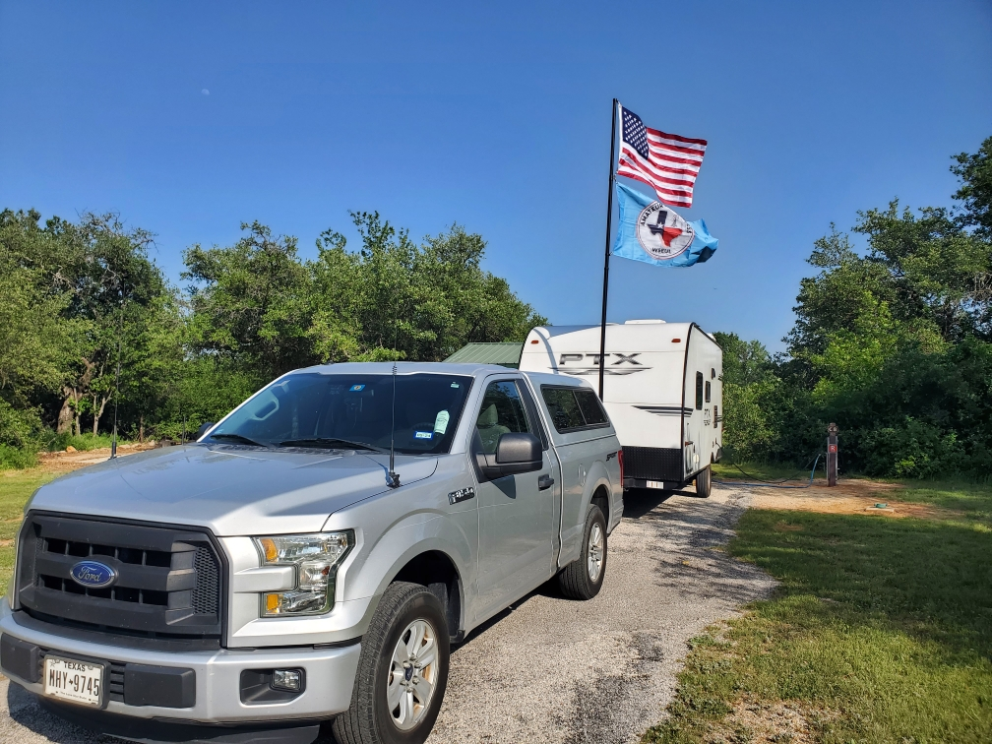
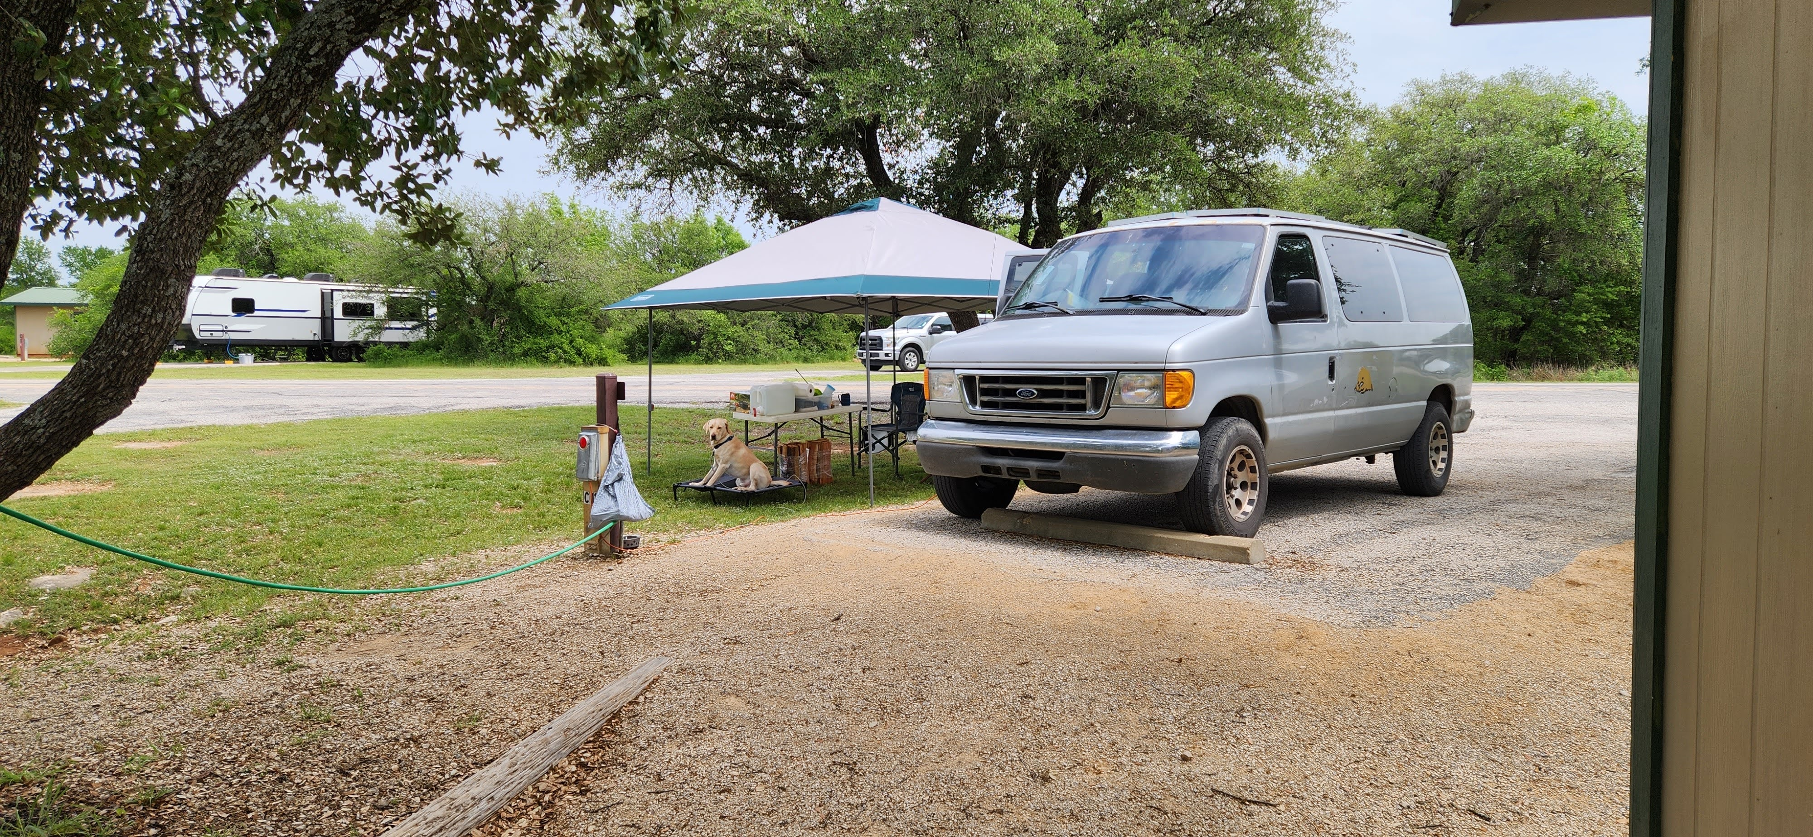
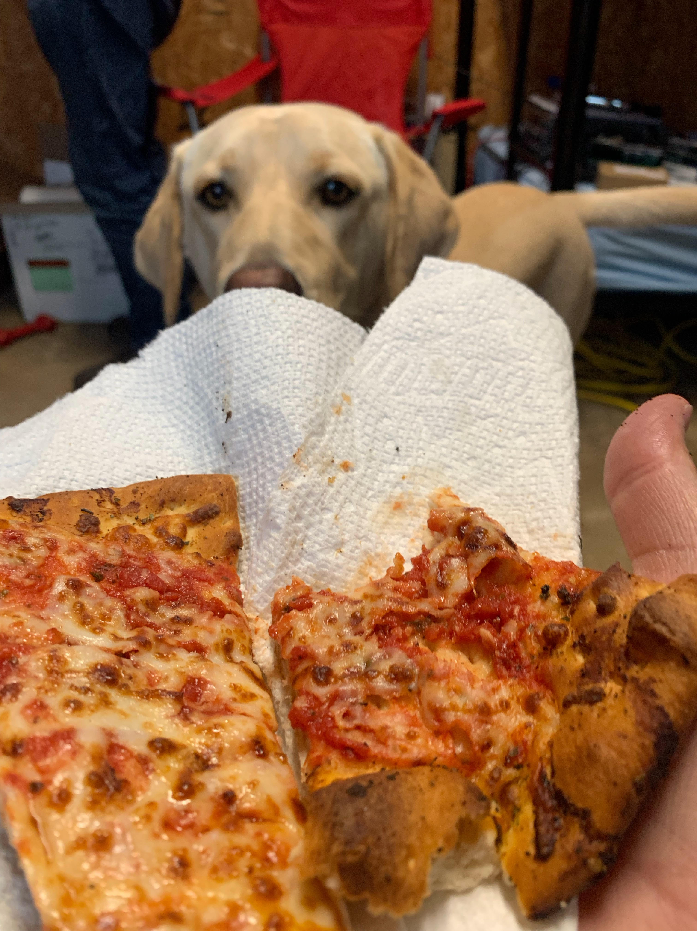
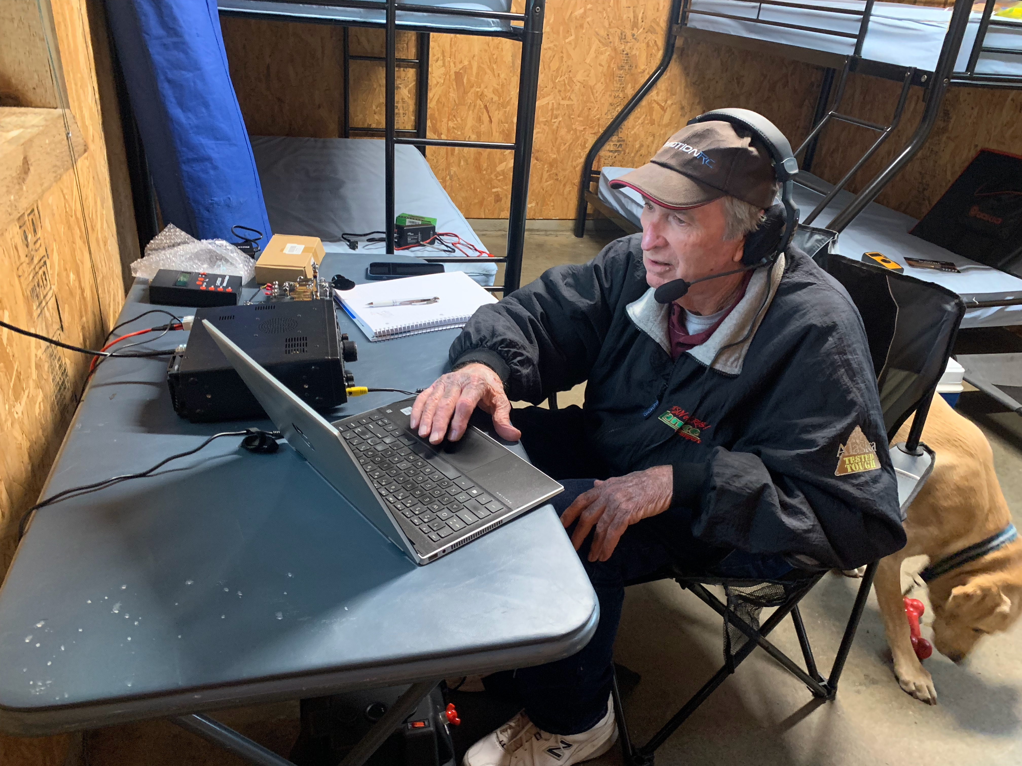
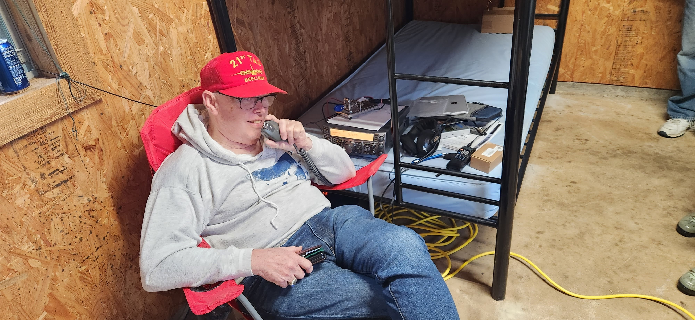
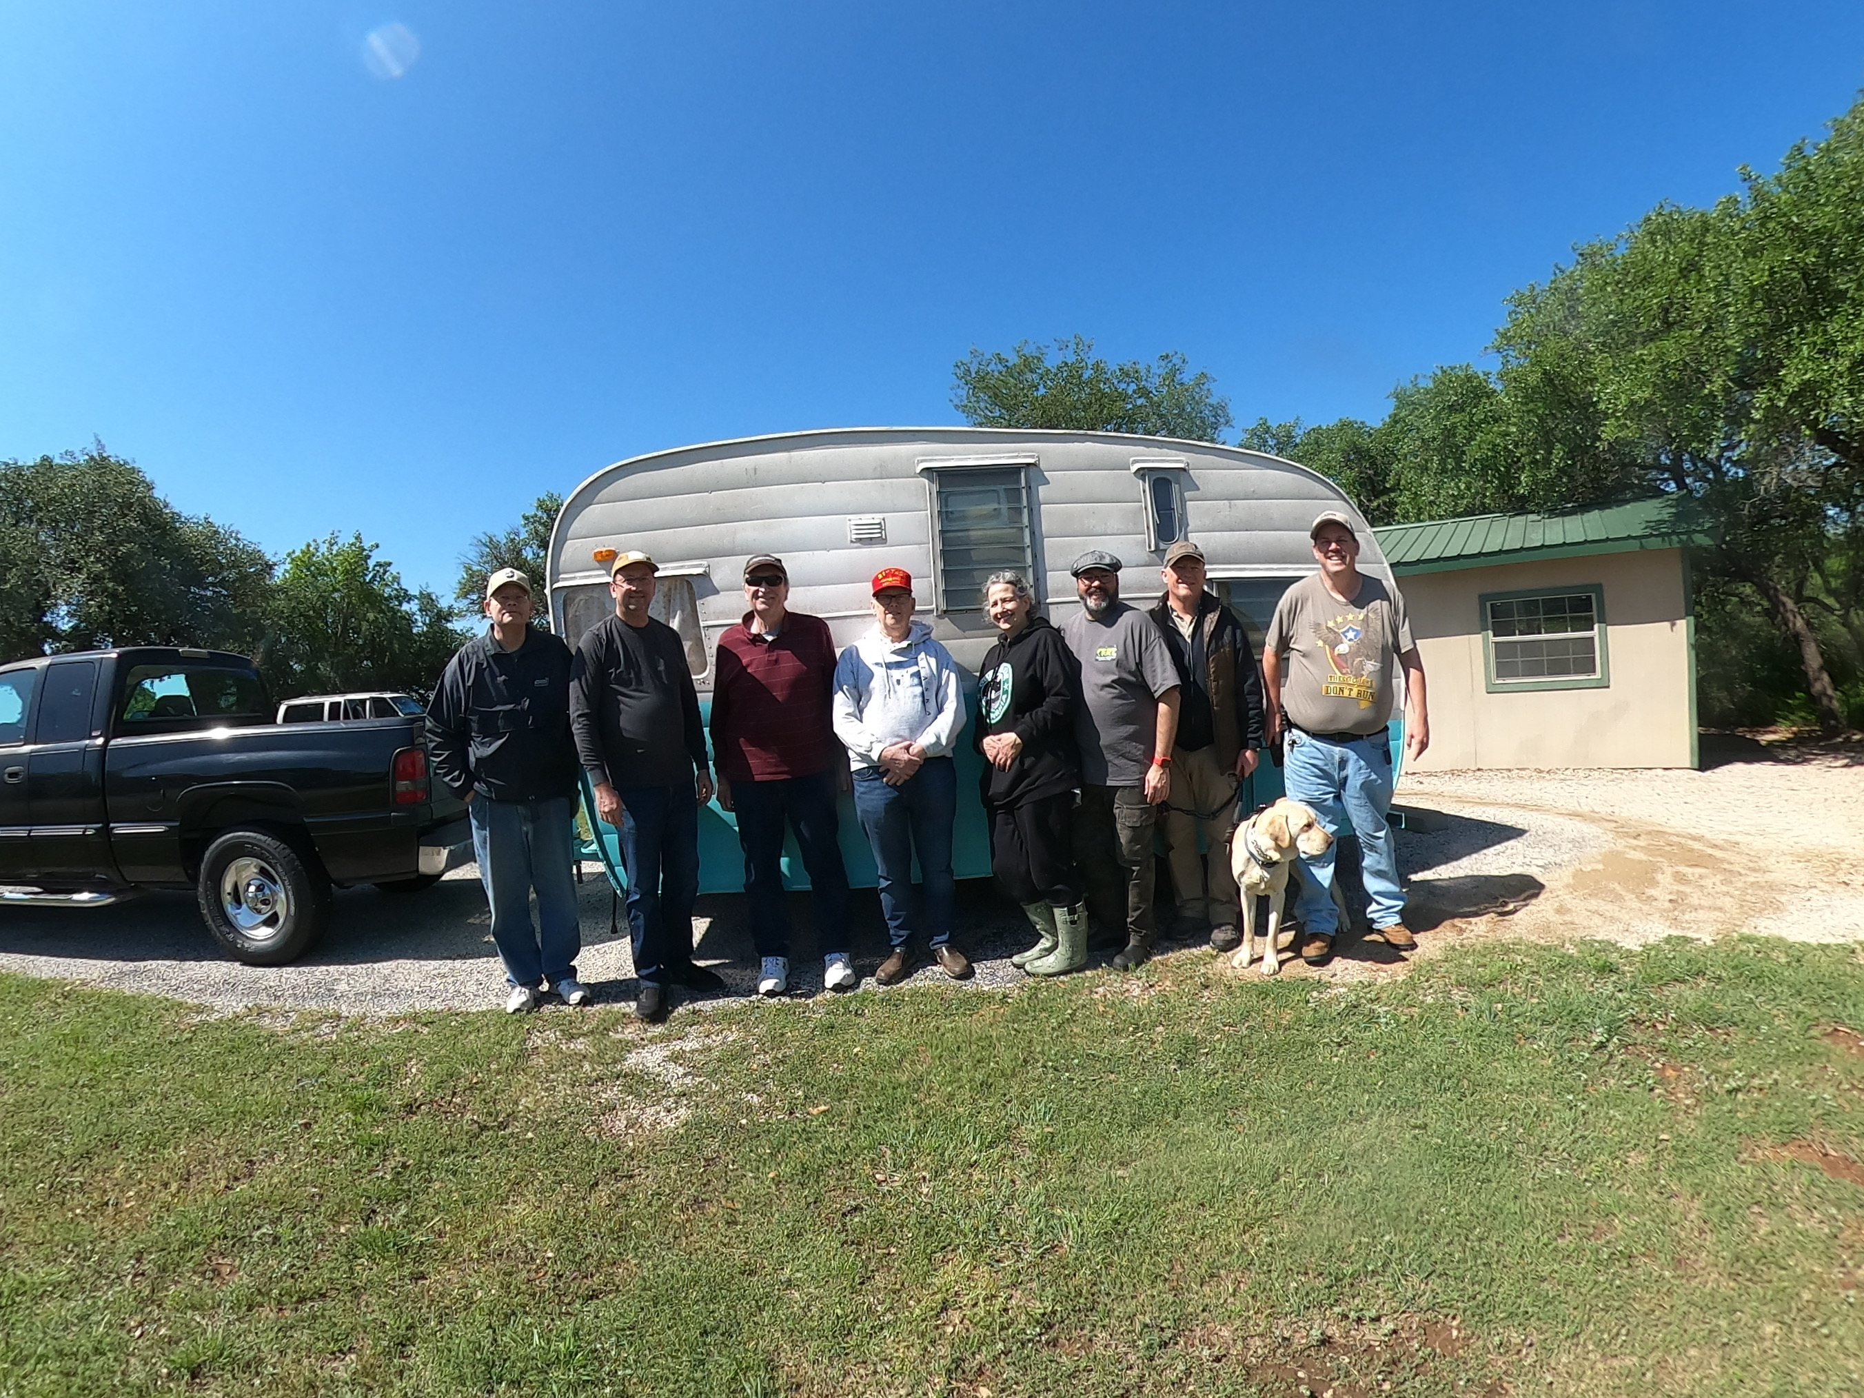
Texas State Parks On The Air
Fort Richardson State Park, April 20 & 21, 2024.

Slide 17

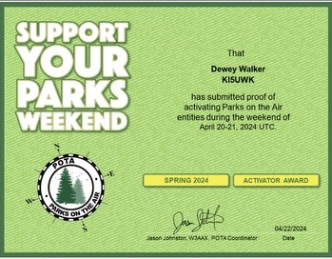


Texas State Parks On The Air
Congrats Dewey!
This is only the beginning…
Fort Richardson State Park, April 20 & 21, 2024.

Slide 18
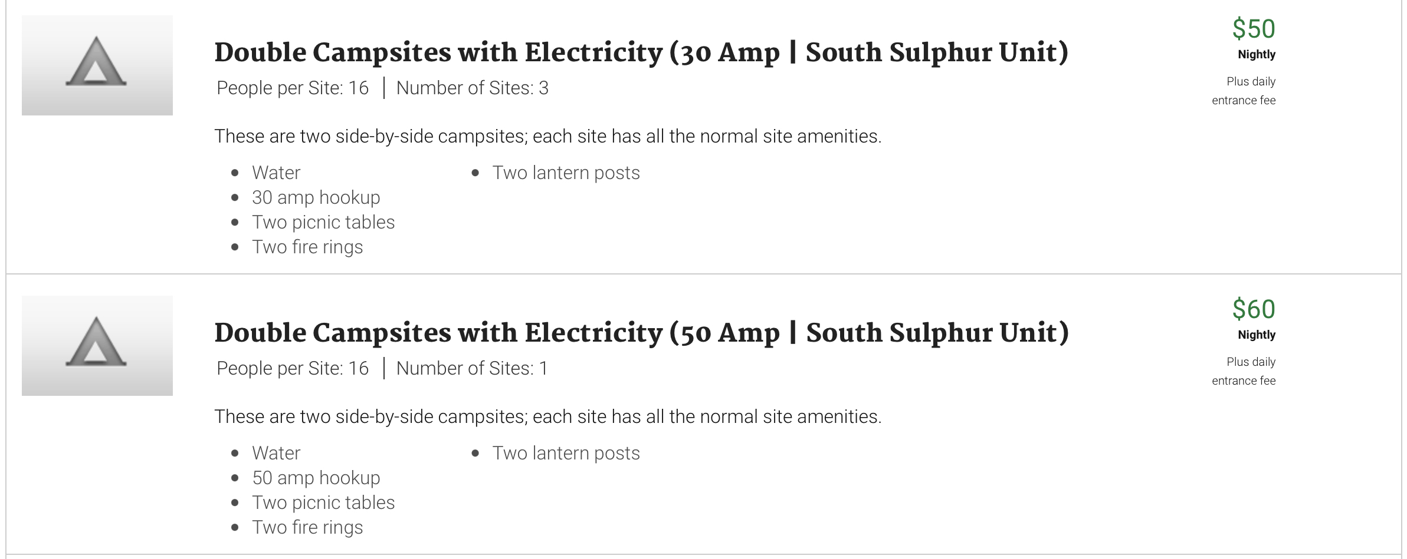

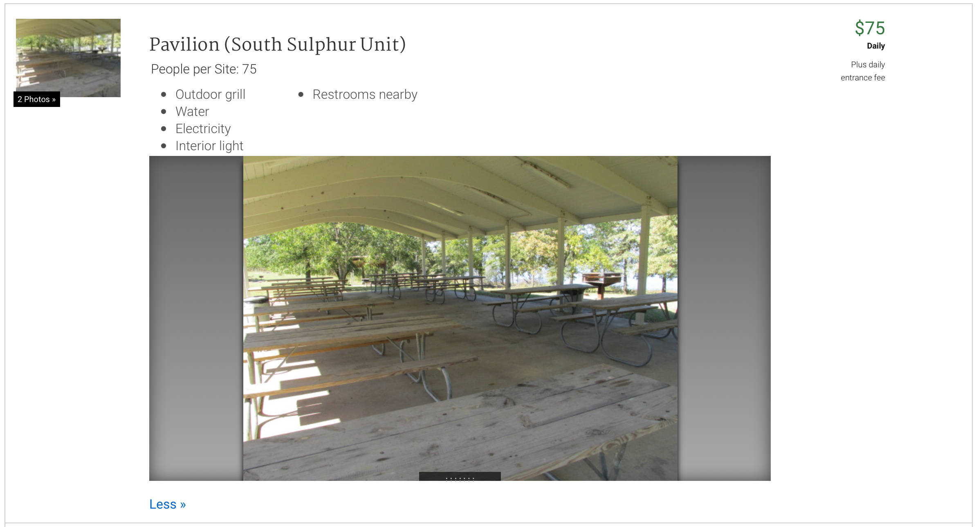
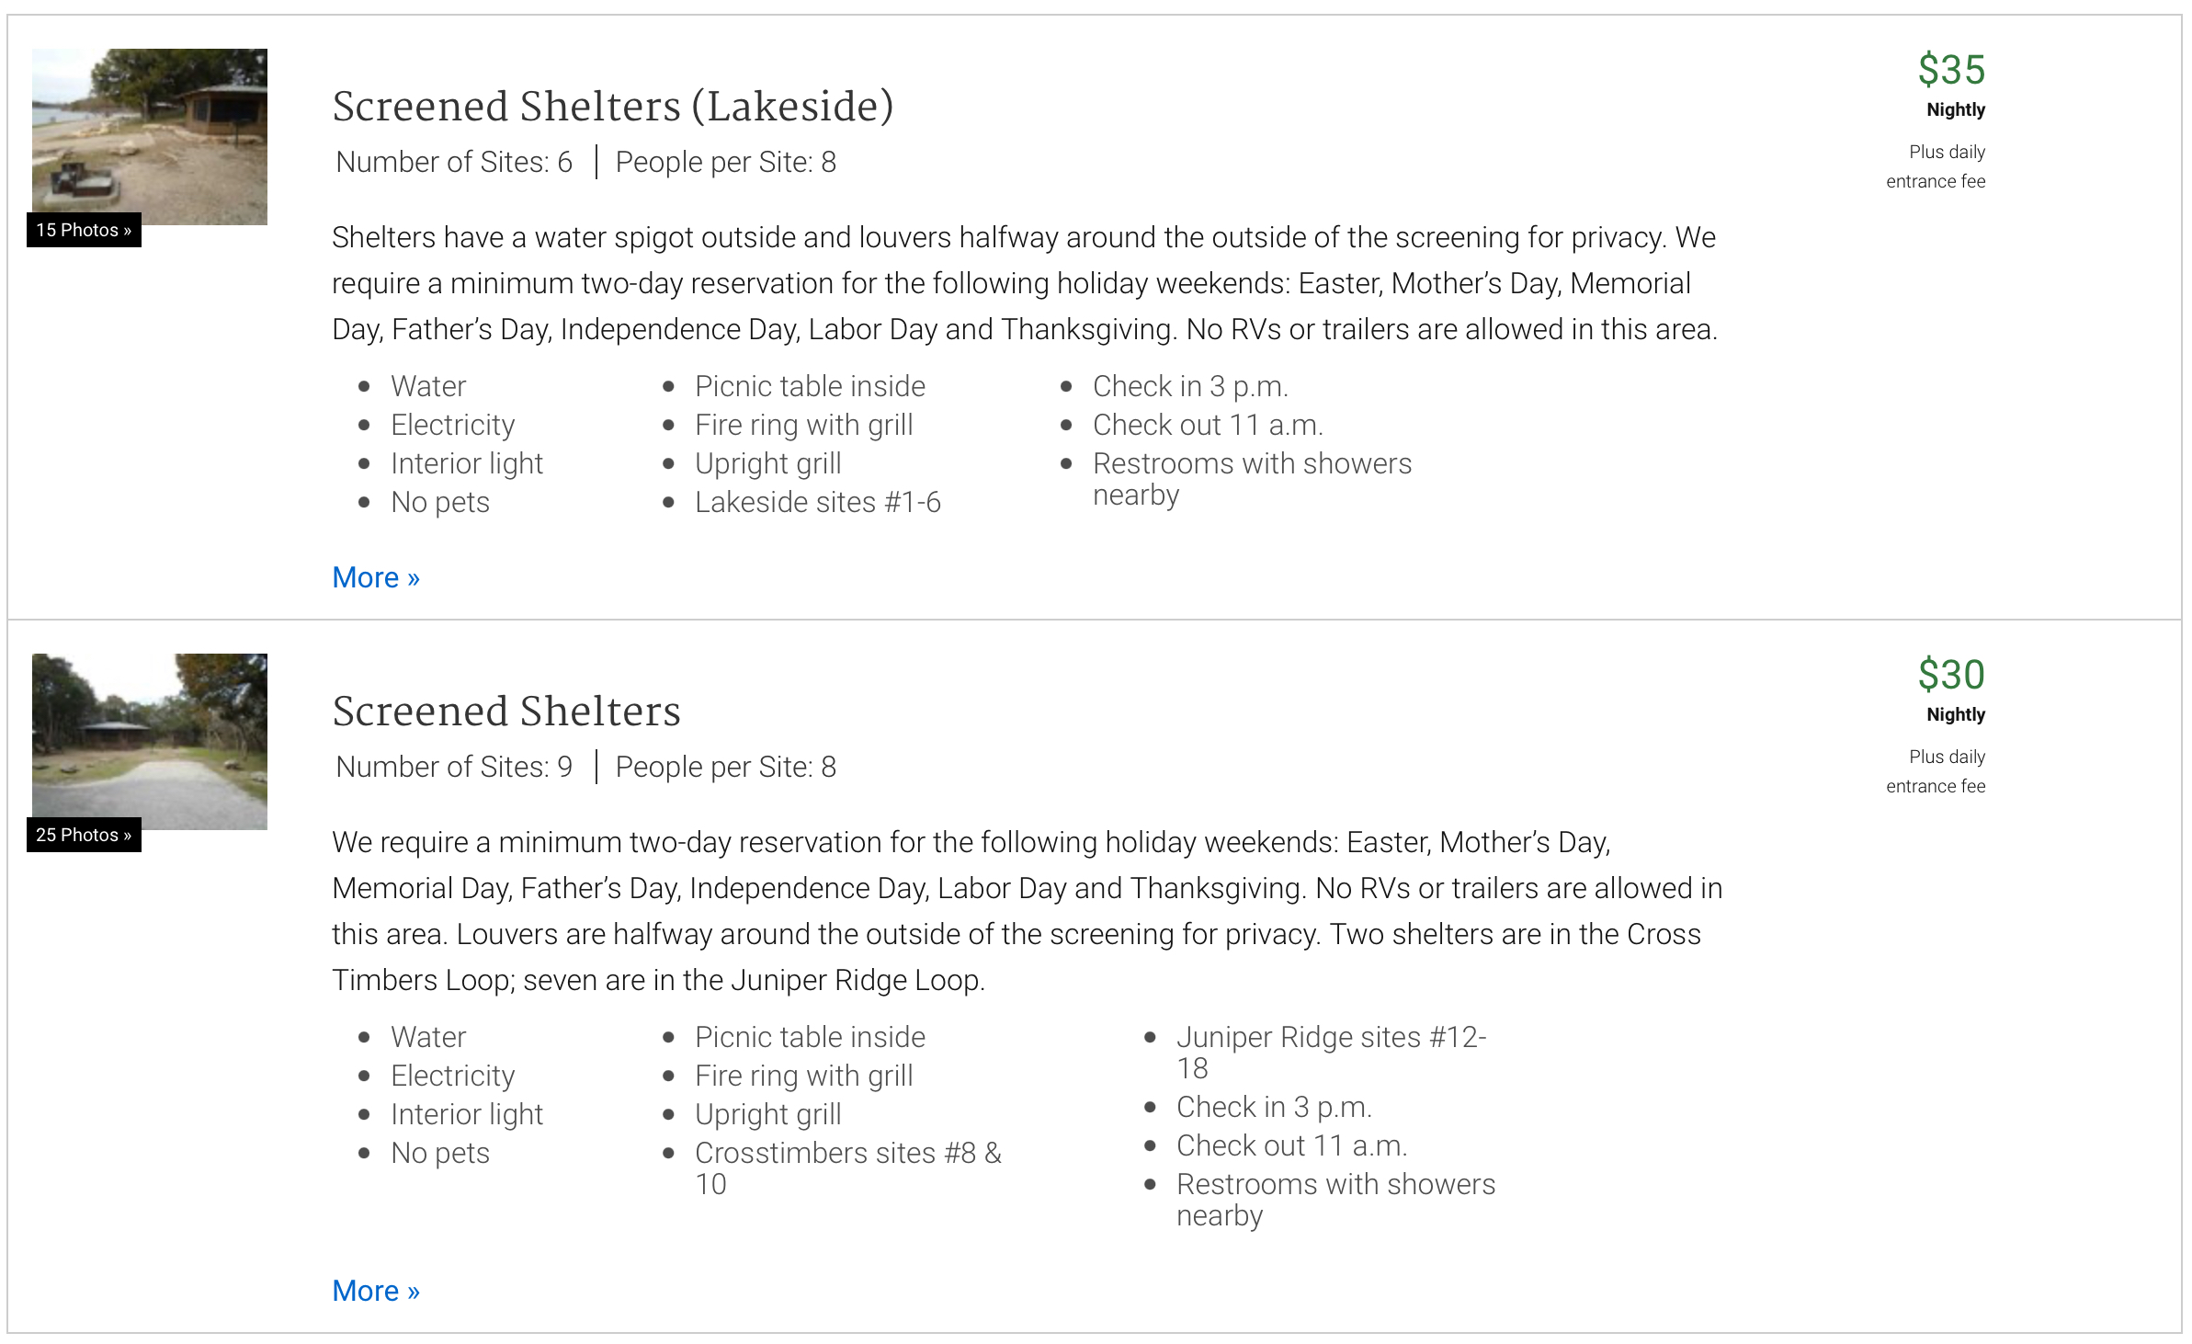
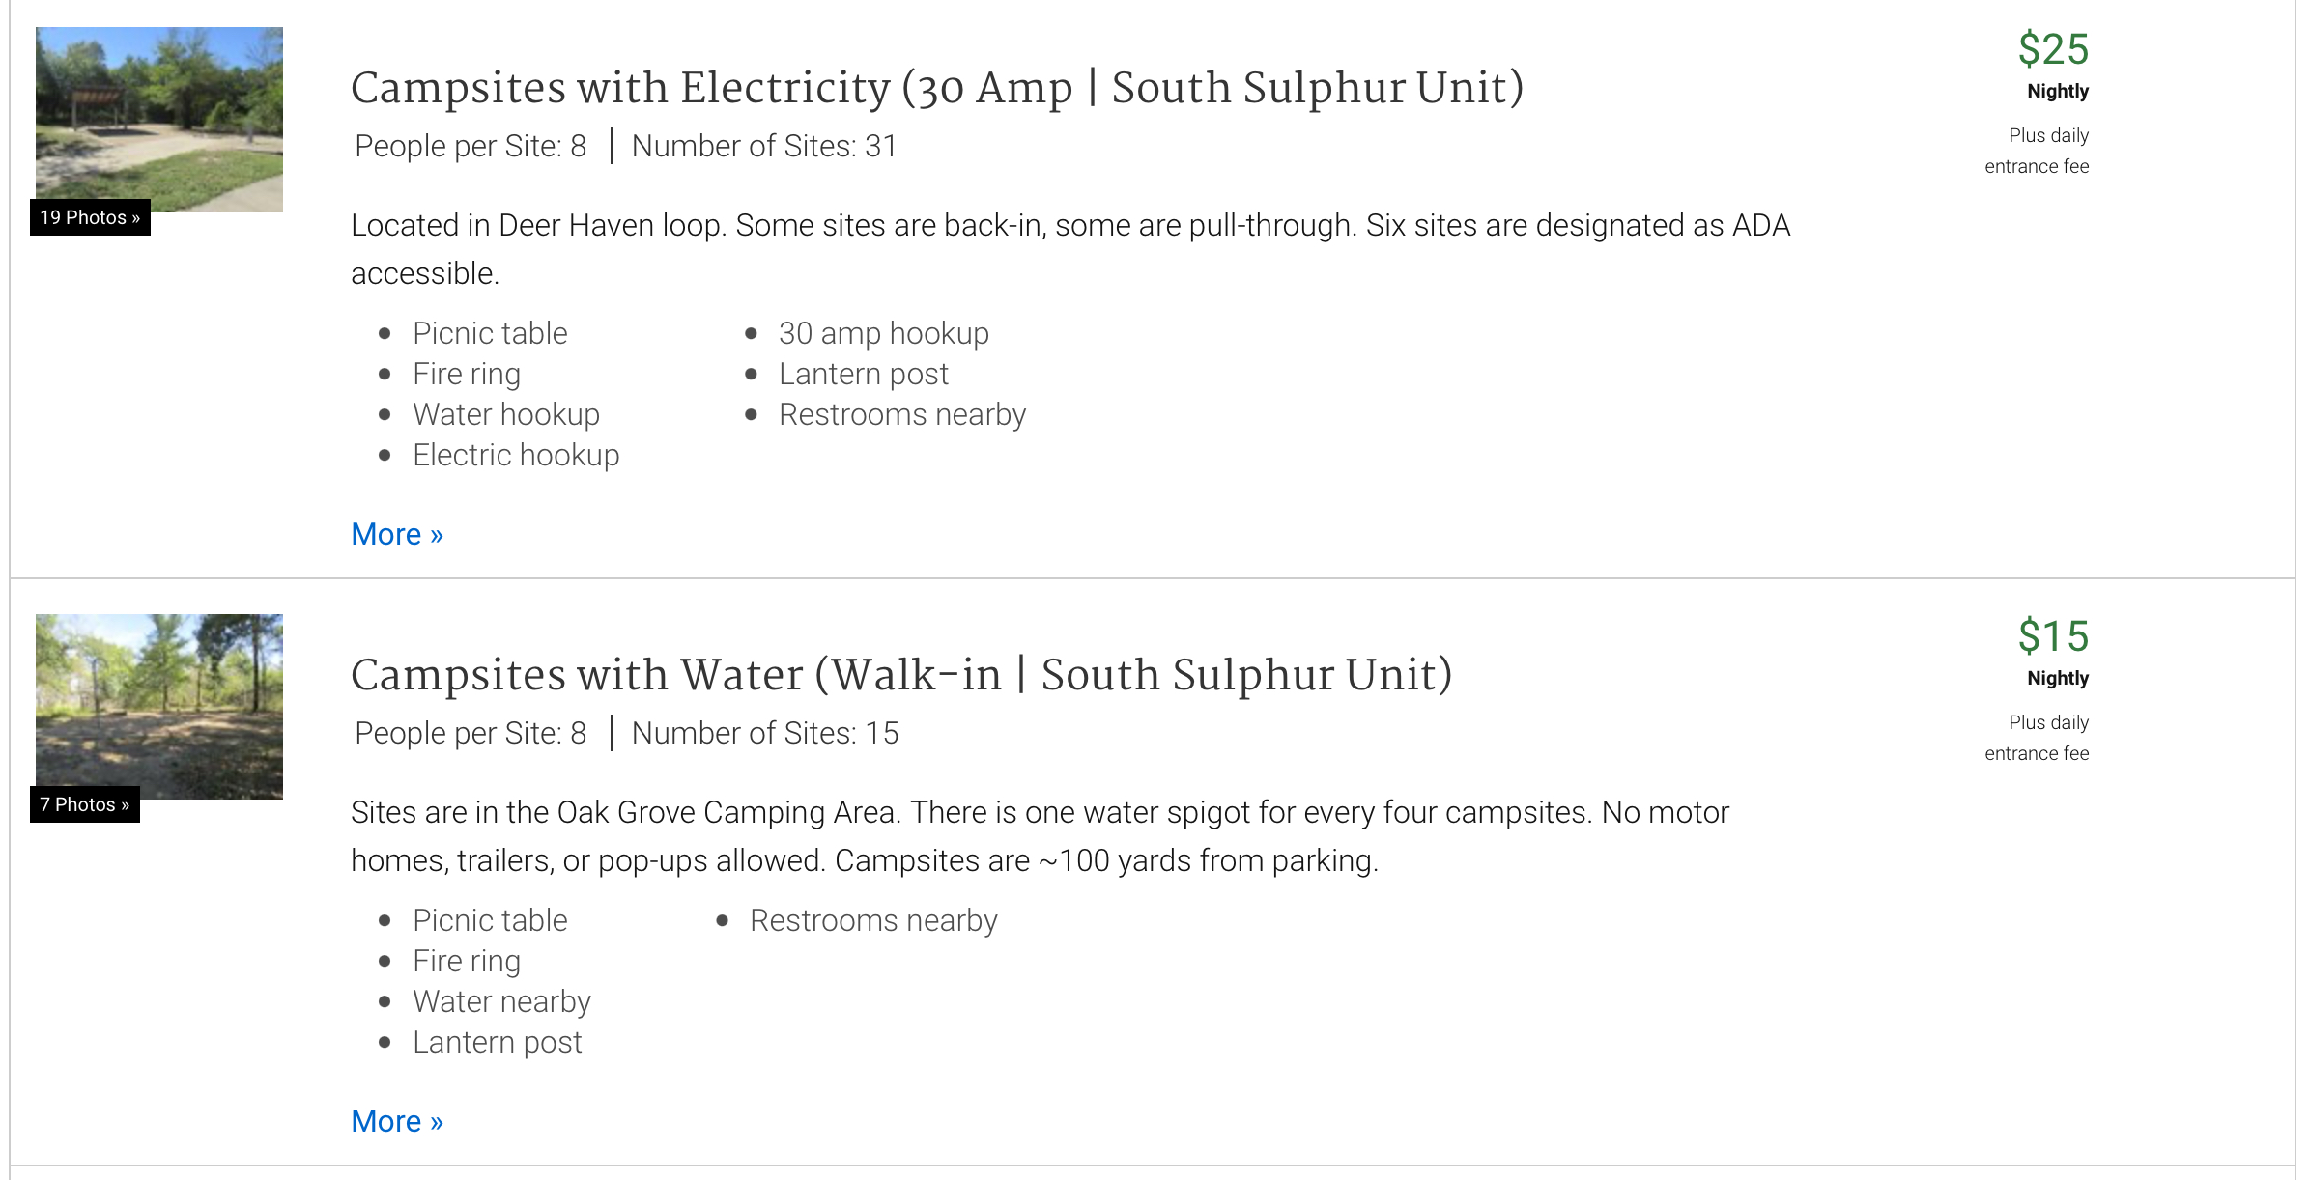
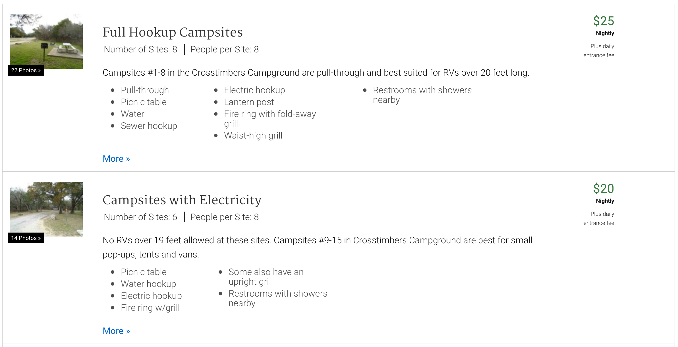
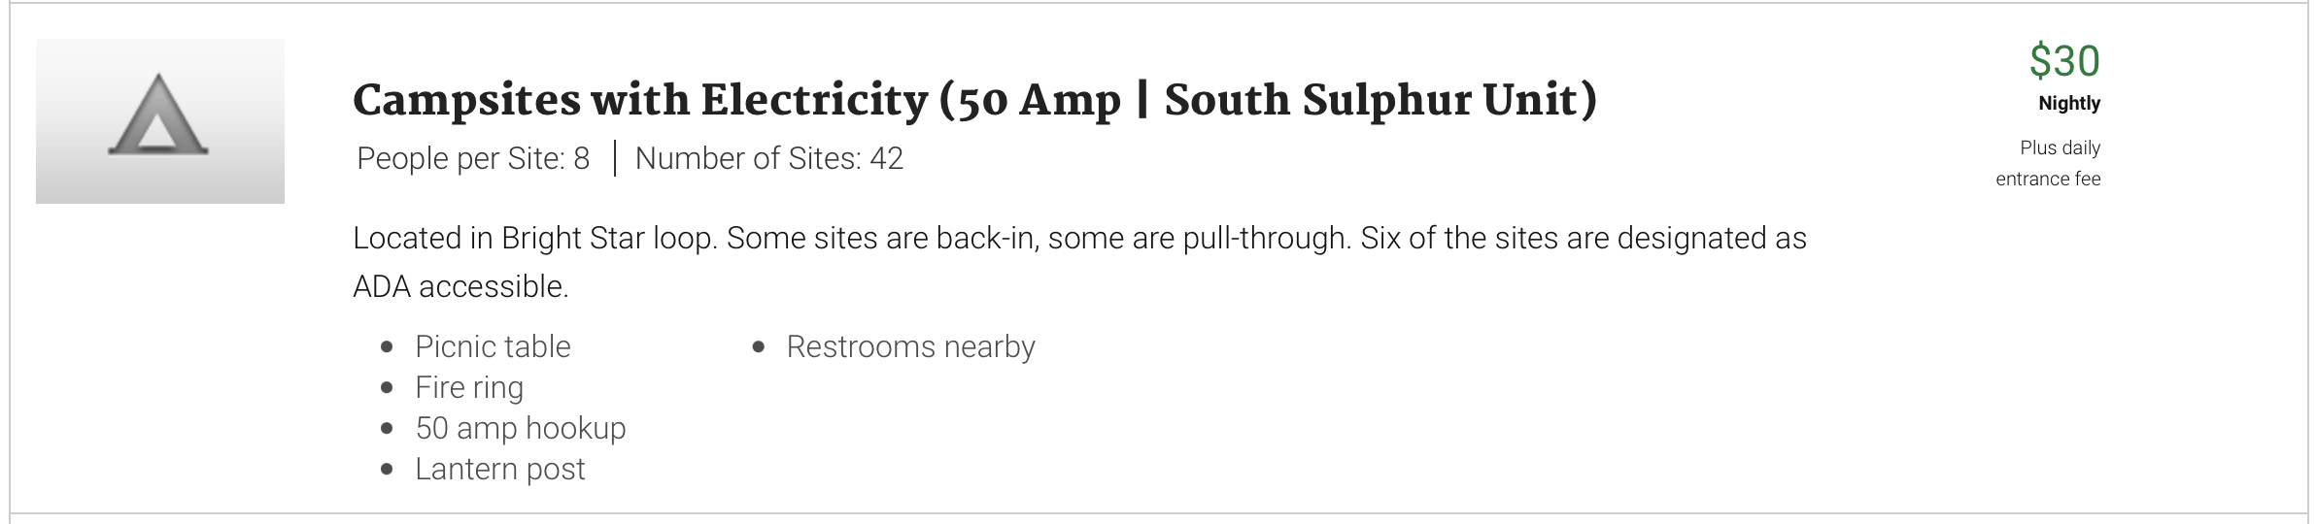
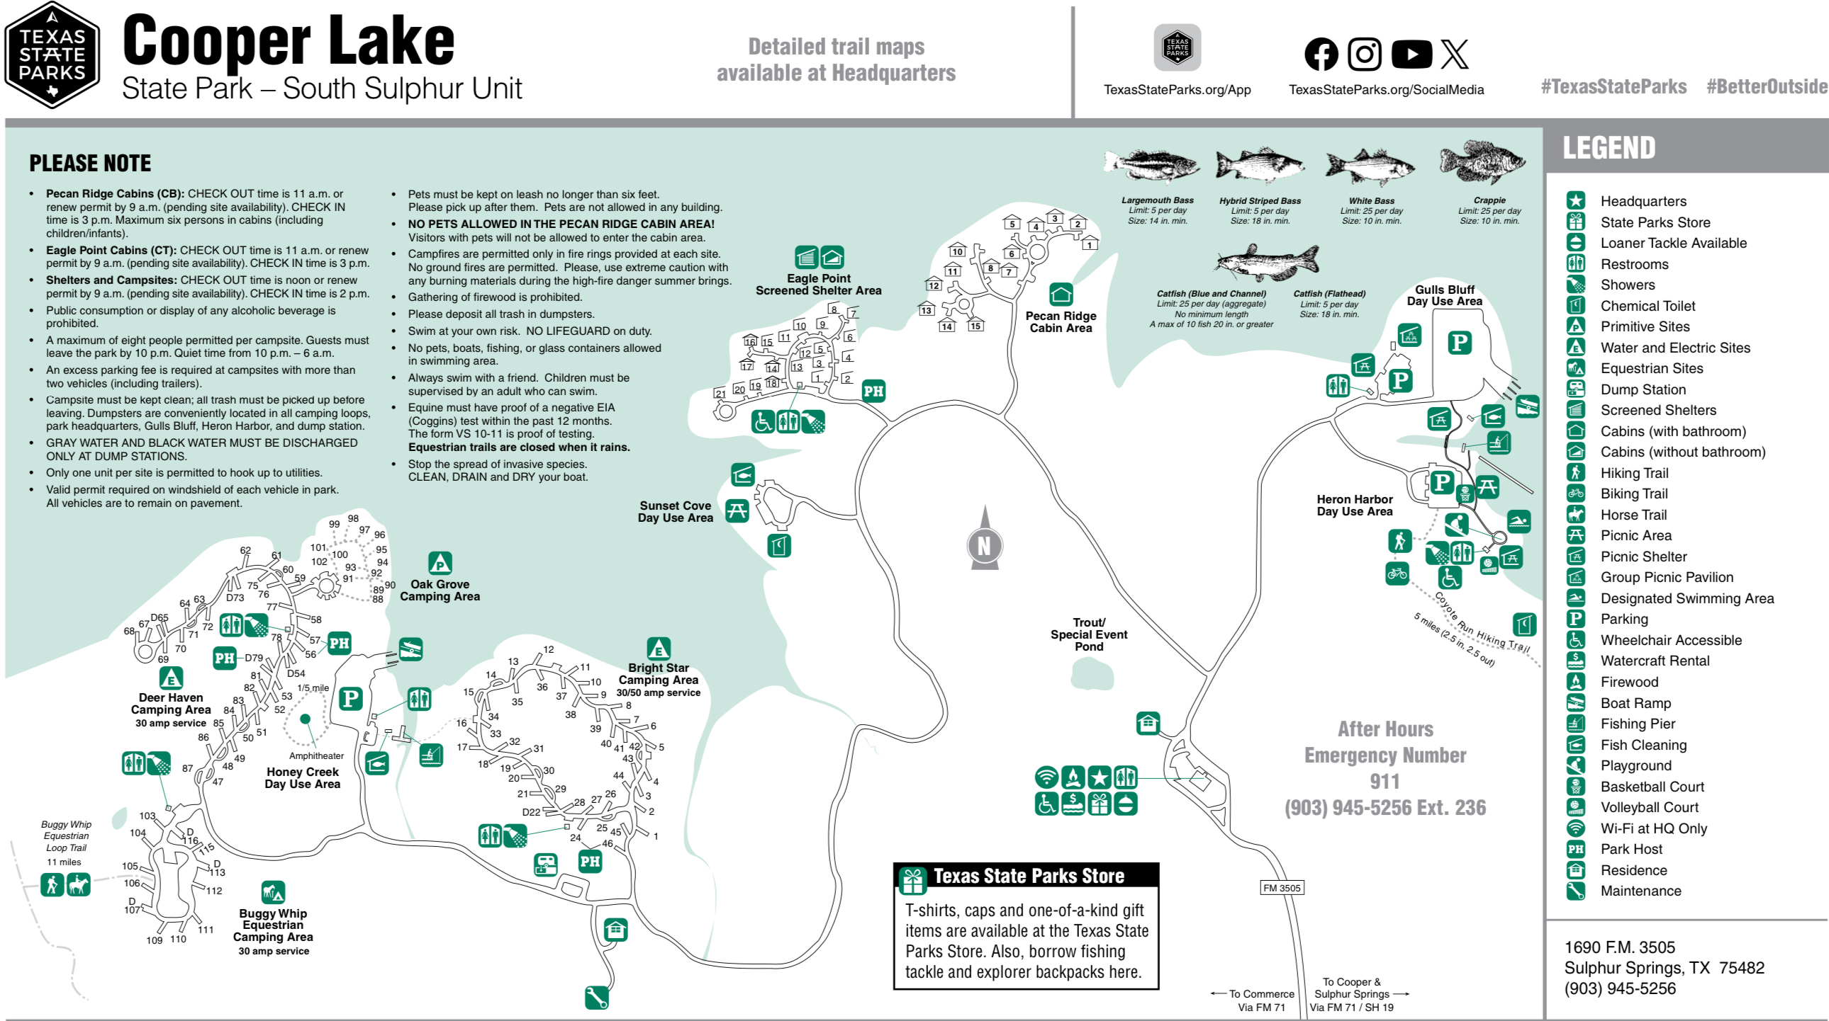
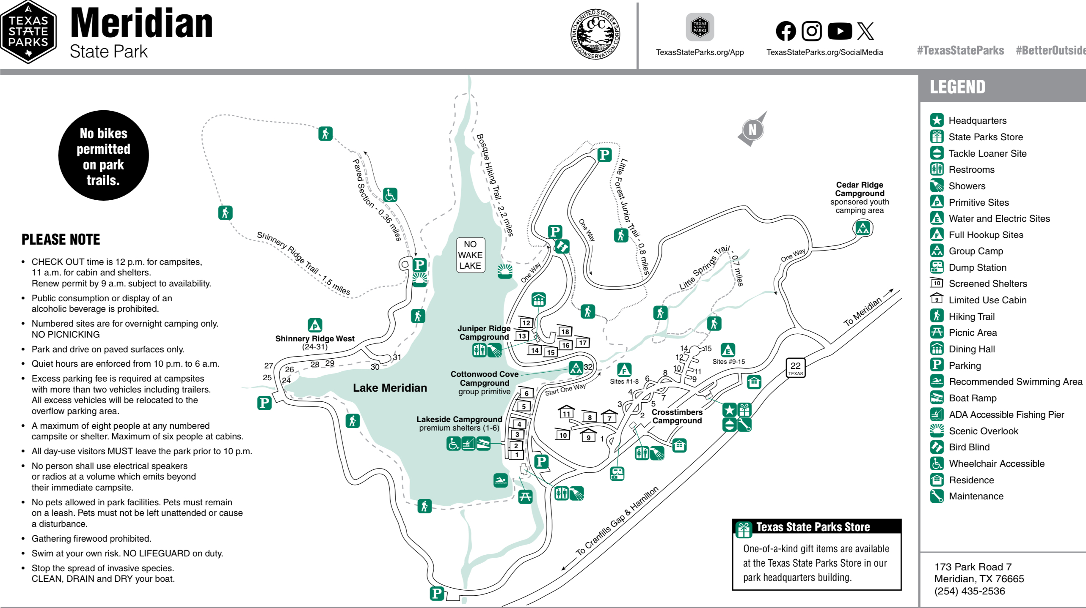
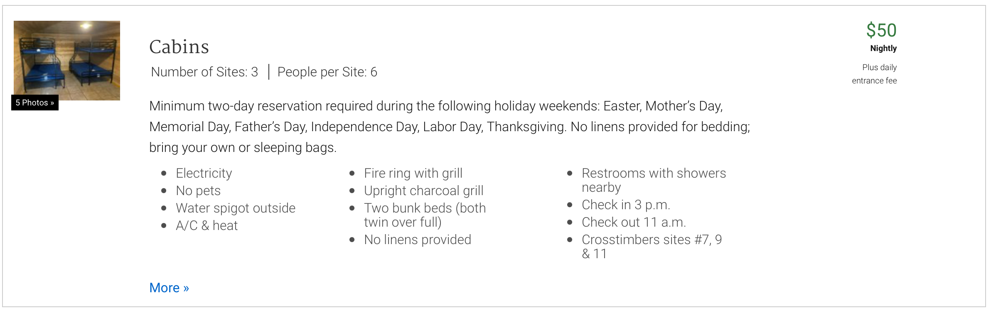
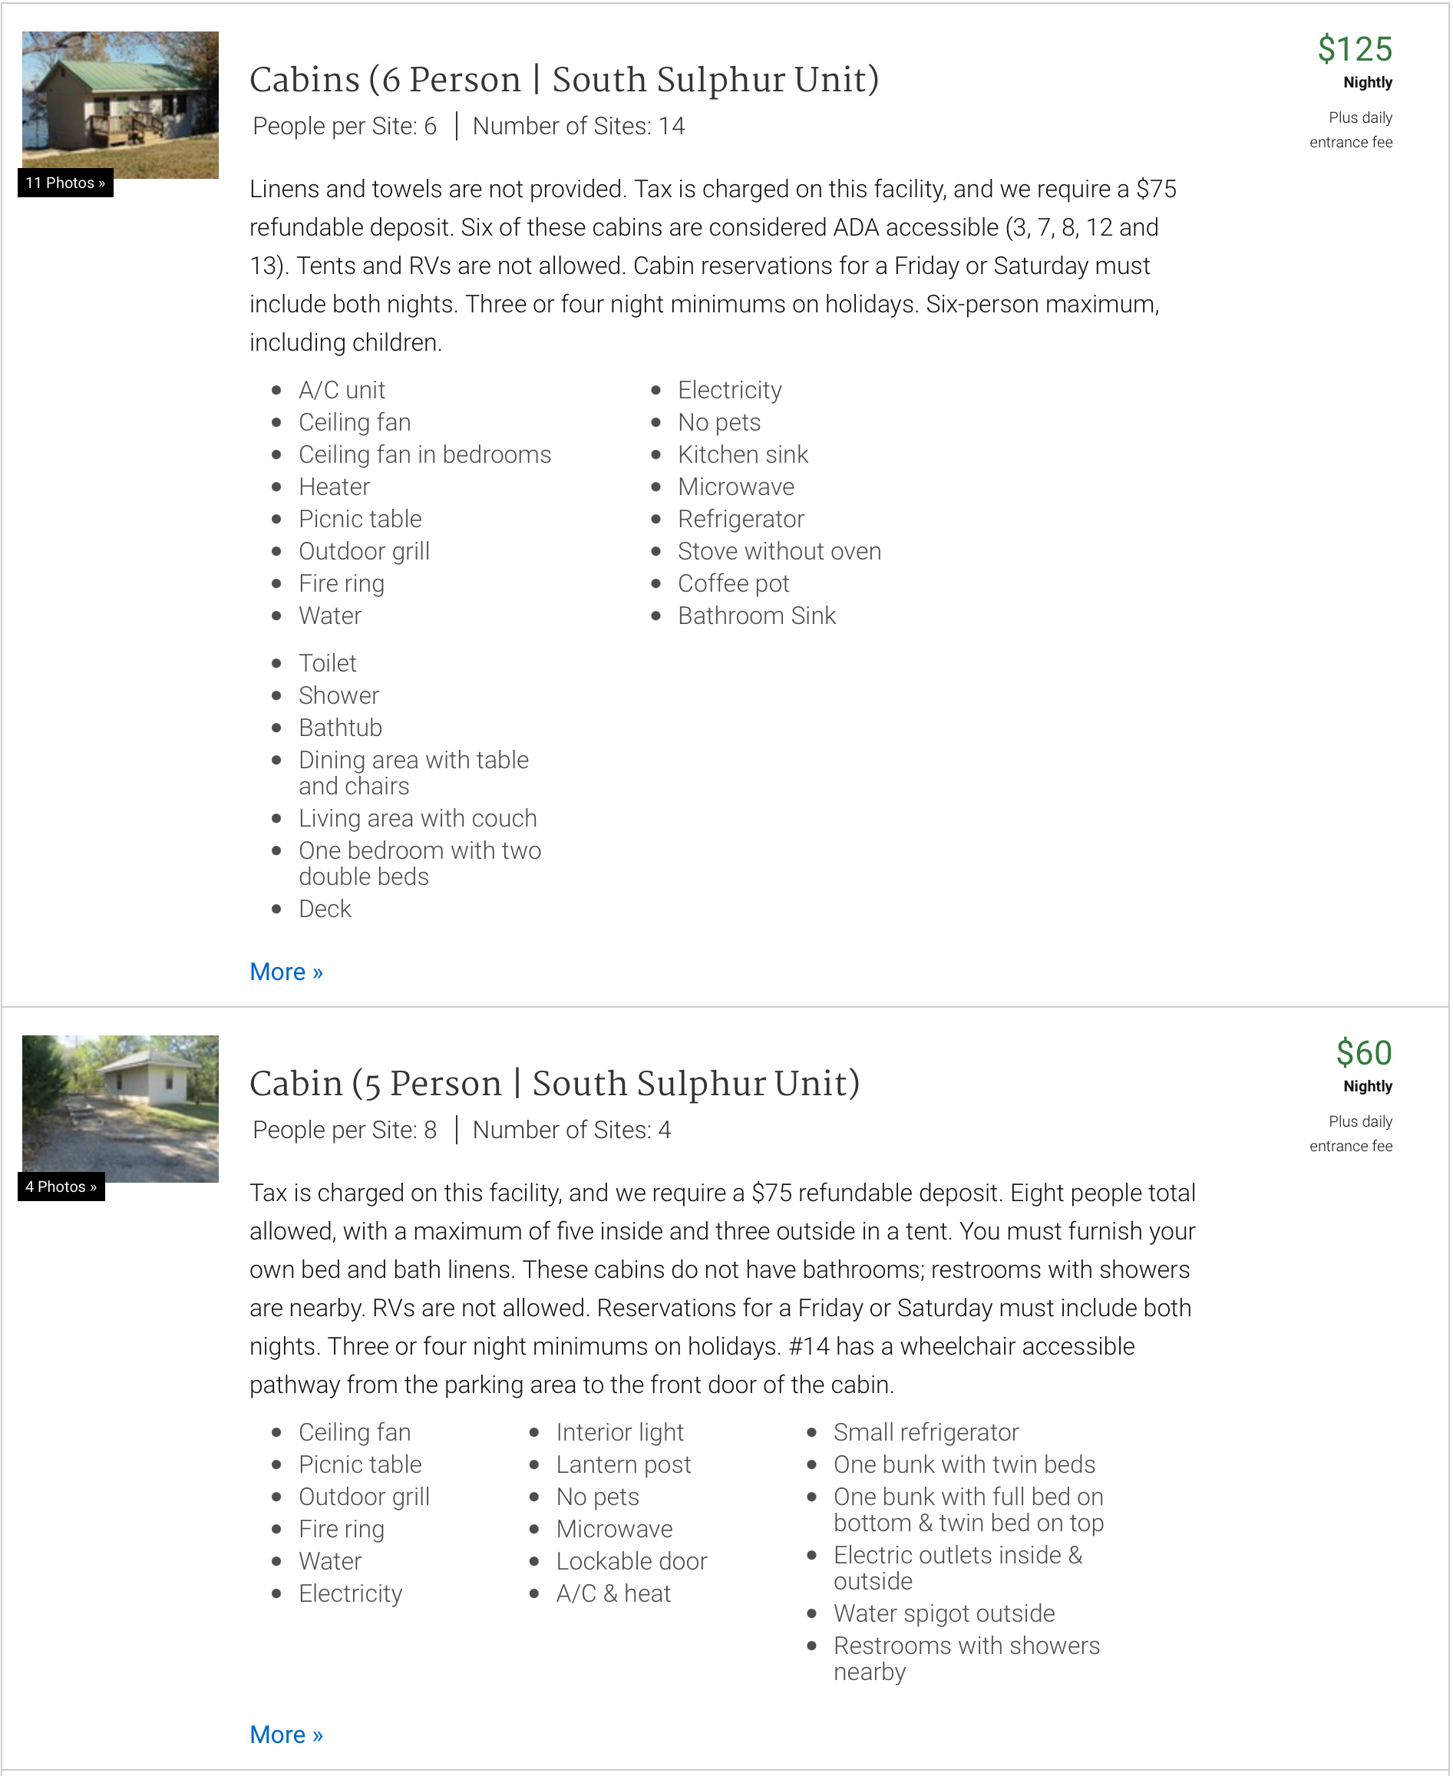
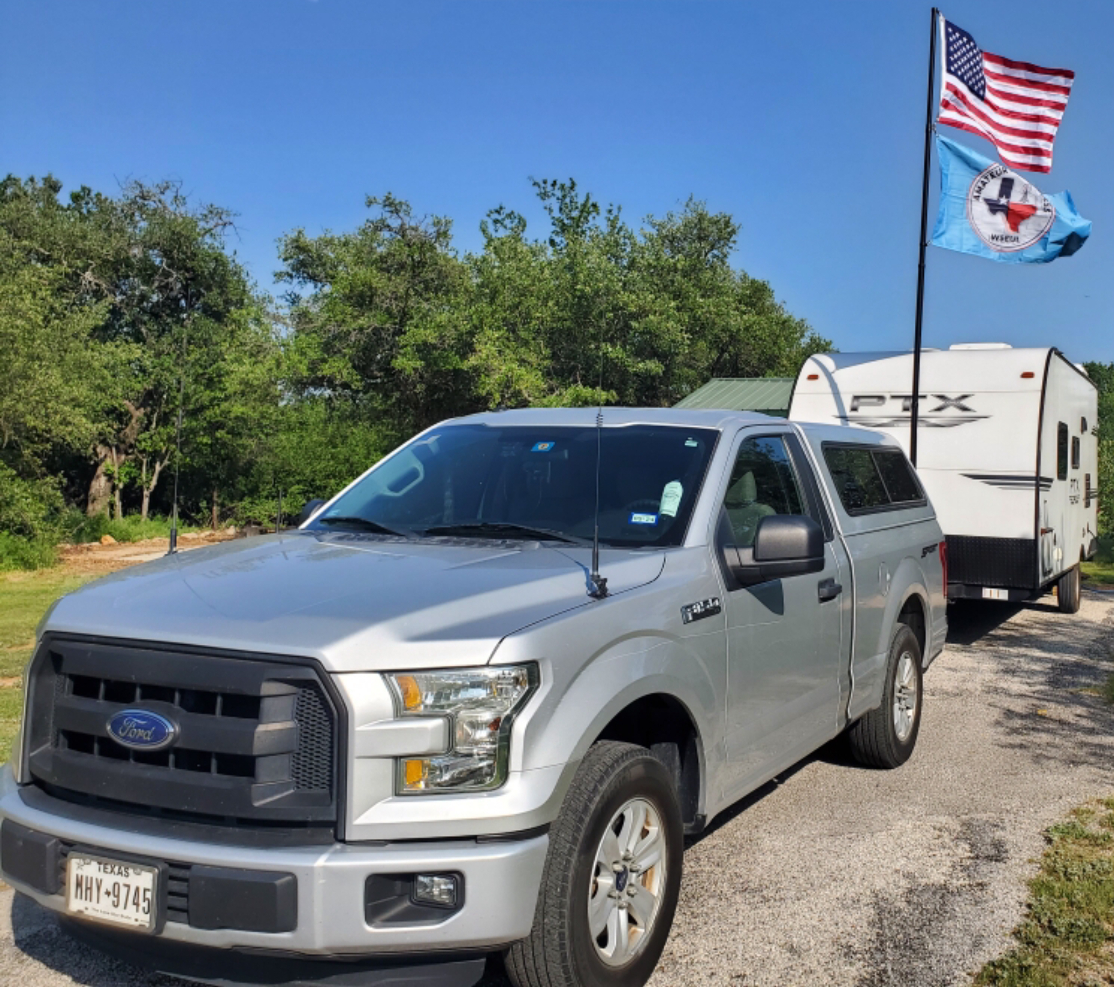
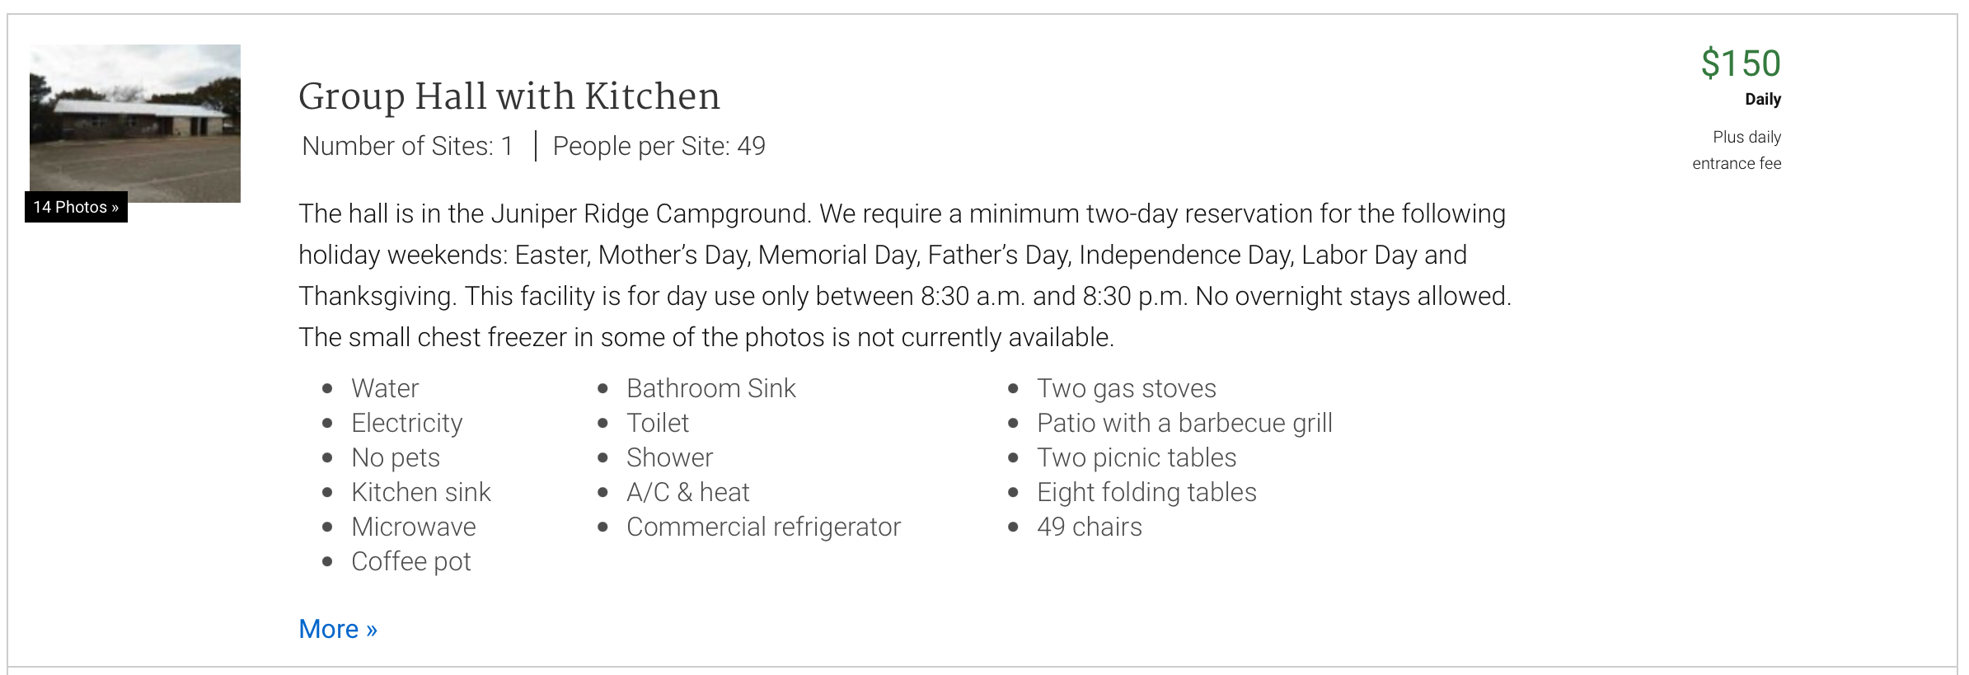
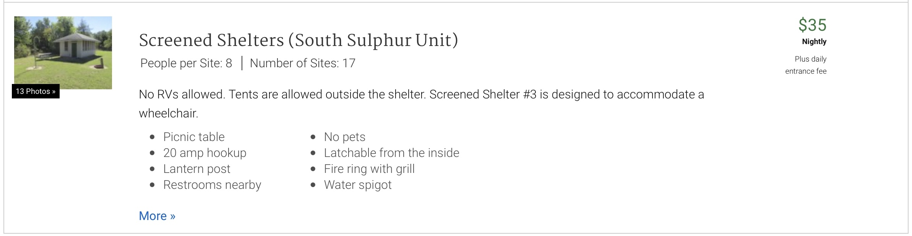
Parks On The Air
Where to next & When?

Slide 19
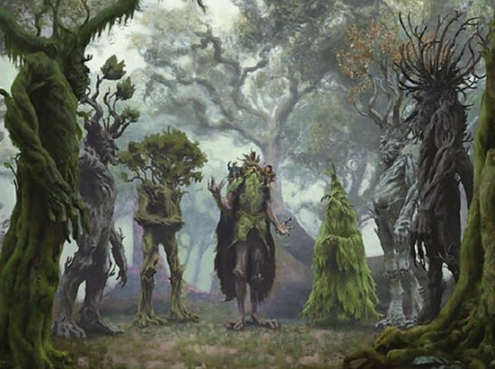
Arbor Days
Recap

Slide 20
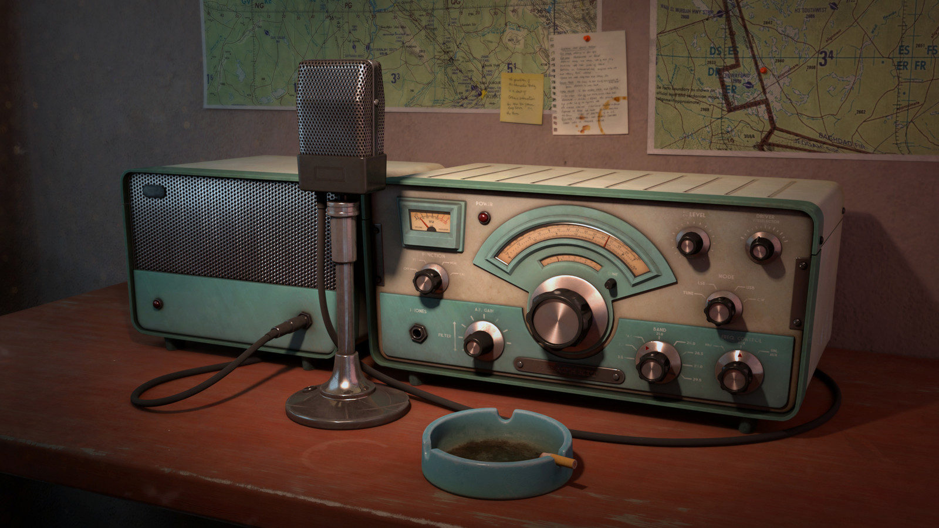
Erik
Greg
Chris
Members

Slide 21

Motion To Adjourn

