Slide 1


Slide 2
March 13, 2024

Slide 3
Introductions

Slide 4
Member Updates

Slide 5
Minutes

Slide 6
Treasurer’s Report

Slide 7

C.E.R.T Update

Slide 8
Local Happenings

Slide 9
Euless ARC Gatherings
ERBC – Every Friday, @ 0830
Texan Kitchen 415 N Main, Euless, TX 76039
H‑E‑B Joint Radio Club Breakfast, every 3rd Saturday, Egg Haven Cafe, 760 Airport Fwy, Suite 100, Hurst, RSVP by midnight Thursday
Club Social – Monday, March 18, 1800 – 1900 Spring Creek BBQ 1509 Airport Freeway. Bedford, TX 76021

Slide 10
Upcoming Events
March
H‑E‑B Joint Radio Club Breakfast, March 16, 0700
CERT Full Team Meeting: March 16, 0900

Slide 11
Upcoming Events
April
TSPOTA: Fort Richardson, April 20-21

Slide 12
Upcoming Events
May
Texas Emergency Management Conference: Fort Worth Convention Center, May 28-31 (CERT Volunteer Opportunities)

Slide 13
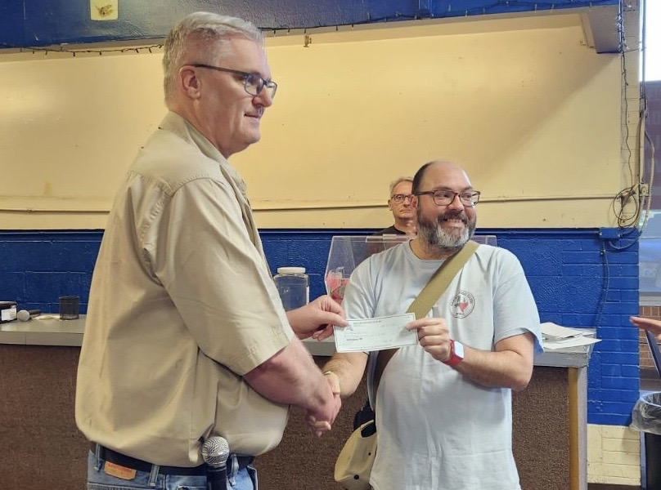
IARC Micro-Grant
At Noon on March 2, 2024 Amateur Radio Euless was awarded/accepted a micro-grant in the amount of $484.90 from the Irving ARC at their 2024 Hamfest. Amateur Radio Euless submitted a proposal to the IARC Micro-Grant Program to replenish the funds used to purchase both antennas for the temporary EOC. The amount requested was $484.90, which was the total cost of both antennas.

Slide 14

2023 Treasury Audit Committee:
Reminder!

Slide 15

Please log your hours.

Slide 16
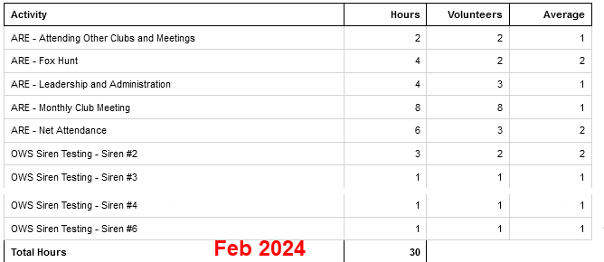
Previous Month Hours

Slide 17
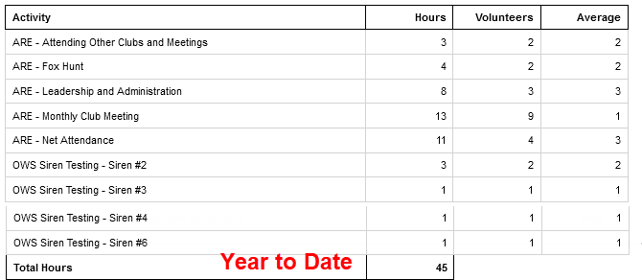
Year To Date Hours

Slide 18


Slide 19
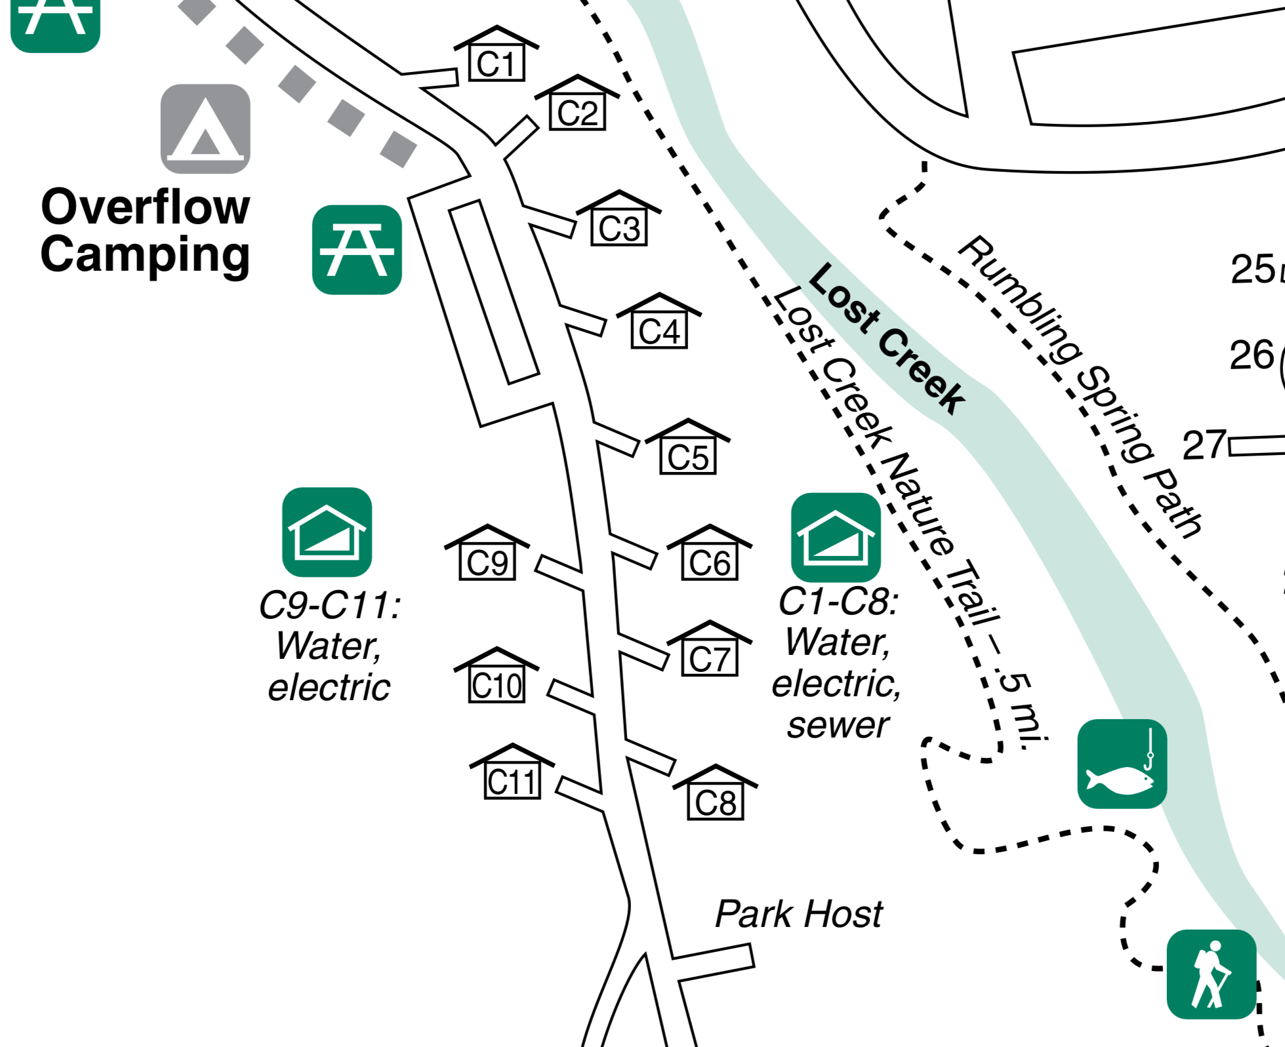

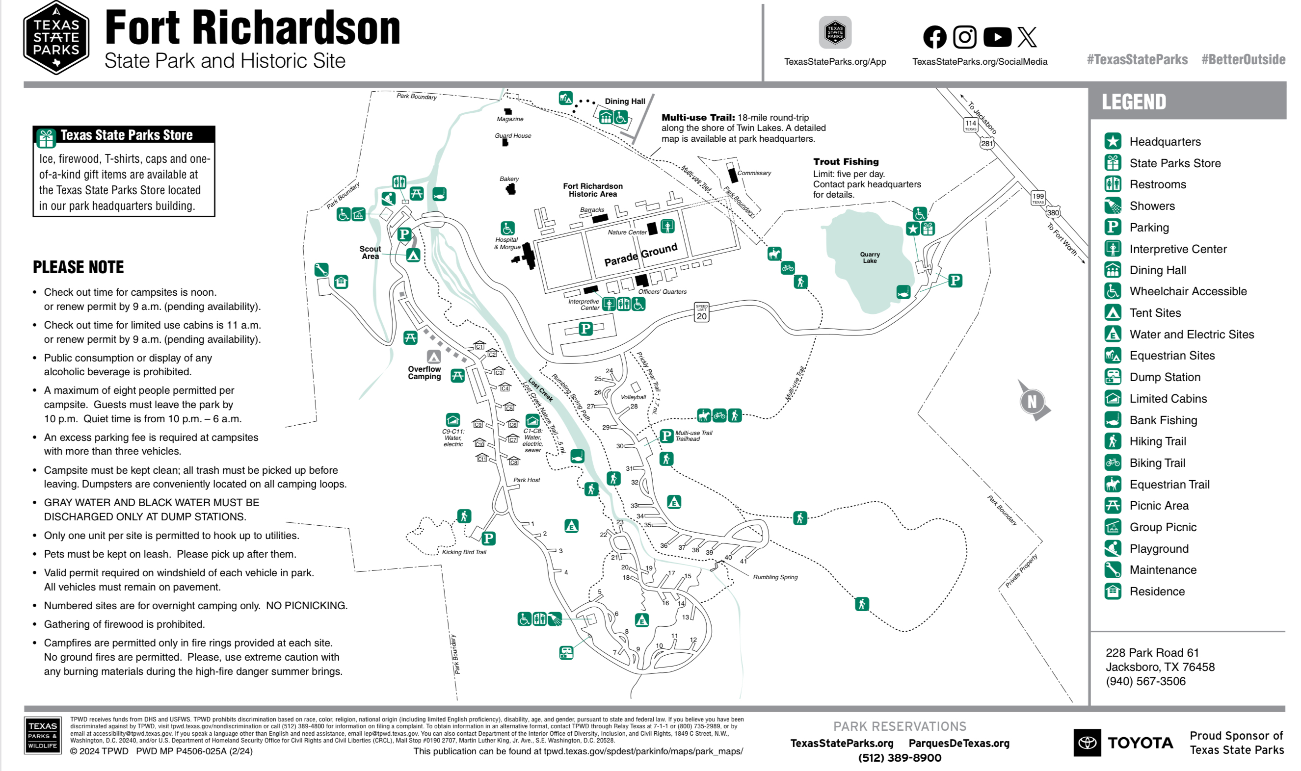
Texas State Parks On The Air
Club Supplied Equipment:
Radios from go kit
Power supply
Antenna controller
Antenna
Ground wires
Chris to bring:
Antenna mast
Flag pole
Flag
Needed items:
Table
Canopy
Members to bring
Food/Beverages
Overnight supplies
Radios
Club T-shirts
Fort Richardson State Park, April 20 & 21, 2024, Cabins 8, 10, & 11.

Slide 20

Erik
Greg
Chris
Members

Slide 21
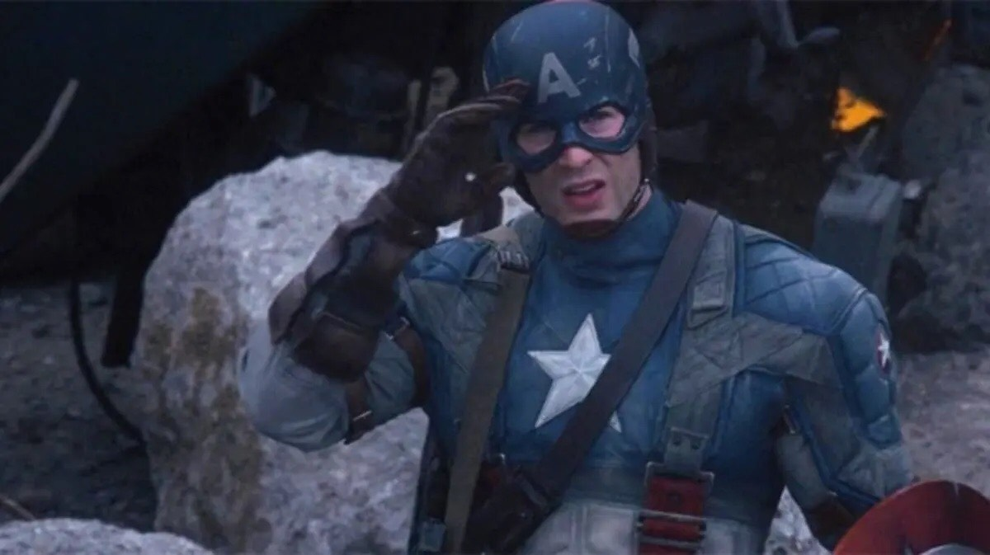
Motion To Adjourn

