Slide 1


Slide 2

January 10, 2024

Slide 3
Introductions

Slide 4
Member Updates

Slide 5
Minutes

Slide 6
Treasurer’s Report

Slide 7

C.E.R.T Update

Slide 8
Local Happenings

Slide 9
Euless ARC Gatherings
ERBC – Every Friday, @ 0830
Texan Kitchen 415 N Main, Euless, TX 76039
H‑E‑B Joint Radio Club Breakfast, every 3rd Saturday, Egg Haven Cafe, 760 Airport Fwy, Suite 100, Hurst, RSVP by midnight Thursday
Club Social – Monday, January 15, 1800 – 1900 54th Street 2201 TX-121. Euless, TX 76039

Slide 10
Upcoming Events
January
Cowtown Hamfest, January 19-20th
H‑E‑B Joint Radio Club Breakfast, January 20th, 0700
CERT Team Meeting - January 20, 0900

Slide 11
Upcoming Events
February
H‑E‑B Joint Radio Club Breakfast, February 17th, 0700
Fire Awards Banquet, February 24, 1900

Slide 12
Irving ARC Microgrant
Comet-NCG 3.5 - 57 MHz Broadband HF + 6 Meters
Comet NCG 144/ 440 MHz
Total cost $484.90

Slide 13
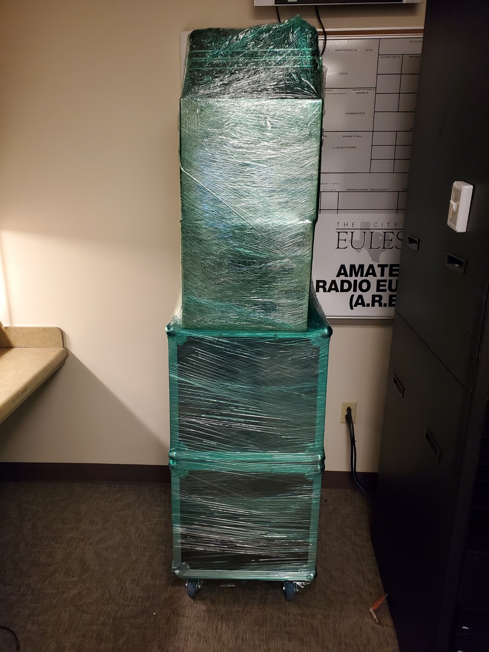
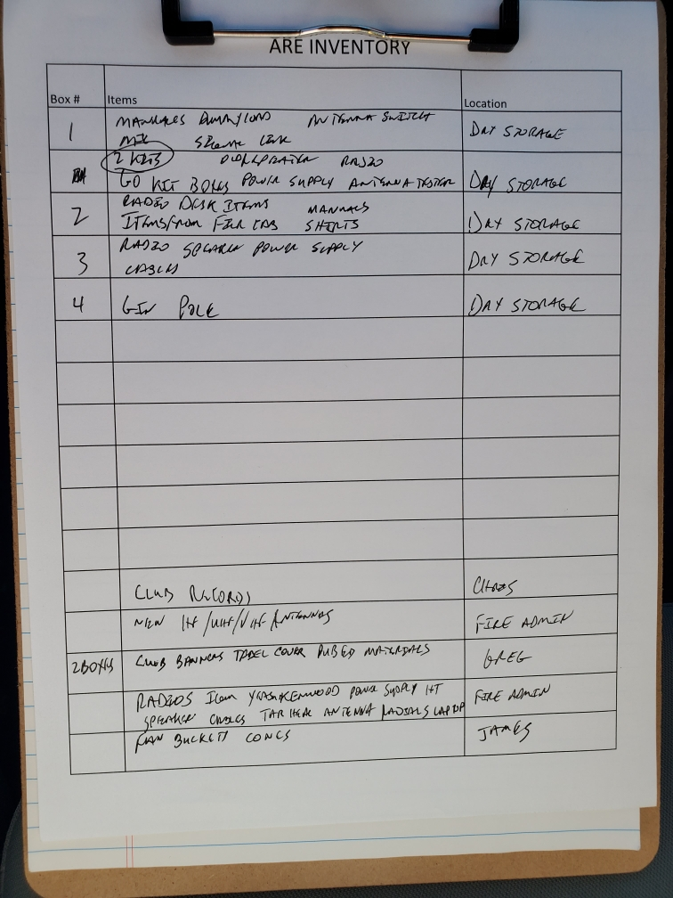
EPD packed up!
Thank you Chris and Greg!

Slide 14

2023 Treasury Audit Committee:
Requesting volunteers!

Slide 15
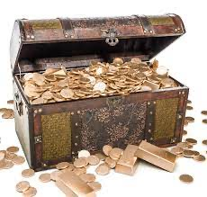
2024 Club Dues
Time to Replenish the Chest.
1. Pay now
2. Pay Online: PayPal
3. Pay by Mail: Please send your payment check made out to Amateur Radio Euless to:
Chris Shanahan
PO Box 281
Euless, TX 76039
(Due to construction of the PD)

Slide 16

Please log your hours.

Slide 17
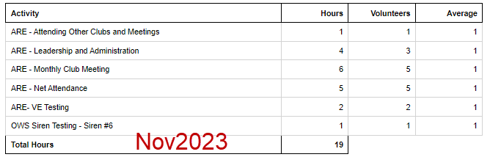
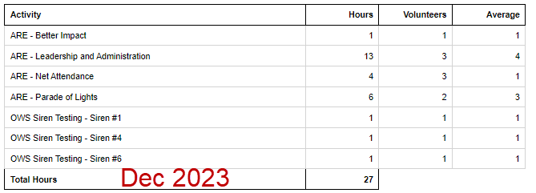
Previous Month Hours

Slide 18
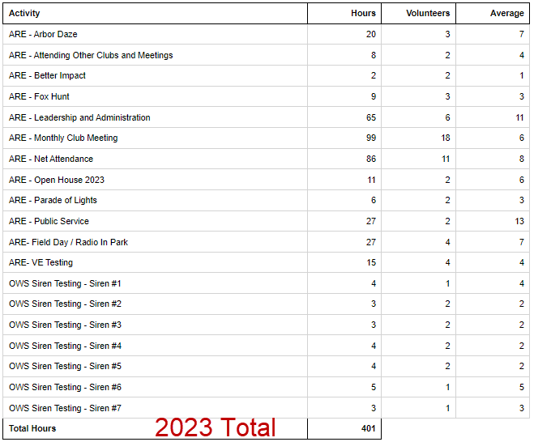
Year To Date Hours

Slide 19


Slide 20

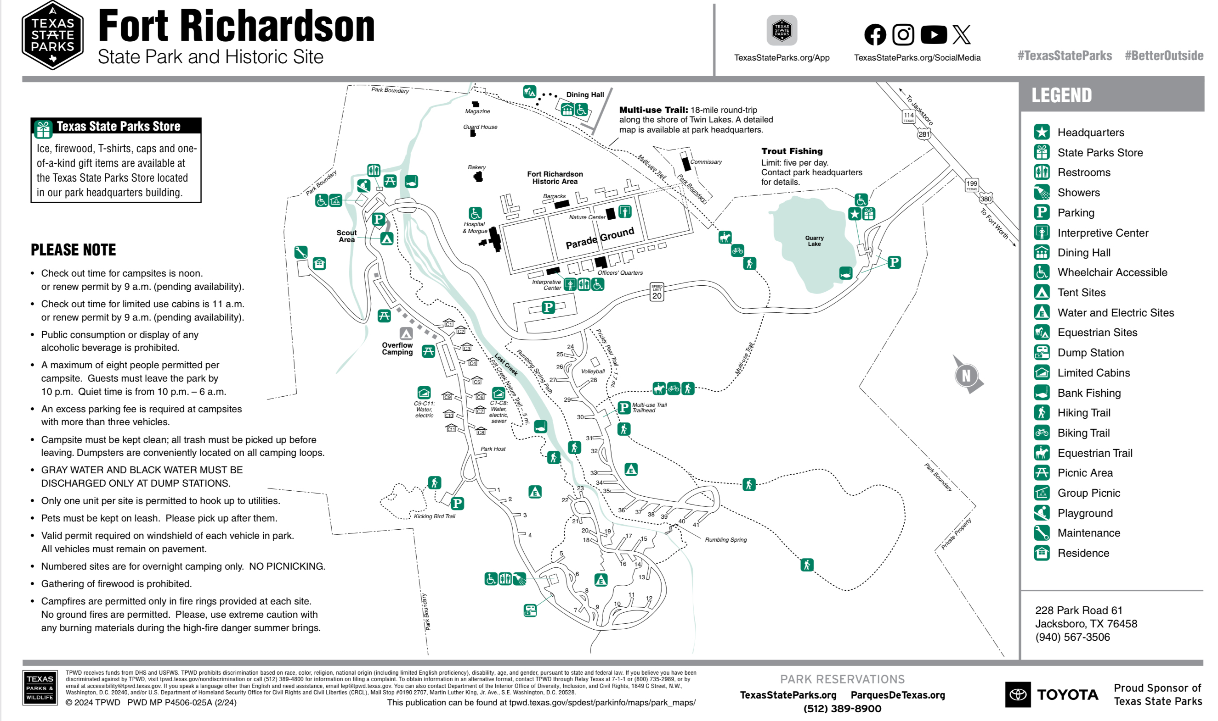
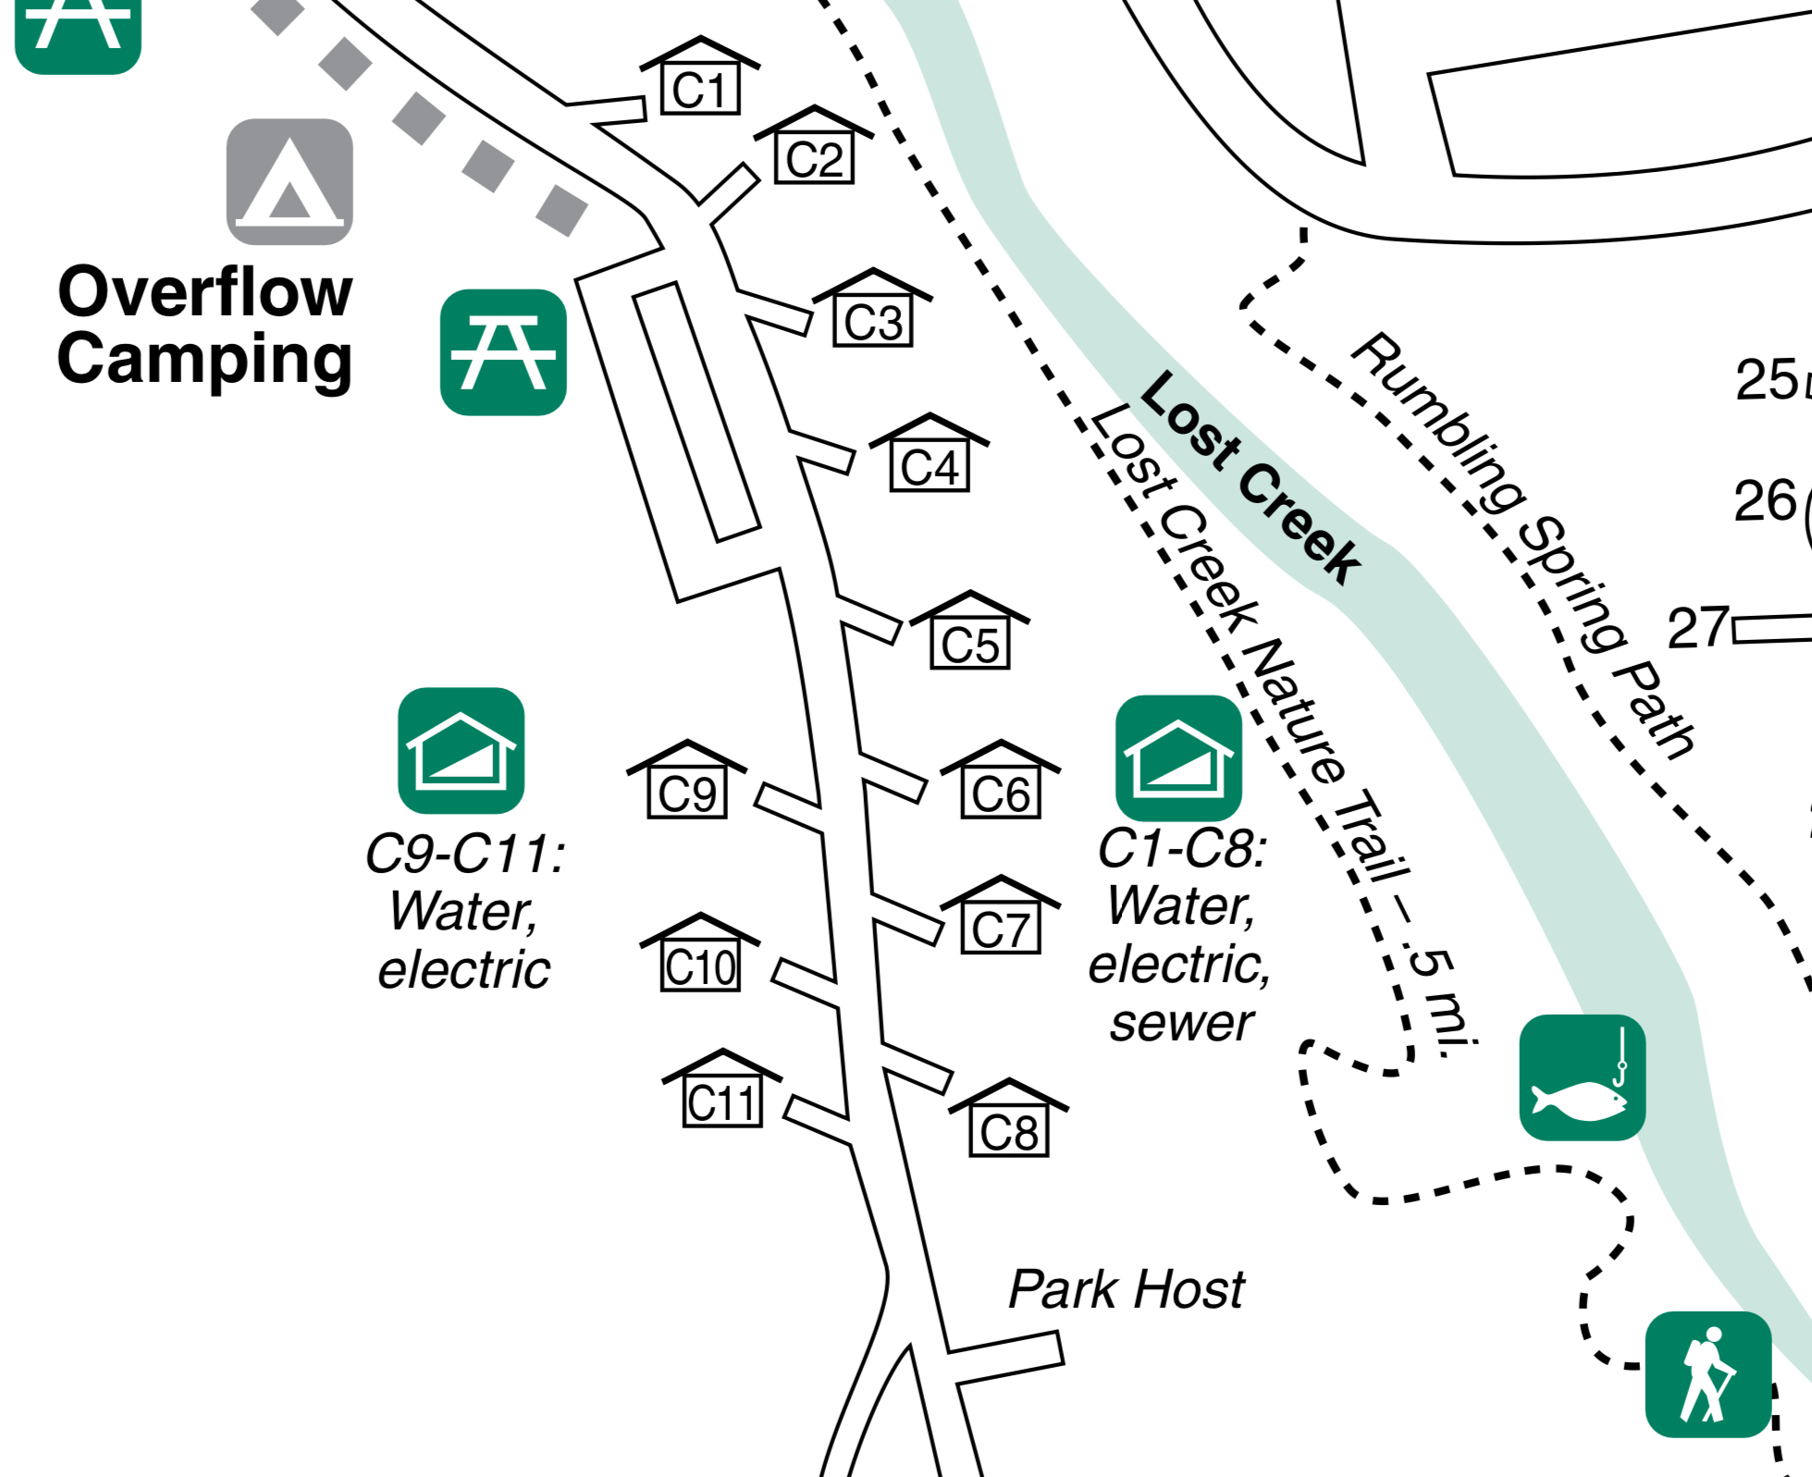
Reserve now!
Texas State Parks On The Air
Fort Richardson State Park, April 20 & 21, 2024, Cabins 8, 10, & 11.

Slide 21

Erik
Greg
Chris
Members

Slide 22
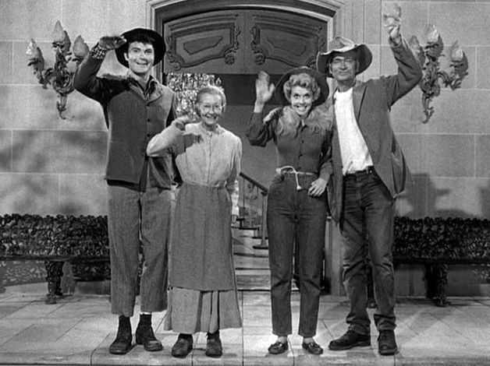
Motion To Adjourn

