Slide 1


Slide 2
February 14, 2024

Slide 3
Introductions

Slide 4
Member Updates

Slide 5
Minutes

Slide 6
Treasurer’s Report

Slide 7

C.E.R.T Update

Slide 8
Local Happenings

Slide 9
Euless ARC Gatherings
ERBC – Every Friday, @ 0830
Texan Kitchen 415 N Main, Euless, TX 76039
H‑E‑B Joint Radio Club Breakfast, every 3rd Saturday, Egg Haven Cafe, 760 Airport Fwy, Suite 100, Hurst, RSVP by midnight Thursday
Club Social – Monday, February19, 1800 – 1900 Cotton Patch 4020 William D Tate Ave. Grapevine, TX 76051

Slide 10
Upcoming Events
February
H‑E‑B Joint Radio Club Breakfast, February 17, 0700
CERT Team Training: Radio, February 17, 0900
Fire Awards Banquet, February 24, 1900

Slide 11
Upcoming Events
March
Irving ARC Hamfest, March 2, 0800
H‑E‑B Joint Radio Club Breakfast, March 22, 0700
CERT Full Team Meeting: March 22, 0900

Slide 12
Upcoming Events
April
TSPOTA: Fort Richardson, April 20-21

Slide 13
Irving ARC Hamfest
March 2, 2024 - 8:00 AM - 2:00 PM
Irving Amateur Radio Club, Inc. Hamfest
Betcha Bingo, 2420 W. Irving Blvd., Irving, Texas 75061
Grand prize, a Yaesu FT-710AESS HF/6 Meter radio, we'll be awarding the following hourly prizes:
12:00 PM Yaesu FTM-500 Dual-Band Digital Mobile
11:00 AM Icom IC-T10 Dual-Band FM HandHeld (2 radios awarded)
10:00 AM Icom IC-V3500 2 Meter FM Mobile (2 radios awarded)
9:00 AM Yaesu FT-2980 2 Meter FM Mobile (2 radios awarded)

Slide 14
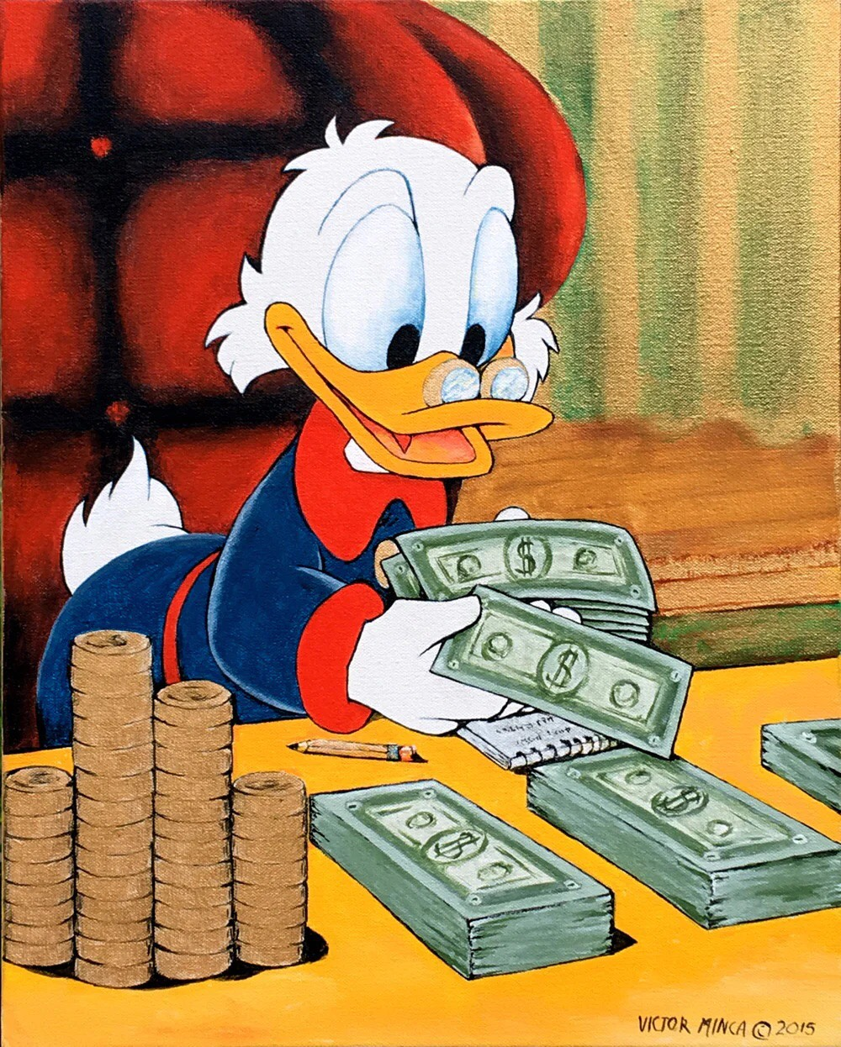
2023 Treasury Audit Committee:
Reminder!

Slide 15

Please log your hours.

Slide 16
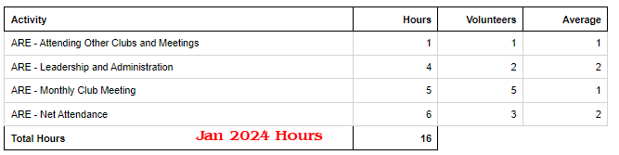
Previous Month Hours

Slide 17
Year To Date Hours

Slide 18


Slide 19

NTX Radio Clubs
https://ke5kpc.net/ntxradioclubs/

Slide 20
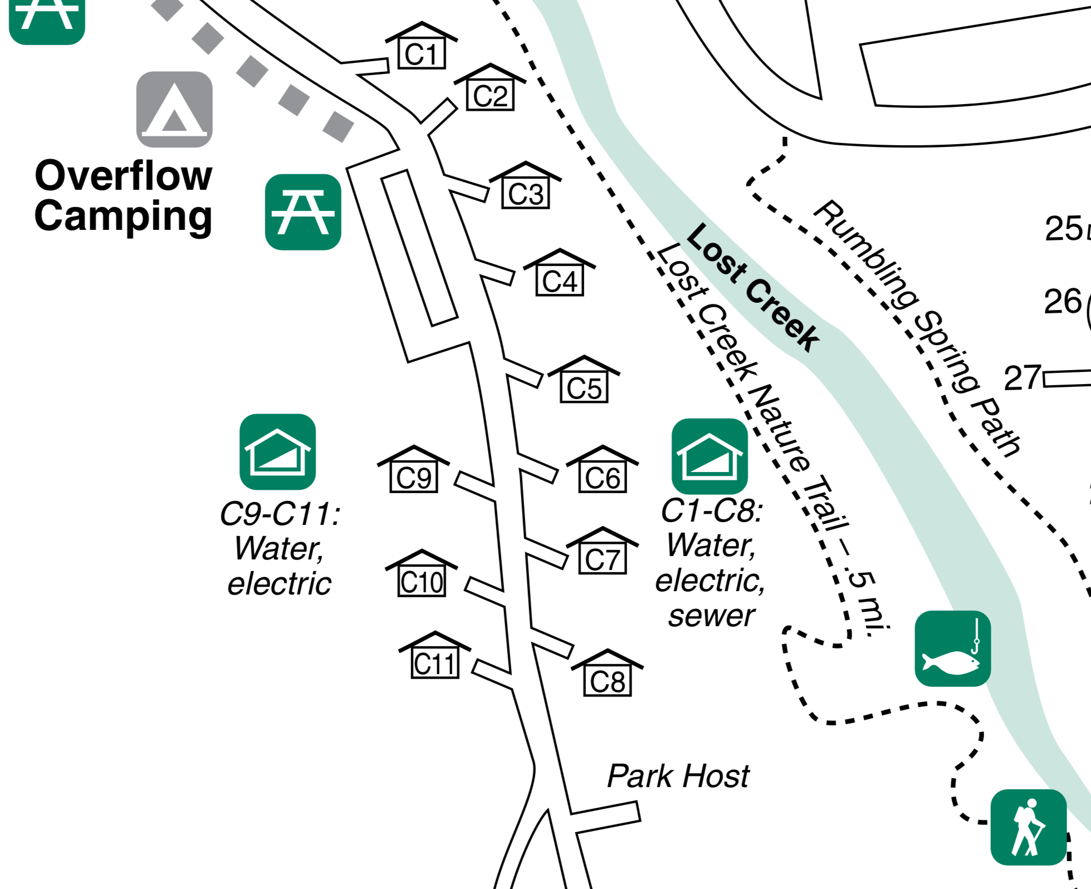

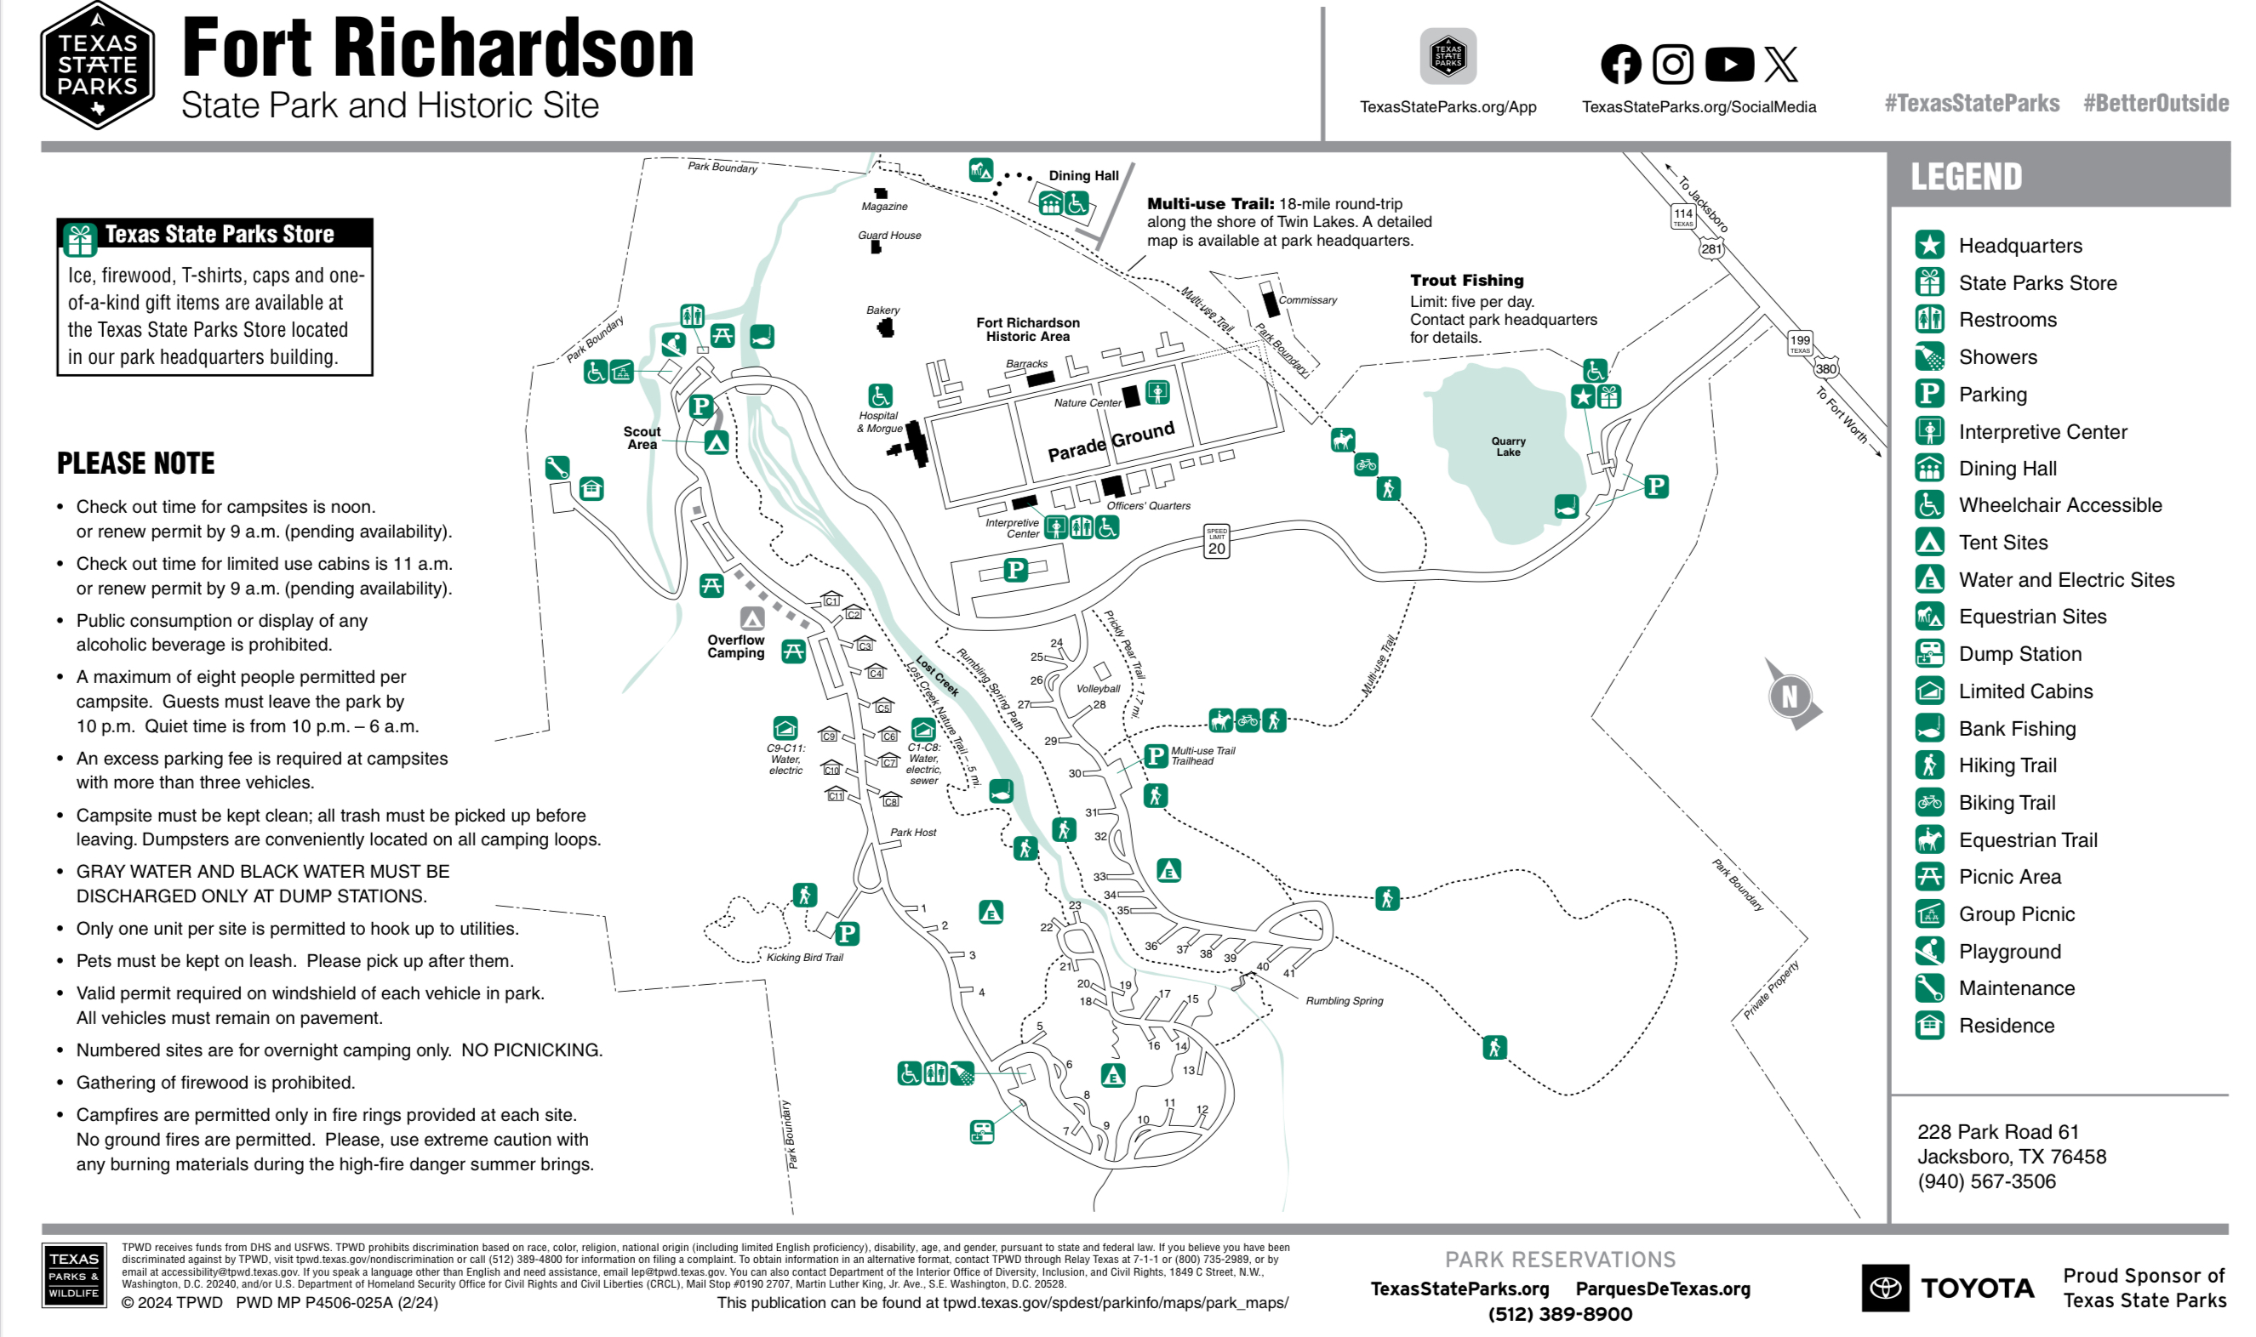
Texas State Parks On The Air
Club Supplied Equipment:
Radios from go kit
Power supply
Antenna controller
Antenna
Ground wires
Chris to bring:
Antenna mast
Flag pole
Flag
Needed items:
Table
Canopy
Members to bring
Food/Beverages
Overnight supplies
Radios
Club T-shirts
Fort Richardson State Park, April 20 & 21, 2024, Cabins 8, 10, & 11.

Slide 21

Erik
Greg
Chris
Members

Slide 22
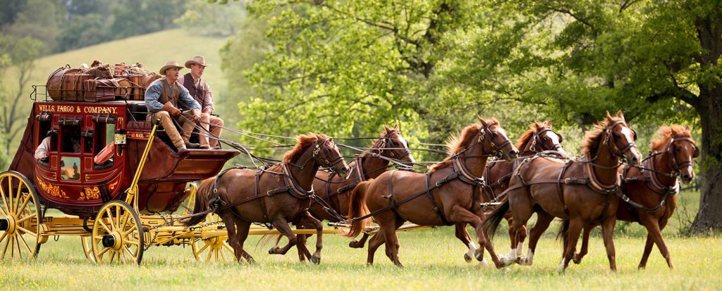
Motion To Adjourn

