Slide 1


Slide 2
October 11, 2023

Slide 3
Introductions

Slide 4
Member Updates

Slide 5
Minutes

Slide 6
Treasurer’s Report

Slide 7

C.E.R.T Update

Slide 8

C.E.R.T Radio Shirt
EULESS CERT COMMUNICATIONS | No Pocket 10 and Up | Pocket 10 and Up | No Pocket 20 and Up | Pocket 20 and Up
S-XL | $20.50 | $26.50 | $17.00 | $23.00
XXL | $23.50 | $29.50 | $20.00 | $26.00
XXXL | $24.50 | $30.50 | $21.00 | $27.00
XXXXL | $25.50 | $31.50 | $22.00 | $28.00
12 T-shirts ordered so far.

Slide 9
Local Happenings

Slide 10
Euless ARC Gatherings
ERBC – Every Friday, @ 0830
Texan Kitchen 415 N Main, Euless, TX 76039
Club Social – Monday, October 16, 1800 – 1900 Chili’s 2810 State Highway 121 Frontage Rd. Grapevine, TX 76051

Slide 11
Upcoming Events
October
Euless Senior Center “Junk in the Trunk” Traffic Safety – October 14, 0700 – 0130
CERT Team Radio Operations Training – Saturday, October 21, 0900 – 1200
Halloween Trunk or Treat – Saturday, October 28, 1700 – 1900, Glade Parks, 2701 Rio Grande Blvd., Euless

Slide 12
Upcoming Events
November
CRUD Day - November 4, 0800 - 1100, Volunteers Needed.
Club Officer Elections, November 8
State Park on the Air Cabin reservation time, November 18
CERT Team Meeting - November 18 0900

Slide 13
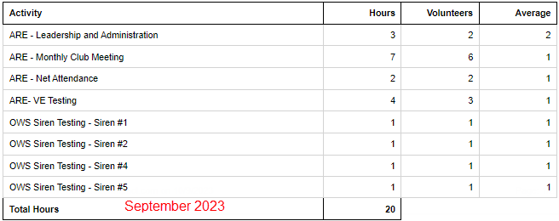
August Hours

Slide 14
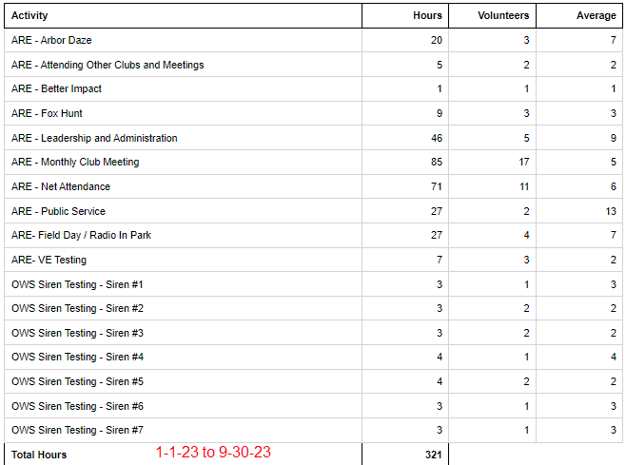
Year To Date Hours

Slide 15

Please log your hours.

Slide 16
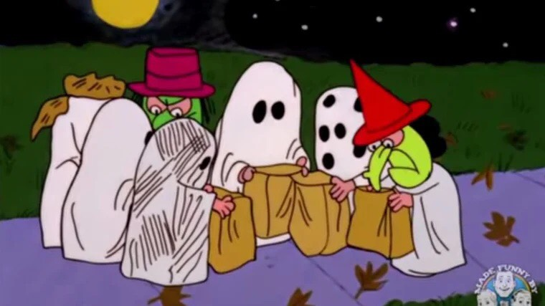
Trunk or Treat
October 28, 1700 - 1900
Supplies: 300 gift bags
Flash lights: $65.00
Band-aids: $25.00
Life Savers: $25.00
Baggies: $25.00
Total: $140.00

Slide 17

Cabin (w/full hookups outside) $45/night + Entrance
Number of Sites: 11 People per Site: 8
Cabins 1 - 11 do not have a bathroom; they do have full hookups for RVs. A 6 percent state tax and 7 percent local occupancy tax are charged on these cabins. They have heating and air-conditioning, as well as bunk beds to sleep five. Linens and pillows are not provided. Pets are not allowed inside the cabin, but are allowed in the area. Tents or RVs are allowed outside.
Texas State Parks On The Air
Fort Richardson State Park, April 20 & 21, 2024, Reserve by November 18th

Slide 18
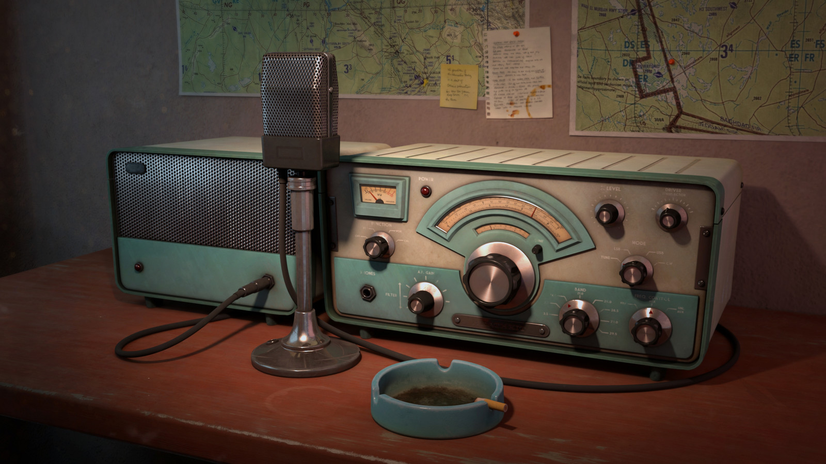
Erik
Greg
Chris
Members

Slide 19
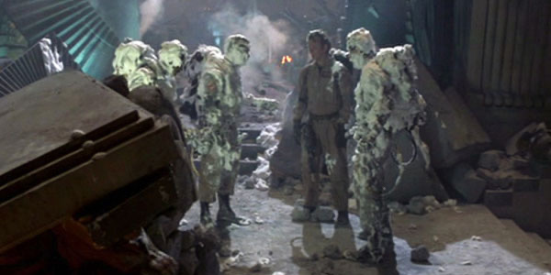
Motion To Adjourn

