Slide 1


Slide 2
November 8, 2023

Slide 3
Introductions

Slide 4
Member Updates

Slide 5
Minutes

Slide 6
Treasurer’s Report

Slide 7

C.E.R.T Update

Slide 8

C.E.R.T Radio Shirt
19 T-shirts ordered so far.
EULESS CERT COMMUNICATIONS | No Pocket | Pocket | No Pocket 10 and Up | Pocket 10 and Up | No Pocket 20 and Up | Pocket 20 and Up
S-XL | 8 | 5 | $20.50 | $26.50 | $17.00 | $23.00
XXL | 6 |  | $23.50 | $29.50 | $20.00 | $26.00
XXXL |  |  | $24.50 | $30.50 | $21.00 | $27.00
XXXXL |  |  | $25.50 | $31.50 | $22.00 | $28.00

Slide 9
Local Happenings

Slide 10
Euless ARC Gatherings
ERBC – Every Friday, @ 0830
Texan Kitchen 415 N Main, Euless, TX 76039
H‑E‑B Joint Radio Club Breakfast, every 3rd Saturday, Egg Haven Cafe, 760 Airport Fwy, Suite 100, Hurst, RSVP by midnight Thursday
Club Social – Monday, November 20, 1800 – 1900 IHOP 2309 W Airport Fwy. Euless, TX 76040

Slide 11
Upcoming Events
November
Club Officer Elections, November 8
State Park on the Air Cabin reservation time, November 18
CERT Team Meeting - November 18 0900

Slide 12
Upcoming Events
December
“A Very Merry Grinchmas” Euless Parade of Lights, Saturday, December 2, Entry Deadline: Monday, Nov. 27
Christmas Party, Wednesday, December 13

Slide 13
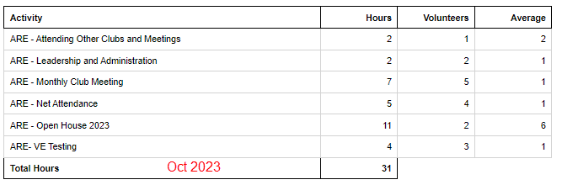
Previous Month Hours

Slide 14
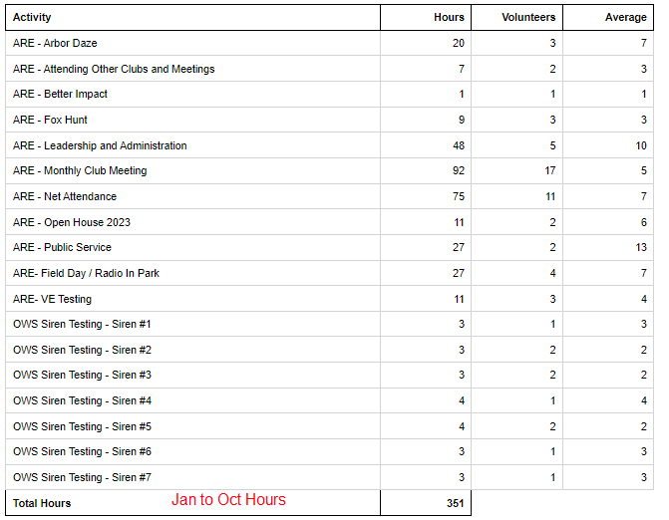
Year To Date Hours

Slide 15
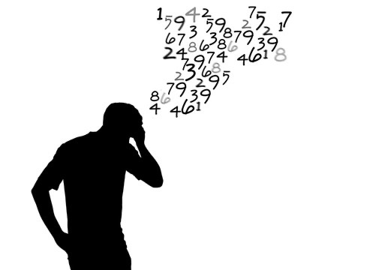
Please log your hours.

Slide 16

Cabin (w/full hookups outside) $45/night + Entrance
Number of Sites: 11 People per Site: 8
Cabins 1 - 11 do not have a bathroom; they do have full hookups for RVs. A 6 percent state tax and 7 percent local occupancy tax are charged on these cabins. They have heating and air-conditioning, as well as bunk beds to sleep five. Linens and pillows are not provided. Pets are not allowed inside the cabin, but are allowed in the area. Tents or RVs are allowed outside.
Reserve by November 18th
Texas State Parks On The Air
Fort Richardson State Park, April 20 & 21, 2024, Reserve by November 18th

Slide 17
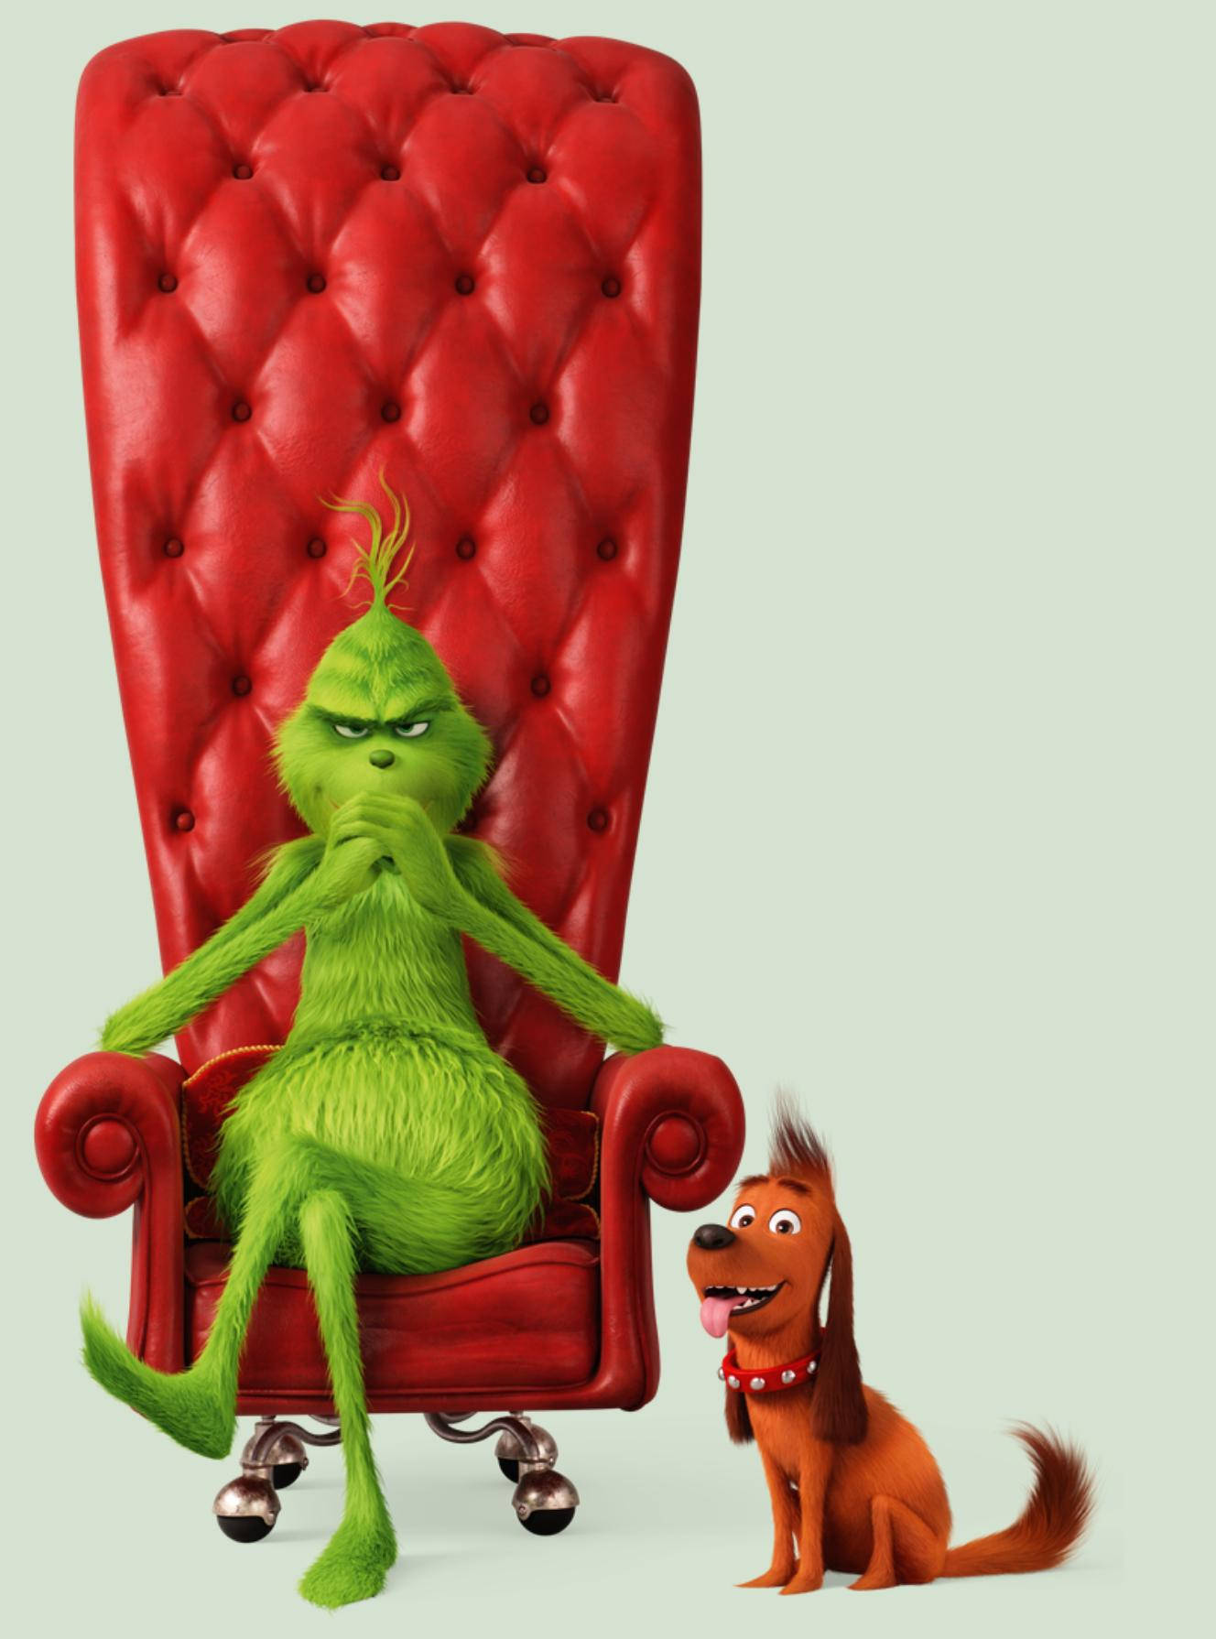
A Very Merry
Grinchmas
Parade of Lights
Saturday, December 2

Slide 18

Annual Christmas Party
December 13, 2023

Slide 19

Club Elections
Record your votes

Slide 20

Erik
Greg
Chris
Members

Slide 21
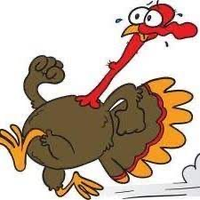
Motion To Adjourn

