Slide 1


Slide 2
July 12, 2023

Slide 3
Introductions

Slide 4
Member Updates

Slide 5
Minutes

Slide 6
Treasurer’s Report

Slide 7

C.E.R.T Update

Slide 8
Local Happenings

Slide 9
Euless ARC Gatherings
ERBC – Every Friday, @ 0830
Texan Kitchen 415 N Main, Euless, TX 76039
Club Social – Monday, July 17th, 1800 – 1900 La Hacienda Ranch 5250 Highway 121, Colleyville, TX 76034

Slide 10
Upcoming Events
July
CERT Team Meeting, Saturday, July 15, 0900-1200, EPD Training Room (Here)
Metrocrest Amateur Radio Society Radio Play Day, Saturday, July 15, 10:00-15:00 Carrollton Josey Ranch Lake Library, 1700 Keller Springs Road
Fox Hunt, Sunday, July 16, 0900

Slide 11
Upcoming Events
August
222 MHz and Up Distance Contest, August 5-6, http://www.arrl.org/222-mhz-and-up-distance-contest
2023 ARRL Rocky Mountain Division Convention, August 12 - 13, Albuquerque, New Mexico
EME 2.3 GHz and up, August 12-13, http://www.arrl.org/eme-contest

Slide 12
Upcoming Events
August (Continued)
10 GHz and up - Round 1, August 19-20, http://www.arrl.org/10-ghz-up
Rookie Roundup - RTTY, August 20, http://www.arrl.org/rookie-roundup
Northeast HamXposition, August 25 - 27, ARRL New England Division Convention, Marlborough, Massachusetts

Slide 13
Upcoming Events
September
QSO Today Virtual Ham Expo (online), September 9 - 10, 2023
Red River Radio Amateurs' Hamfest, September 23, ARRL Dakota Division Convention, West Fargo, North Dakota

Slide 14

Field Day
Success!

Slide 15
Field Day
Lessons learned:
Foot Traffic
Heat
Safety
Energy
Grounding
Self Sufficiency
Experiences:
Learning
Teamwork
Camaraderie

Slide 16

Audit Committee
Thank you!

Slide 17
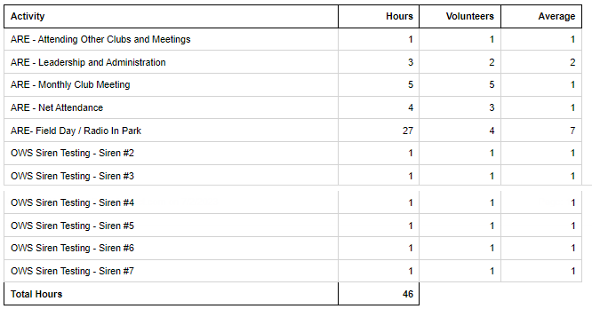
Volunteer Hours

Slide 18

Log your hours.

Slide 19

Looking Ahead

Slide 20

Parks On The Air
(National Parks/Trails/Forests, State Parks/Trails, & International)
Activators are those amateurs who operate portable from within Parks on the Air (POTA) designated parks.
Hunters are those amateurs who make contact with Activators who are operating portable from within Parks on the Air (POTA) designated parks
https://parksontheair.com
https://pota.app/#/

Slide 21

Cabin (w/full hookups outside) $45/night + Entrance
Number of Sites: 11 People per Site: 8
Cabins 1 - 11 do not have a bathroom; they do have full hookups for RVs. A 6 percent state tax and 7 percent local occupancy tax are charged on these cabins. They have heating and air-conditioning, as well as bunk beds to sleep five. Linens and pillows are not provided. Pets are not allowed inside the cabin, but are allowed in the area. Tents or RVs are allowed outside.
Texas State Parks On The Air
Fort Richardson State Park, April 20 & 21

Slide 22

BSA
Amateur Radio Merit Badge

Slide 23

Self-sufficiency

Slide 24
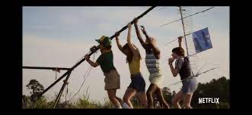
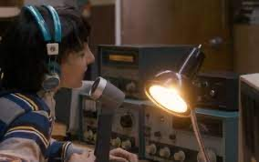

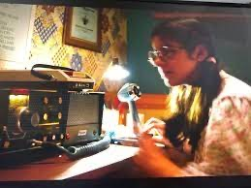
Recruiting & Outreach

Slide 25

Erik
Greg
Chris
Members

Slide 26
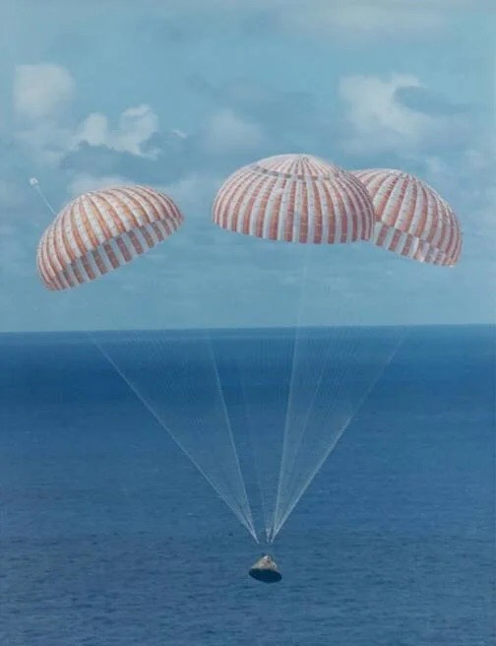
Motion To Adjourn

