Slide 1


Slide 2
April 12, 2023

Slide 3
Member Update

Slide 4
Introductions

Slide 5
Minutes

Slide 6
Treasurer’s Report

Slide 7

C.E.R.T Update

Slide 8
Local Happenings

Slide 9
Euless ARC Gatherings
ERBC – Every Friday, @ 0830
Texan Kitchen 415 N Main, Euless, TX 76039
Club Social – Monday, April. 17th 1800 – 1900
Panera 2911 Highway121, Euless, TX 76039

Slide 10
Upcoming Events
April
Texas State Parks on the Air to Commemorate
Tom King, WK5DX, the Texas Event's Founder
Event Timing: April 15-16, 2023
Event Address: Anywhere your radio is!
Contact us at k5lrk.tx@gmail.com
https://www.tspota.org/home

Slide 11
Upcoming Events
April
(Continued)
World Amateur Radio Day
Tuesday, April 18th 0000 - Wednesday, April 19th 0000
Fox Hunt, April 22nd 0900,
Start from anywhere.
Arbor Daze, Saturday, April 29th,
Midway Park

Slide 12
Upcoming Events
June
Field Day, June 24-25, Details to come…

Slide 13
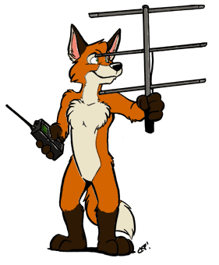
Fox Hunts:
Next date?

Slide 14
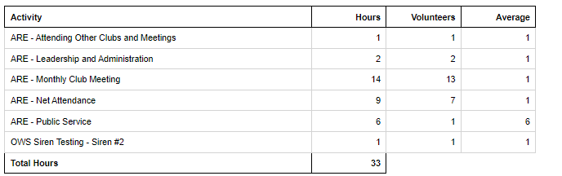
Volunteer Hours

Slide 15

Arbor Daze
April 29, 2023
Committee:
George Smith
Volunteer #2
Volunteer #3

Slide 16

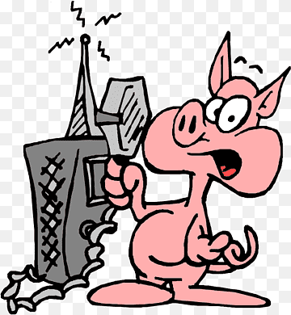
ARE Ham
After Eggs?
2nd & 4th Saturdays 0830-1030 Texan Kitchen 1100-0200 EPD Training Rm *Starting May 13 (Due to Fox Hunt)

Slide 17
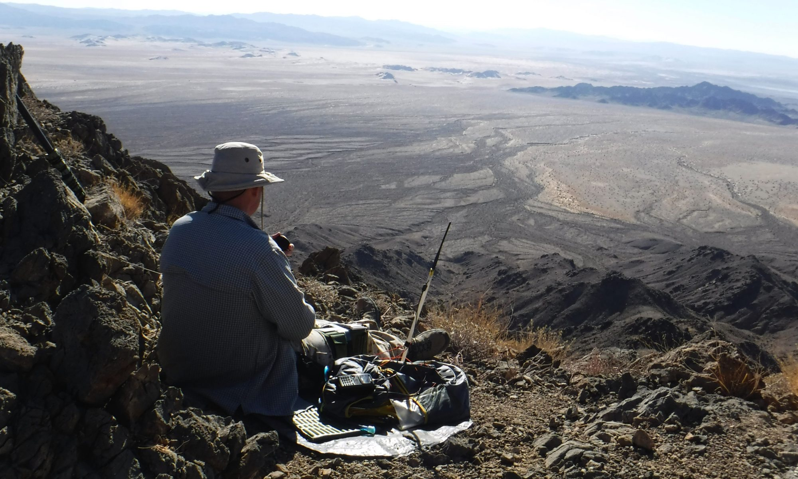
Committee:
Dewey Walker
Volunteer #2
Volunteer #3
Field Day
June 24-25

Slide 18
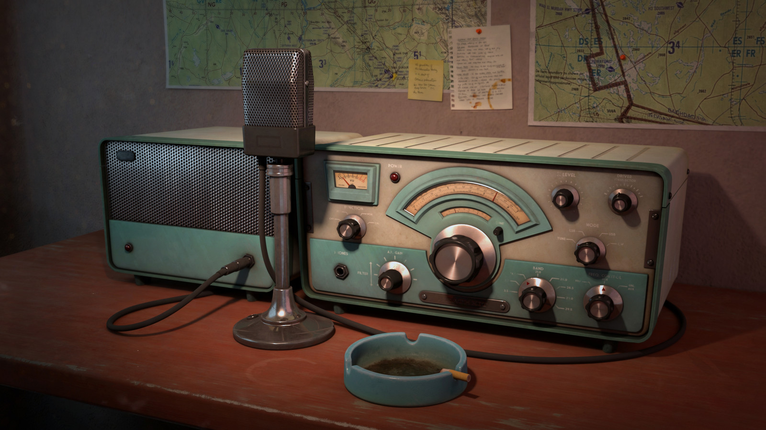
Erik
Greg
Chris
Members
Open Chat

Slide 19

Motion To Adjourn

